Slide 1
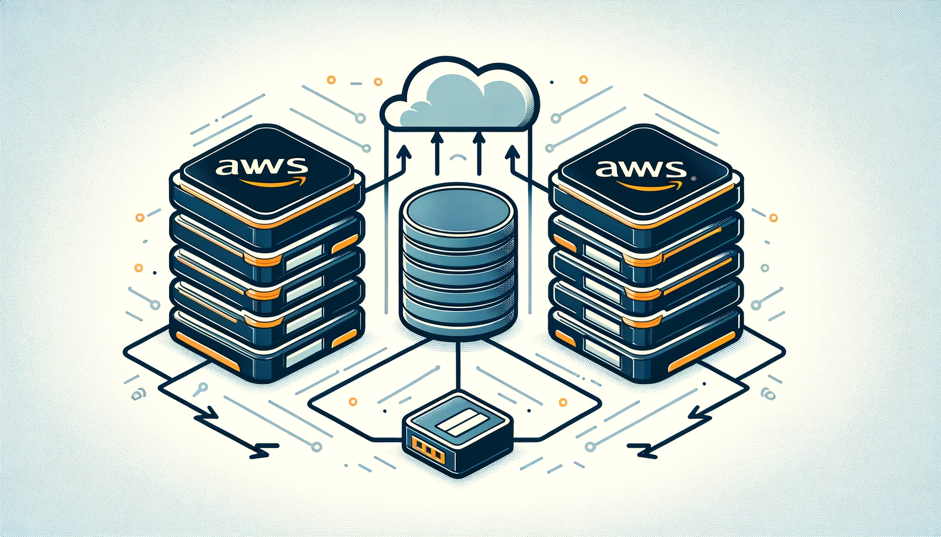
Instance Store in
Fargate:
Efficient Main-Sidecar
container communication?

Slide 2
Thank you,
have a nice day…

Slide 3
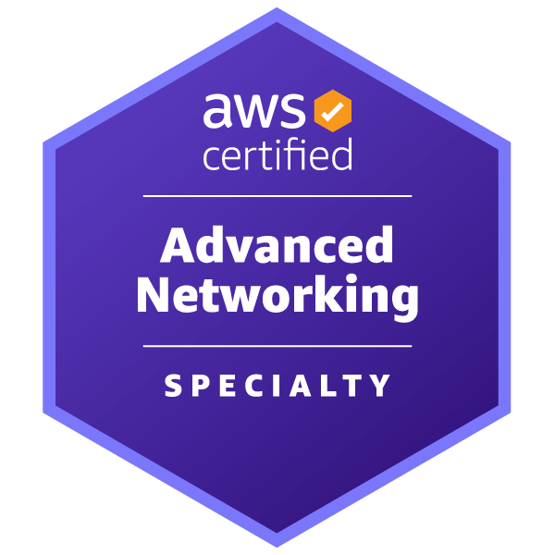
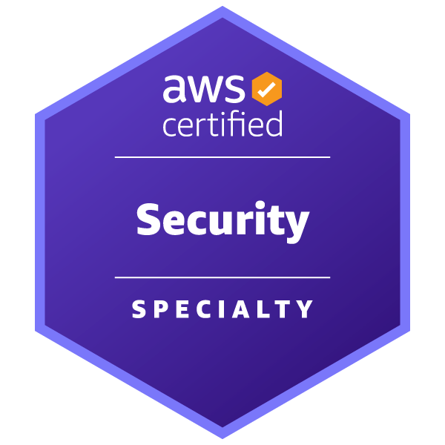
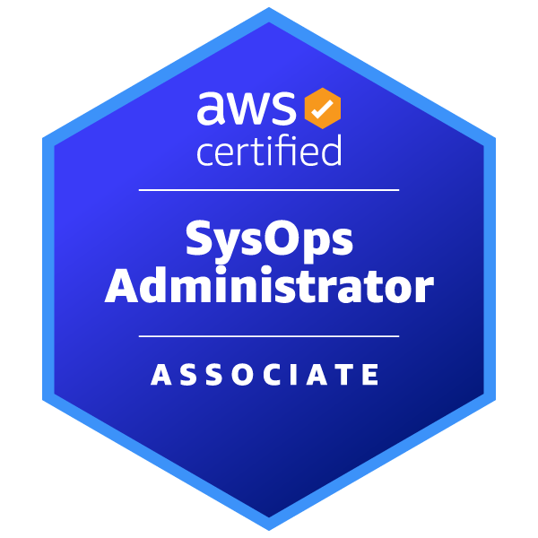
Michal Salanci
Professional Experience
Career Highlights
2011 - 2012
AT&T Global Network Services
24x7 Emergency System Engineer
AT&T Global Network Services
Lead Network Engineer
T-Systems
Senior Network Engineer
T-Systems
Senior DevOps Engineer
AWS Community Builder
AWS User Group Kosice Leader
AWS User Group Meetup Organizer
2012 - 2015
2015 - 2021
Certifications
2021 -
Certifications
Fun fact you might have not known
I hold PhD in history and auxiliary historical sciences
Personal Motto
Who dares wins (British SAS)

Slide 4
CONTAINERS AND AWS
Good old times with on-prem
Containers in EC2
AWS ECS and AWS Fargate

Slide 5
Fargate
ECS
EC2
EC2
EC2
EC2
EC2
EC2
EC2

Slide 6
ECS Task
ECS Service
ECS Cluster
Host ???
CONTAINERS IN AWS

Slide 7
Task 1 – 192.168.2.28
?
?

Slide 8
Task 1 – 192.168.2.28
?
?
?

Slide 9
Fargate instance 1
Task 1 – 192.168.2.28
?
?
Instance Store

Slide 10
Fargate instance 1
Fargate instance n
Task 1 – 192.168.2.28
Squid container
?
?
Task 1 – 192.168.2.28
?
?
Fargate instance x
EFS
Task 1 – 192.168.2.28
Squid container
?

Slide 11
Fargate instance 1
Task 1 – 192.168.2.28
?
?
EFS
Instance Store

Slide 12
SERVERLESS FORWARD PROXY
Customer VPC 1
Customer VPC 2
Private subnet
Private subnet
EC2 instance
EC2 instance
Outbound VPC
Private subnet
Private subnet
Internet Gateway
Public subnet
Transit Gateway att.
Transit Gateway att.
Customer VPC 3
Customer VPC n
Service VPC
NAT Gateway
Private subnet
Private subnet
Inspection subnet
Public subnet
?
EC2 instance
EC2 instance
Log gathering and Analytics:
Athena , Synthetics, etc...
?
AWS NFW
Private subnet
Private subnet
Fargate
AWS NFW endpoint
Forward proxy container
Transit Gateway att.
Transit Gateway att.
Private subnet
Private subnet
Network loadbalaner
Transit Gateway
Transit Gateway att.
Transit Gateway
Transit Gateway att.

Slide 13
Task 1 – 192.168.2.28
Squid container
CloudWatch
Need stdout !

Slide 14
Fargate instance 1
Task 1 – 192.168.2.28
Squid container
CloudWatch
?
Instance Store

Slide 15
Fargate instance 1
Task 1 – 192.168.2.28
Squid container
CloudWatch
Instance Store

Slide 16
Task 1 – 192.168.2.28

Slide 17
Building the squid
Building the FluentBit
Degfining the storage
Defining the magic
CONNECTING THE DOTS

Slide 18
FROM ubuntu
ENV SQUID_CACHE_DIR=/var/spool/squid \
SQUID_LOG_DIR=/var/log/squid \
SQUID_USER=proxy
# update ubuntu and install squid
RUN apt-get update \
&& apt-get install -y squid-openssl \
&& /usr/lib/squid/security_file_certgen -c -s /var/spool/squid/ssl_db -M 4MB \
&& chown -R proxy: /var/spool/squid/ssl_db
COPY whitelist_URL.txt /etc/squid/whitelist_URL.txt
COPY whitelist_IP.txt /etc/squid/whitelist_IP.txt
COPY squid.conf /etc/squid/squid.conf
COPY nobump.acl /etc/squid/nobump.acl
# copy entrypoint script to keep container alive, give it a rights and run it
COPY entrypoint.sh /sbin/entrypoint.sh
RUN chmod 755 /sbin/entrypoint.sh
RUN mkdir /etc/squid/ssl \
&& cd /etc/squid/ssl \
&& openssl genrsa -out haha.key 4096 \
&& openssl req -new -key haha.key -out haha.csr -subj "/C=XX/ST=XX/L=HAHA FPA/O=HAHA FPA/CN=HAHA FPA" \
&& openssl x509 -req -days 3650 -in haha.csr -signkey haha.key -out squid.crt \
&& cat haha.key haha.crt >> haha.pem \
&& chmod +r /etc/squid/ssl/*
EXPOSE 3128/tcp
ENTRYPOINT ["/sbin/entrypoint.sh"]
VOLUME ["/var/log/squid"]
Whitelist.txt
Squid.conf

Slide 19
FROM amazon/aws-for-fluent-bit:stable
ADD fluent-bit-custom.conf /fluent-bit/etc/fluent-bit-custom.conf
VOLUME ["/var/log/squid"]
RUN yum -y update \
&& yum clean all
Custom.conf
[INPUT]
Name tail
Path /var/log/squid/*
Tag sometagicanttell
[OUTPUT]
Name stdout
Match *

Slide 20
TaskDefinition:
Type: AWS::ECS::TaskDefinition
Properties:
Volumes:
- Name: fpav2-ephemeral
ContainerDefinitions:
- Name: squid
MountPoints:
- SourceVolume: fpav2-ephemeral
ContainerPath: /var/log/squid
ReadOnly: false
Image: !Sub path_to_the_image
***
LogConfiguration:
LogDriver: awsfirelens
Options:
Name: stdout
- Name: log_router
MountPoints:
- SourceVolume: fpav2-ephemeral
ContainerPath: /var/log/squid
ReadOnly: true
Image: !Sub path_to_the_image
FirelensConfiguration:
Type: fluentbit
Options:
config-file-type: file
config-file-value: /fluent-bit/etc/fluent-bit-custom.conf
***
LogConfiguration:
LogDriver: awslogs
***
RequiresCompatibilities:
- FARGATE
***
Task 1 – 192.168.2.28

Slide 21
Bro, check the storage for the logs
Modify the log to standart out, as per custom.conf file
STDOUT
Send it to CoudWatch now!
[INPUT]
Name tail
Path /var/log/squid/*
Tag sometagicanttell
[OUTPUT]
Name stdout
Match *

Slide 22
TaskDefinition:
Type: AWS::ECS::TaskDefinition
Properties:
Volumes:
- Name: fpav2-ephemeral
ContainerDefinitions:
- Name: squid
MountPoints:
- SourceVolume: fpav2-ephemeral
ContainerPath: /var/log/squid
ReadOnly: false
Image: !Sub path_to_the_image
***
LogConfiguration:
LogDriver: awsfirelens
Options:
Name: stdout
- Name: log_router
MountPoints:
- SourceVolume: fpav2-ephemeral
ContainerPath: /var/log/squid
ReadOnly: true
Image: !Sub path_to_the_image
FirelensConfiguration:
Type: fluentbit
Options:
config-file-type: file
config-file-value: /fluent-bit/etc/fluent-bit-custom.conf
***
LogConfiguration:
LogDriver: awslogs
***
RequiresCompatibilities:
- FARGATE
***
Task 1 – 192.168.2.28

Slide 23
Fargate instance 1
Fargate instance 2
ECS Cluster
ECS Service
Task 1 – 192.168.2.28
Task 2 192.168.2.69
Squid container
Fluentbit container
Squid container
Fluentbit container
Instance store
Instance store

Slide 24
Thank you
Michal Salanci
michal.salanci@t-systems.com
https://www.linkedin.com/in/michal-salanci-3496724b/
https://michal-salanci.s3.eu-central-1.amazonaws.com/index.html

