Slide 1
More on network security
Forward proxy with
AWS Network Firewall and Fargate
More on network security | Michl Salanci | Deutsche Telekom Systems Solutions Slovakia | AWS Community Days Switzerland | 27. 6. 2024

Slide 2
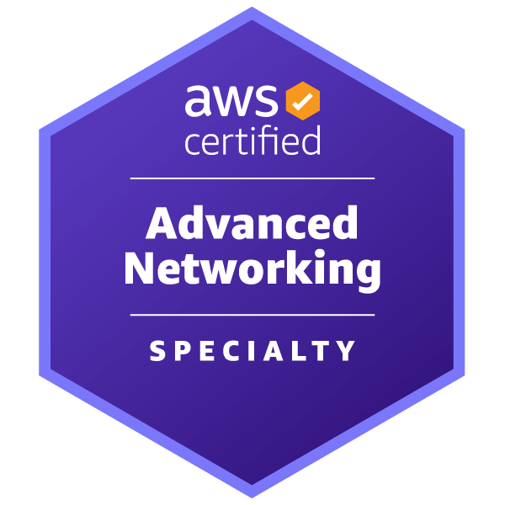
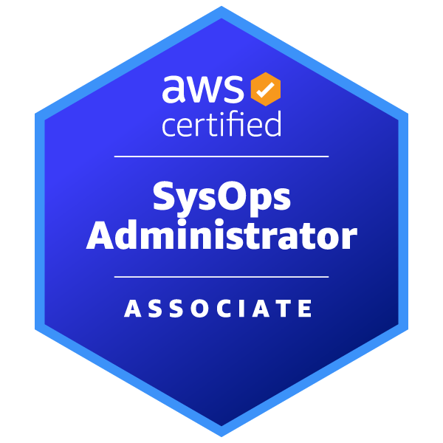
Michal Salanci
Professional Experience
Career Highlights
2011 - 2012
AT&T Global Network Services
24x7 Emergency System Engineer
AT&T Global Network Services
Lead Network Engineer
T-Systems
Senior Network Engineer
T-Systems
Senior DevOps Engineer
AWS Community Builder
AWS User Group Kosice Leader
AWS User Group Meetup Organizer
2012 - 2015
2015 - 2021
Certifications
2021 -
Certifications
Fun fact you might have not known
I hold PhD in history and auxiliary historical sciences
Personal Motto
Who dares wins (British SAS)

Slide 3
Agenda
What is forward proxy ?
Benefits of forward proxy
Explicit vs Transparent
Demand for forward proxy
Forward proxy options in AWS
Expicit proxy setup
Transparet proxy setup
More on network security | Michl Salanci | Deutsche Telekom Systems Solutions Slovakia | AWS Community Days Switzerland | 27. 6. 2024

Slide 4
What is Forward Proxy ?
More on network security | Michl Salanci | Deutsche Telekom Systems Solutions Slovakia | AWS Community Days Switzerland | 27. 6. 2024

Slide 5
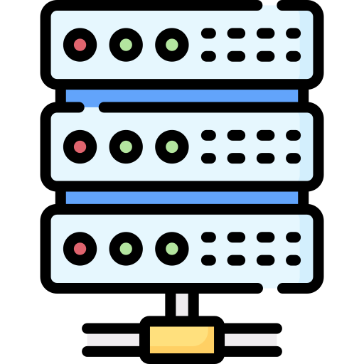
filtering
Forward proxy server
www.somesite.com
More on network security | Michl Salanci | Deutsche Telekom Systems Solutions Slovakia | AWS Community Days Switzerland | 27. 6. 2024

Slide 6
Benefits of forward proxy
Security
Caching
Logging
More on network security | Michl Salanci | Deutsche Telekom Systems Solutions Slovakia | AWS Community Days Switzerland | 27. 6. 2024

Slide 7
Benefits of forward proxy
Access Control and Content Filtering
Anonymity and Privacy
Performance and Caching
Logging and Monitoring
More on network security | Michl Salanci | Deutsche Telekom Systems Solutions Slovakia | AWS Community Days Switzerland | 27. 6. 2024

Slide 8
Explicit vs Transparent
TCP termination
Listenng
Client configuration
Bypassing
More on network security | Michl Salanci | Deutsche Telekom Systems Solutions Slovakia | AWS Community Days Switzerland | 27. 6. 2024

Slide 9
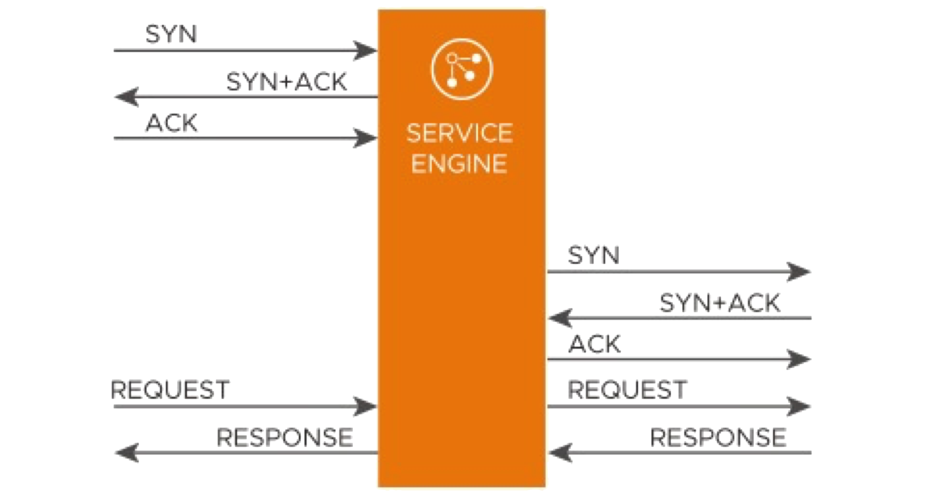
TCP session termination
Explicit
Transparent
Client
Forward Proxy
Server
Client
Forward Proxy
Server
Webserver
Webserver
More on network security | Michl Salanci | Deutsche Telekom Systems Solutions Slovakia | AWS Community Days Switzerland | 27. 6. 2024

Slide 10
Listening the traffic
Explicit
Transparent
myproxy.com:3128
Client
Forward Proxy
Server
Client
Forward Proxy
Server
Webserver
Webserver
More on network security | Michl Salanci | Deutsche Telekom Systems Solutions Slovakia | AWS Community Days Switzerland | 27. 6. 2024

Slide 11
Configuration on client’s side
Explicit
Transparent
curl -x http://myproxy.com:3128 https://www.amazon.com
curl http://www.amazon.com
myproxy.com:3128
myproxy.com:3128
Client
Forward Proxy
Server
Client
Forward Proxy
Server
www.amazon.com
www.amazon.com
More on network security | Michl Salanci | Deutsche Telekom Systems Solutions Slovakia | AWS Community Days Switzerland | 27. 6. 2024

Slide 12
Bypassing the proxy
Explicit
Transparent
curl -x http://www.amazon.com
curl -x http://myproxy.com:3128 http://www.amazon.com
curl http://www.amazon.com
myproxy.com:3128
Client
Forward Proxy
Server
Client
Forward Proxy
Server
www.amazon.com
www.amazon.com
More on network security | Michl Salanci | Deutsche Telekom Systems Solutions Slovakia | AWS Community Days Switzerland | 27. 6. 2024

Slide 13
Demand for forward proxy
Why do we need it ?
More on network security | Michl Salanci | Deutsche Telekom Systems Solutions Slovakia | AWS Community Days Switzerland | 27. 6. 2024

Slide 14
Customer VPC 1
Customer VPC 2
Serverless forward proxy
Private subnet
Private subnet
Public subnet
EC2 instance
EC2 instance
NAT Gateway
Outbound VPC
Private subnet
Private subnet
Internet Gateway
Internet Gateway
Public subnet
Transit Gateway att.
Transit Gateway att.
Customer VPC 3
Customer VPC n
NAT Gateway
Private subnet
Private subnet
EC2 instance
EC2 instance
Private subnet
Private subnet
Transit Gateway att.
Transit Gateway att.
Private subnet
Transit Gateway
Transit Gateway att.
More on network security | Michl Salanci | Deutsche Telekom Systems Solutions Slovakia | AWS Community Days Switzerland | 27. 6. 2024

Slide 15
Customer VPC 1
Customer VPC 2
Serverless forward proxy
Private subnet
Private subnet
EC2 instance
EC2 instance
Outbound VPC
Private subnet
Private subnet
Internet Gateway
Public subnet
Transit Gateway att.
Transit Gateway att.
Customer VPC 3
Customer VPC n
Service VPC
NAT Gateway
Private subnet
Private subnet
EC2 instance
EC2 instance
Log gathering and Analytics:
Athena , Synthetics, etc...
Private subnet
Private subnet
Transit Gateway att.
Transit Gateway att.
Private subnet
Private subnet
Transit Gateway
Transit Gateway
Transit Gateway att.
More on network security | Michl Salanci | Deutsche Telekom Systems Solutions Slovakia | AWS Community Days Switzerland | 27. 6. 2024

Slide 16
Customer VPC 1
Customer VPC 2
Serverless forward proxy
Private subnet
Private subnet
EC2 instance
EC2 instance
Outbound VPC
Private subnet
Private subnet
Internet Gateway
Public subnet
Transit Gateway att.
Transit Gateway att.
Customer VPC 3
Customer VPC n
Service VPC
NAT Gateway
Private subnet
Private subnet
EC2 instance
EC2 instance
Whitelist
Log gathering and Analytics:
Athena , Synthetics, etc...
Logs in CloudWatch
Private subnet
Private subnet
Transit Gateway att.
Transit Gateway att.
Private subnet
Private subnet
Transit Gateway
Transit Gateway att.
Transit Gateway
Transit Gateway att.
More on network security | Michl Salanci | Deutsche Telekom Systems Solutions Slovakia | AWS Community Days Switzerland | 27. 6. 2024

Slide 17
Forward proxy options in AWS
3rd party proxy in EC2 / Container
3rd party appliance in GWLB
AWS native options
More on network security | Michl Salanci | Deutsche Telekom Systems Solutions Slovakia | AWS Community Days Switzerland | 27. 6. 2024

Slide 18
EC2 vs Serverless ?
AWS native vs 3rd party?
More on network security | Michl Salanci | Deutsche Telekom Systems Solutions Slovakia | AWS Community Days Switzerland | 27. 6. 2024

Slide 19
In EC2? Serverless? AWS Native? 3rd party?
Squid Proxy
Squid Proxy
NGINX
NGINX
Fargate
HA Proxy
EC2
HA Proxy
More on network security | Michl Salanci | Deutsche Telekom Systems Solutions Slovakia | AWS Community Days Switzerland | 27. 6. 2024

Slide 20
In EC2? Serverless? AWS Native? 3rd party?
Palo Alto NFW
Firepower
BIG-IP LTM/APM
GW LoadBalancer
Fortigate
More on network security | Michl Salanci | Deutsche Telekom Systems Solutions Slovakia | AWS Community Days Switzerland | 27. 6. 2024

Slide 21
In EC2? Serverless? AWS Native? 3rd party?
VPC
Stateful rules
Inspection subnet
Stateless rules
Domain name rules
Suricata compatible rules
AWS Network Firewall endpoint
AWS Network Firewall
More on network security | Michl Salanci | Deutsche Telekom Systems Solutions Slovakia | AWS Community Days Switzerland | 27. 6. 2024

Slide 22
Transparent proxy decision
Inspection subnet
Squid Proxy
Squid Proxy
NGINX
NGINX
AWS NFW
EC2
HA Proxy
Fargate
HA Proxy
AWS NFW endpoint
Palo Alto NFW
Inspection subnet
Firepower
BIG-IP LTM/APM
AWS Network Firewall endpoint
GW LB
AWS Network Firewall
Fortigate
More on network security | Michl Salanci | Deutsche Telekom Systems Solutions Slovakia | AWS Community Days Switzerland | 27. 6. 2024

Slide 23
Explicit proxy decision
Inspection subnet
Squid Proxy
Squid Proxy
Squid Proxy
NGINX
NGINX
EC2
HA Proxy
Fargate
HA Proxy
Fargate
Forward proxy ECS Task
Palo Alto NFW
Inspection subnet
Firepower
BIG-IP LTM/APM
AWS Network Firewall endpoint
GW LB
AWS Network Firewall
Fortigate
More on network security | Michl Salanci | Deutsche Telekom Systems Solutions Slovakia | AWS Community Days Switzerland | 27. 6. 2024

Slide 24
Serverless forward proxy
Inspection subnet
Explicit
Transparent
Squid Proxy
AWS NFW
FluentBit
Fargate
AWS NFW endpoint
Forward proxy ECS Task
More on network security | Michl Salanci | Deutsche Telekom Systems Solutions Slovakia | AWS Community Days Switzerland | 27. 6. 2024

Slide 25
Customer VPC 1
Customer VPC 2
Serverless forward proxy
Private subnet
Private subnet
EC2 instance
EC2 instance
Outbound VPC
Private subnet
Private subnet
Internet Gateway
Public subnet
Transit Gateway att.
Transit Gateway att.
Inspection subnet
Customer VPC 3
Customer VPC n
Service VPC
NAT Gateway
Private subnet
Private subnet
Squid Proxy
Whitelist
EC2 instance
EC2 instance
Squid Proxy
Log gathering and Analytics:
Athena , Synthetics, etc...
Logs in CloudWatch
AWS NFW
Private subnet
Private subnet
FluentBit
AWS NFW
Fargate
AWS NFW endpoint
Forward proxy ECS Task
FluentBit
AWS NFW endpoint
Transit Gateway att.
Transit Gateway att.
Private subnet
Private subnet
Fargate
Forward proxy ECS Task
Transit Gateway
Transit Gateway att.
Transit Gateway
Transit Gateway att.
More on network security | Michl Salanci | Deutsche Telekom Systems Solutions Slovakia | AWS Community Days Switzerland | 27. 6. 2024

Slide 26
Explitit proxy setup
Building the images
Introducing fluentbit
Setting up the squid
Rule example
More on network security | Michl Salanci | Deutsche Telekom Systems Solutions Slovakia | AWS Community Days Switzerland | 27. 6. 2024

Slide 27
Building a Squid image
FROM ubuntu
ENV SQUID_CACHE_DIR=/var/spool/squid \
SQUID_LOG_DIR=/var/log/squid \
SQUID_USER=proxy
# update ubuntu and install squid
RUN apt-get update \
&& apt-get install -y squid-openssl \
&& /usr/lib/squid/security_file_certgen -c -s /var/spool/squid/ssl_db -M 4MB \
&& chown -R proxy: /var/spool/squid/ssl_db
COPY whitelist_URL.txt /etc/squid/whitelist_URL.txt
COPY whitelist_IP.txt /etc/squid/whitelist_IP.txt
COPY squid.conf /etc/squid/squid.conf
COPY nobump.acl /etc/squid/nobump.acl
# copy entrypoint script to keep container alive, give it a rights and run it
COPY entrypoint.sh /sbin/entrypoint.sh
RUN chmod 755 /sbin/entrypoint.sh
RUN mkdir /etc/squid/ssl \
&& cd /etc/squid/ssl \
&& openssl genrsa -out haha.key 4096 \
&& openssl req -new -key haha.key -out haha.csr -subj "/C=XX/ST=XX/L=HAHA FPA/O=HAHA FPA/CN=HAHA FPA" \
&& openssl x509 -req -days 3650 -in haha.csr -signkey haha.key -out squid.crt \
&& cat haha.key haha.crt >> haha.pem \
&& chmod +r /etc/squid/ssl/*
EXPOSE 3128/tcp
ENTRYPOINT ["/sbin/entrypoint.sh"]
VOLUME ["/var/log/squid"]
Whitelist.txt
Squid.conf
entrypoint.sh
*.amazon.com
*.google.com
More on network security | Michl Salanci | Deutsche Telekom Systems Solutions Slovakia | AWS Community Days Switzerland | 27. 6. 2024

Slide 28
Task 1 – 192.168.2.28
Squid container
CloudWatch
Need stdout !
More on network security | Michl Salanci | Deutsche Telekom Systems Solutions Slovakia | AWS Community Days Switzerland | 27. 6. 2024

Slide 29
Fargate instance 1
Task 1 – 192.168.2.28
Squid container
CloudWatch
Instance Store
More on network security | Michl Salanci | Deutsche Telekom Systems Solutions Slovakia | AWS Community Days Switzerland | 27. 6. 2024

Slide 30
Building a FluentBit image
FROM amazon/aws-for-fluent-bit:stable
ADD fluent-bit-custom.conf /fluent-bit/etc/fluent-bit-custom.conf
VOLUME ["/var/log/squid"]
RUN yum -y update \
&& yum clean all
Custom.conf
[INPUT]
Name tail
Path /var/log/squid/*
Tag sometagicanttell
[OUTPUT]
Name stdout
Match *
More on network security | Michl Salanci | Deutsche Telekom Systems Solutions Slovakia | AWS Community Days Switzerland | 27. 6. 2024

Slide 31
TaskDefinition:
Type: AWS::ECS::TaskDefinition
Properties:
Family: !Join ['-', [‘proxy', !ImportValue VpcName]]
Volumes:
- Name: fpav2-ephemeral
ContainerDefinitions:
- Name: squid
MountPoints:
- SourceVolume: fpav2-ephemeral
ContainerPath: /var/log/squid
ReadOnly: false
Image: path_to_the_image
Cpu: 0
PortMappings:
- ContainerPort: 3128
HostPort: 3128
MemoryReservation: 1000
Essential: true
LogConfiguration:
LogDriver: awsfirelens
Options:
Name: stdout
***
- Name: log_router
MountPoints:
- SourceVolume: fpav2-ephemeral
ContainerPath: /var/log/squid
ReadOnly: true
Image: path_to_the_image
FirelensConfiguration:
Type: fluentbit
Options:
config-file-type: file
config-file-value: /fluent-bit/etc/fluent-bit-custom.conf
Cpu: 0
MemoryReservation: 1000
DependsOn:
- ContainerName: squid
Condition: START
Essential: true
LogConfiguration:
LogDriver: awslogs
***
Cpu: '2048'
Memory: '4096'
NetworkMode: awsvpc
RequiresCompatibilities:
- FARGATE
Connecting the dots in ECS Task
Fargate instance
Task 1 – 192.168.2.28
More on network security | Michl Salanci | Deutsche Telekom Systems Solutions Slovakia | AWS Community Days Switzerland | 27. 6. 2024

Slide 32
Make explicit the explicit
Inspection subnet – 192.168.2.0/24
Squid Proxy
curl –x internal-fwdproxynlb-1234567890-eu-central-1.elb.amazonaws.com:3128
–I http://www.amazon.coma
FluentBit
Fargate
Squid in ECS container
Forward proxy ECS Task
Private subnet – 192.168.3.0/24
Network LB
internal-fwdproxynlb-1234567890-eu-central-1.elb.amazonanaws.com
192.168.3.10
Network LB
internal-fwdproxynlb-1234567890-eu-central-1.elb.amazonanaws.com
192.168.3.10
Network Loadbalancer
More on network security | Michl Salanci | Deutsche Telekom Systems Solutions Slovakia | AWS Community Days Switzerland | 27. 6. 2024

Slide 33
Inspection subnet
Squid Proxy
Squid Proxy
Squid Proxy
Squid Proxy
FluentBit
FluentBit
FluentBit
FluentBit
ECS Task 192.168.2.33
ECS Task 192.168.2.112
ECS Task 192.168.2.247
ECS Task 192.168.2.¸148
curl –x internal-fwdproxynlb-1234567890-eu-central-1.elb.amazonaws.com:3128
–I http://www.amazon.coma
Private subnet
Network LB
internal-fwdproxynlb-1234567890-eu-central-1.elb.amazonanaws.com
192.168.3.10
More on network security | Michl Salanci | Deutsche Telekom Systems Solutions Slovakia | AWS Community Days Switzerland | 27. 6. 2024

Slide 34
Make explicit the explicit
Inspection subnet – 192.168.2.0/24
Client sends request
Hits ECS Task
Squid inspects it against the whitelist
Go or nogo
Squid Proxy
curl –x internal-fwdproxynlb-1234567890-eu-central-1.elb.amazonaws.com
–I http://www.amazon.com
FluentBit
Fargate
Squid in ECS container
Forward proxy ECS Task
Private subnet – 192.168.3.0/24
Network LB
internal-fwdproxynlb-1234567890-eu-central-1.elb.amazonanaws.com
192.168.3.10
Network LB
internal-fwdproxynlb-1234567890-eu-central-1.elb.amazonanaws.com
192.168.3.10
Network Loadbalancer
More on network security | Michl Salanci | Deutsche Telekom Systems Solutions Slovakia | AWS Community Days Switzerland | 27. 6. 2024

Slide 35
Transparent proxy setup
Setting up Network Firewall
Logging
More on network security | Michl Salanci | Deutsche Telekom Systems Solutions Slovakia | AWS Community Days Switzerland | 27. 6. 2024

Slide 36
AWS Network Fireall – the good news
Managed L3-L7 firewall
VPC
“Unbreakable“ as it scales up as needed
Inspection subnet
Solid speed of rule inspection
No TCP termination
Direct integration with CloudWatch
Supports multiple ruletypes
Stateful
Stateless
Domain
Suricata
AWS Network Firewall endpoint
AWS Network Firewall
More on network security | Michl Salanci | Deutsche Telekom Systems Solutions Slovakia | AWS Community Days Switzerland | 27. 6. 2024

Slide 37
AWS Network Fireall – the bad news
VPC
Inspection subnet
Blocked domain visible only
CloudWatch logs significant delay
AWS Network Firewall endpoint
AWS Network Firewall
More on network security | Michl Salanci | Deutsche Telekom Systems Solutions Slovakia | AWS Community Days Switzerland | 27. 6. 2024

Slide 38
AWS Network Fireall – another good news and bad news
VPC
Inspection subnet
Blocked domain visible only
CloudWatch logs significant delay
AWS Network Firewall endpoint
AWS Network Firewall
More on network security | Michl Salanci | Deutsche Telekom Systems Solutions Slovakia | AWS Community Days Switzerland | 27. 6. 2024

Slide 39
AWS Network Firewall setup
Rules
Rule Groups
Policy
Setting up an action
Grouping the rules
Default action
Priority of a Rule Groups
Evaluation ordering (Action, Strict)
Logging
5-tuple rules only
srcIP, scrPort, dstIP, dstPort, Protocol
Action: Pass, Drop, fwd to Stateful
Stateless - L3-L4
5-tuple, domain, suricata
srcIP, scrPort, dstIP, dstPort, Protocol
Action: Pass, Drop, Reject, Alert
Stateful – L3-L7
More on network security | Michl Salanci | Deutsche Telekom Systems Solutions Slovakia | AWS Community Days Switzerland | 27. 6. 2024

Slide 40
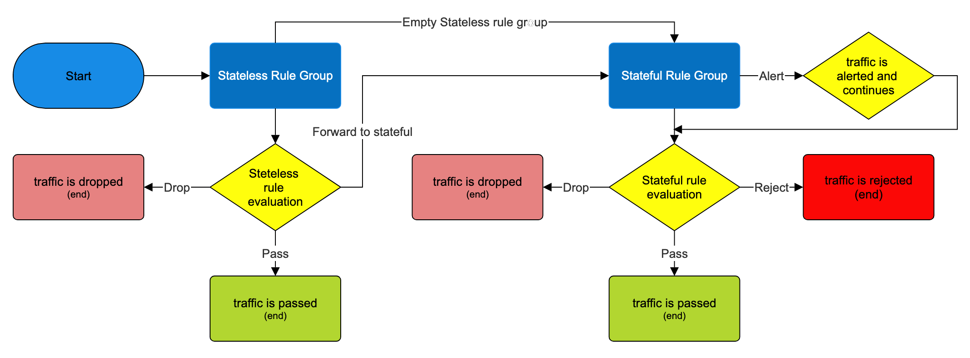
More on network security | Michl Salanci | Deutsche Telekom Systems Solutions Slovakia | AWS Community Days Switzerland | 27. 6. 2024

Slide 41
Firewall Policy for rule ordering nand RuleGroup Priority
Evaluation ordering (Action (previously known as Default) or Strict)
In which order the policy evaluates the rules
Rule Group Priority
How can we prioritise rulegroups
More on network security | Michl Salanci | Deutsche Telekom Systems Solutions Slovakia | AWS Community Days Switzerland | 27. 6. 2024

Slide 42
Action (Default) ordering
Takes the all rules from the all the rulegroups and act as there is a single rule group
Evaluation order is:
Pass
Drop
Reject
Alert
More on network security | Michl Salanci | Deutsche Telekom Systems Solutions Slovakia | AWS Community Days Switzerland | 27. 6. 2024

Slide 43
Action (Default) ordering
Rule Group 1
drop rule for 20.0.0.0/16
Pass
Drop
Reject
Alert
pass rule for everything
drop rule for 20.0.0.0/16
Rule Group 2
pass rule for everything
More on network security | Michl Salanci | Deutsche Telekom Systems Solutions Slovakia | AWS Community Days Switzerland | 27. 6. 2024

Slide 44
Policy with Strict ordering
Takes the rulegroups based on their priority, and evaluates rulegroup each separately
Within the rulegroup, the evaluation order is sequentional
More on network security | Michl Salanci | Deutsche Telekom Systems Solutions Slovakia | AWS Community Days Switzerland | 27. 6. 2024

Slide 45
Strict ordering
Rule Group 1
drop rule for 20.0.0.0/16
Rule Group 1
drop rule for 20.0.0.0/16
Based on RG priority
Rule Group 2
allow rule for everything
Rule Group 2
allow rule for everything
More on network security | Michl Salanci | Deutsche Telekom Systems Solutions Slovakia | AWS Community Days Switzerland | 27. 6. 2024

Slide 46
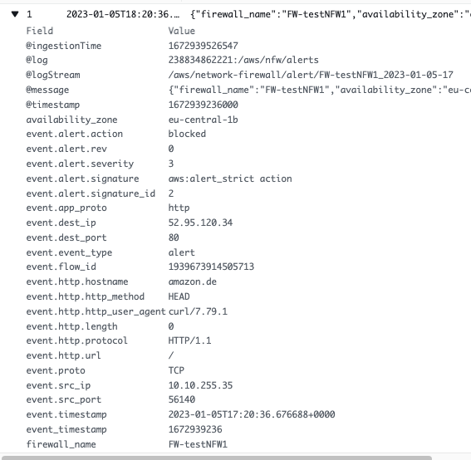
Fun with logging #1
Blocked domain and IP visible
More on network security | Michl Salanci | Deutsche Telekom Systems Solutions Slovakia | AWS Community Days Switzerland | 27. 6. 2024

Slide 47
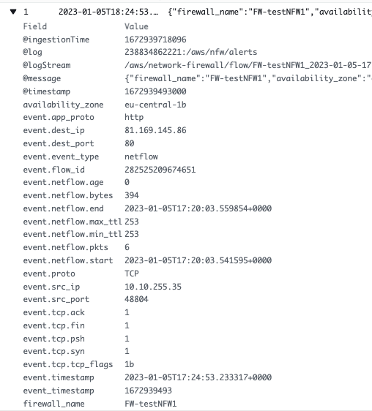
Fun with logging #1
Allowed IP visible only
More on network security | Michl Salanci | Deutsche Telekom Systems Solutions Slovakia | AWS Community Days Switzerland | 27. 6. 2024

Slide 48
Fun with logging #1
Allowed IP visible only
More on network security | Michl Salanci | Deutsche Telekom Systems Solutions Slovakia | AWS Community Days Switzerland | 27. 6. 2024

Slide 49
Fun with logging #1 workaround
1. Policy with strict order
2. Default actions set to ‚Drop estabished‘ and ‚Alert Established‘
3. Alert rule for every pass rule
More on network security | Michl Salanci | Deutsche Telekom Systems Solutions Slovakia | AWS Community Days Switzerland | 27. 6. 2024

Slide 50
pass http any any -> any any (http.host; content:”amazon.com"; endswith; sid:5 rev:1;)
alert http any any -> any any (http.host; content :”amazon.com"; endswith; sid:5; rev:1;)
pass http any any -> any any (http.host; content:”amazon.com"; endswith; sid:50; rev:1;)
pass tls any any -> any any (tls.sni; content:" amazon.com "; endswith; sid:6; rev:1;)
pass http any any -> any any (http.host; content:" amazon.com "; endswith; sid:60; rev:1;)
alert tls any any -> any any (tls.sni; content:" amazon.com "; endswith; sid:60; rev:1;)
pass tls any any -> any any (tls.sni; content:" amazon.com "; endswith; sid:6; rev:1;)
alert http any any -> any any (http.host; content :”amazon.com"; endswith; sid:50; rev:1;)
pass http any any -> any any (http.host; content:" amazon.com "; endswith; sid:5; rev:1;)
More on network security | Michl Salanci | Deutsche Telekom Systems Solutions Slovakia | AWS Community Days Switzerland | 27. 6. 2024

Slide 51
alert tls any any <> any any (msg:"pass all tls traffic from/to whitelisted IPs"; sid:2;)
alert http any any <> any any (msg:"pass all http traffic from/to whitelisted IPs"; sid:4;)
pass tls any any -> any any (tls.sni; content:" amazon.com"; endswith; sid:6; rev:1;)
pass http any any -> any any (http.host; content:" amazon.com "; endswith; sid:5; rev:1;)
pass tls any any -> any any (tls.sni; content:" google.com "; endswith; sid:7; rev:1;)
pass http any any -> any any (http.host; content:" google.com "; endswith; sid:8; rev:1;)
pass tls any any -> any any (tls.sni; content:"github.com"; endswith; sid:9; rev:1;)
pass http any any -> any any (http.host; content:" github.com "; endswith; sid:10; rev:1;)
pass tls any any -> any any (tls.sni; content:”nhl.com"; endswith; sid:11; rev:1;)
pass http any any -> any any (http.host; content:" nhl.com "; endswith; sid:12; rev:1;)
reject tcp any any -> any any (flow:established; msg:"no pass or alert rule hit - sending TCP RST"; sid:5000; rev:1;)
More on network security | Michl Salanci | Deutsche Telekom Systems Solutions Slovakia | AWS Community Days Switzerland | 27. 6. 2024

Slide 52
Fun with logging #2
Logging delay between NFW and CloudWatch
Usually 3-5 minutes
More on network security | Michl Salanci | Deutsche Telekom Systems Solutions Slovakia | AWS Community Days Switzerland | 27. 6. 2024

Slide 53
Automatic deploymend
Merge request by customer
Outbound VPC
Whitelist entry updated
Suricata ruleset update
New container deployed
More on network security | Michl Salanci | Deutsche Telekom Systems Solutions Slovakia | AWS Community Days Switzerland | 27. 6. 2024

Slide 54
Client VPC 10.0.0.0/16
Transparent proxy
network flow
Outbound VPC – 192.168.0.0/16
Public subnet
192.168.0.0/16 | Local
10.0.0.0/16 | NFW
0.0.0.0/0 | IGW
Public subnet – 192.168.1.0/24
VPC main RT
10.0.0.0/16 | Local
0.0.0.0/0 | TGW
192.168.1.20
3.48.29.55
Private subnet 1 – 10.0.1.0/24
Inspection subnet
192.168.0.0/16 | Local
10.0.0.0/16 | TGW
0.0.0.0/0 | NATGW
Inspection subnet – 192.168.2.0/24
curl –I http://www.amazon.com
10.0.1.130
192.168.2.28
Private subnet 2 – 10.0.2.0/24
Private subnet
192.168.0.0/16 | Local
0.0.0.0/0 | NFW
Private subnet – 192.168.3.0/24
www.amazon.com
internal-fwdproxynlb-1234567890-eu-central-1.elb.amazonaws.com
192.168.3.10
Transity Gateway RT
10.0.0.0/16 | Client VPC TGW attachment
192.168.0.0/16 | Outbound VPC TGW attachment
0.0.0.0/0 | Outbound VPC TGW attachment
More on network security | Michl Salanci | Deutsche Telekom Systems Solutions Slovakia | AWS Community Days Switzerland | 27. 6. 2024

Slide 55
Client VPC 10.0.0.0/16
Explicit proxy
network flow
Outbound VPC– 192.168.0.0/16
Public subnet
192.168.0.0/16 | Local
10.0.0.0/16 | NFW
0.0.0.0/0 | IGW
Public subnet – 192.168.1.0/24
VPC main RT
10.0.0.0/16 | Local
0.0.0.0/0 | TGW
192.168.1.20
3.48.29.55
Private subnet 1 – 10.0.1.0/24
Inspection subnet
192.168.0.0/16 | Local
10.0.0.0/16 | TGW
0.0.0.0/0 | NATGW
Inspection subnet – 192.168.2.0/24
curl –x internal-fwdproxynlb-1234567890-eu-central-1.elb.amazonaws.com
–I http://www.amazon.com
10.0.1.130
192.168.2.28
Private subnet 2 – 10.0.2.0/24
Private subnet
192.168.0.0/16 | Local
0.0.0.0/0 | NFW
Private subnet – 192.168.3.0/24
www.amazon.com
internal-fwdproxynlb-1234567890-eu-central-1.elb.amazonaws.com
192.168.3.10
SRC | DST
TCP Termination Webpage IP : 192.168.2.28 (Task IP) | 192.168.2.28 (Task IP) 10.0.1.130 (EC2 IP)
SRC | DST
NAT 192.168.2.28 (ECS Task IP) : 3.48.29.55 (NATGW IP) | Webpage IP
SRC | DST
Webpage IP | 3.48.29.55 (NATGW IP)
SRC | DST
TCP Termination 10.1.0.130 : 192.168.2.28 (ECS Task IP) | Network LoadBalancer 192.168.3.10 Webpage IP
SRC | DST
10.0.1.130 (EC2 IP) | Network LoadBalancer 192.168.3.10
SRC | DST
Webpage IP | NAT 3.48.29.55 (NATGW IP) : 192.168.2.28 (Task IP)
Transity Gateway RT
10.0.0.0/16 | Client VPC TGW attachment
192.168.0.0/16 | Outbound VPC TGW attachment
0.0.0.0/0 | Outbound VPC TGW attachment
More on network security | Michl Salanci | Deutsche Telekom Systems Solutions Slovakia | AWS Community Days Switzerland | 27. 6. 2024

Slide 56
Thank you
Michal Salanci
michal.salanci@t-systems.com
https://www.linkedin.com/in/michal-salanci-3496724b/
https://michal-salanci.s3.eu-central-1.amazonaws.com/index.html

