Slide 1
Monitor AWS network resources with Telegraf
managed by Fargate
Michal Salanci
Monitor AWS network resources with Telegraf, managed by Fargate | Michl Salanci | Deutsche Telekom Systems Solutions Slovakia | SysAdminDay Leipzig | 26.72024

Slide 2
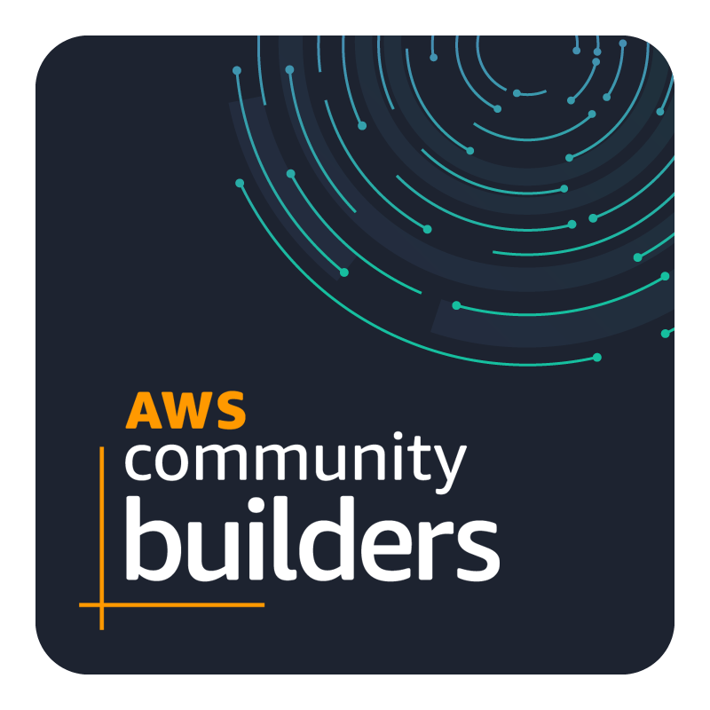
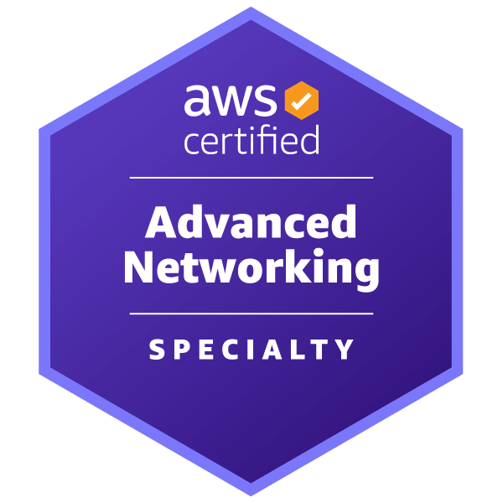
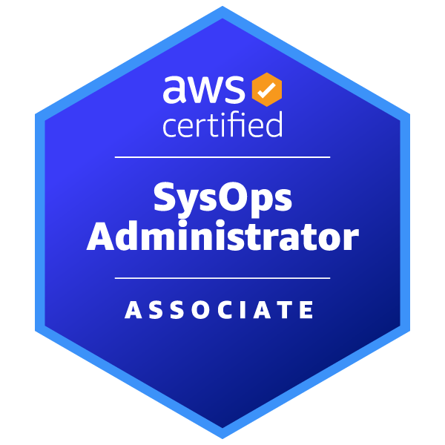
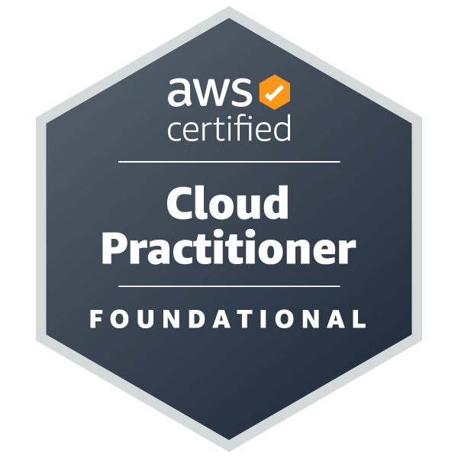
Michal Salanci
Professional Experience
Career Highlights
2011 - 2012
AT&T Global Network Services
24x7 Emergency System Engineer
AT&T Global Network Services
Lead Network Engineer
T-Systems
Senior Network Engineer
T-Systems
Senior DevOps Engineer
AWS Community Builder
AWS User Group Kosice Leader
AWS User Group Meetup Organizer
2012 - 2015
2015 - 2021
Certifications
2021 -
Certifications
Fun fact you might have not known
I hold PhD in history and auxiliary historical sciences
Personal Motto
Who dares wins (British SAS)

Slide 3
Agenda
What is Fargate
Forward Proxy
Logs in AWS CloudWatch and Grafana
Using the Telegraf for monitoring
Monitor AWS network resources with Telegraf, managed by Fargate | Michl Salanci | Deutsche Telekom Systems Solutions Slovakia | SysAdminDay Leipzig | 26.72024

Slide 4
AWS Fargate
Serverless compute engine for container management, within AWS
Monitor AWS network resources with Telegraf, managed by Fargate | Michl Salanci | Deutsche Telekom Systems Solutions Slovakia | SysAdminDay Leipzig | 26.72024

Slide 5
Customer VPC 1
Customer VPC 2
Serverless forward proxy
Private subnet
Private subnet
EC2 instance
EC2 instance
Outbound VPC
Private subnet
Private subnet
Internet Gateway
Public subnet
Transit Gateway att.
Transit Gateway att.
Customer VPC 3
Customer VPC n
Service VPC
NAT Gateway
Private subnet
Private subnet
Log gathering and Analytics:
Athena , Synthetics, etc...
Whitelist
EC2 instance
EC2 instance
Squid Proxy
AWS NFW
Private subnet
Private subnet
Fargate
FluentBit
AWS NFW endpoint
Transit Gateway att.
Transit Gateway att.
Private subnet
Private subnet
Network LB on ports:
- 3129 for explicit proxy
Transit Gateway
Transit Gateway att.
Transit Gateway
Transit Gateway att.
Monitor AWS network resources with Telegraf, managed by Fargate | Michl Salanci | Deutsche Telekom Systems Solutions Slovakia | SysAdminDay Leipzig | 26.72024

Slide 6
Customer VPC 1
Customer VPC 2
Serverless forward proxy
Private subnet
Private subnet
EC2 instance
EC2 instance
Outbound VPC
Private subnet
Private subnet
Internet Gateway
Public subnet
Transit Gateway att.
Transit Gateway att.
Customer VPC 3
Customer VPC n
Service VPC
NAT Gateway
Private subnet
Private subnet
Log gathering and Analytics:
Athena , Synthetics, etc...
Whitelist
EC2 instance
EC2 instance
Squid Proxy
AWS NFW
Private subnet
Private subnet
Fargate
FluentBit
AWS NFW endpoint
Transit Gateway att.
Transit Gateway att.
Private subnet
Private subnet
Network LB on ports:
- 3129 for explicit proxy
- 53 for DNS requesrs
Transit Gateway
Transit Gateway att.
Transit Gateway
Transit Gateway att.
Monitor AWS network resources with Telegraf, managed by Fargate | Michl Salanci | Deutsche Telekom Systems Solutions Slovakia | SysAdminDay Leipzig | 26.72024

Slide 7
Customer VPC 1
Customer VPC 2
Serverless forward proxy
Private subnet
Private subnet
EC2 instance
EC2 instance
Outbound VPC
Private subnet
Private subnet
Internet Gateway
Public subnet
Transit Gateway att.
Transit Gateway att.
Customer VPC 3
Customer VPC n
Service VPC
NAT Gateway
Private subnet
Private subnet
Log gathering and Analytics:
Athena , Synthetics, etc...
Whitelist
EC2 instance
EC2 instance
Squid Proxy
Dnsmasq
AWS NFW
Private subnet
Private subnet
Fargate
FluentBit
AWS NFW endpoint
Transit Gateway att.
Transit Gateway att.
Private subnet
Private subnet
Network LB on ports:
- 3129 for explicit proxy
- 53 for DNS requesrs
Transit Gateway
Transit Gateway att.
Transit Gateway
Transit Gateway att.
Monitor AWS network resources with Telegraf, managed by Fargate | Michl Salanci | Deutsche Telekom Systems Solutions Slovakia | SysAdminDay Leipzig | 26.72024

Slide 8
Squid Proxy
FluentBit
Cloudwatch
Monitor AWS network resources with Telegraf, managed by Fargate | Michl Salanci | Deutsche Telekom Systems Solutions Slovakia | SysAdminDay Leipzig | 26.72024

Slide 9
Squid Proxy
AWS NFW
AWS NFW endpoint
FluentBit
Cloudwatch
Monitor AWS network resources with Telegraf, managed by Fargate | Michl Salanci | Deutsche Telekom Systems Solutions Slovakia | SysAdminDay Leipzig | 26.72024

Slide 10
Squid Proxy
AWS NFW
Dnsmasq
AWS NFW endpoint
FluentBit
Cloudwatch
Monitor AWS network resources with Telegraf, managed by Fargate | Michl Salanci | Deutsche Telekom Systems Solutions Slovakia | SysAdminDay Leipzig | 26.72024

Slide 11
Outbound VPC
Internet Gateway
Public subnet
NAT Gateway
Whitelist
Squid Proxy
Dnsmasq
AWS NFW
Fargate
FluentBit
AWS NFW endpoint
Private subnet
Cloudwatch
Network LB on ports:
- 3129 for explicit proxy
- 53 for DNS requesrs
Transit Gateway att.
Monitor AWS network resources with Telegraf, managed by Fargate | Michl Salanci | Deutsche Telekom Systems Solutions Slovakia | SysAdminDay Leipzig | 26.72024

Slide 12
Squid proxy log
squid: [1721941552.336047706, {"log"=>"2024-07-25T21:05:52+0000 49ms 192.168.0.185 TCP_TUNNEL/200 7286b CONNECT www.testsite.com:443 www.testsite.com HIER_DIRECT/4.156.80.26 -", "ecs_cluster"=>"ecs-cluster-forwardproxy-1", "ecs_task_arn"=>"arn:aws:ecs:eu-central-1:123456789:task/ ecs-cluster-forwardproxy-1]
AWS network firewal log
event.alert.action: allowed
event.app_proto: tls
event.dest_ip: 4.156.80.26
event.dest_port: 443
event.proto: TCP
event.src_ip: 192.168.0.185
event.tls.sni: www.testsite.com
Monitor AWS network resources with Telegraf, managed by Fargate | Michl Salanci | Deutsche Telekom Systems Solutions Slovakia | SysAdminDay Leipzig | 26.72024

Slide 13
Dnsmasq log
dnsmasq[1]: query[CNAME] _ www.testsite.com from 192.168.0.185 ", "ecs_cluster"=>" ecs-cluster-forwardproxy-1 ", "ecs_task_arn"=>"arn:aws:ecs:eu-central-1:123456789:task/ ecs-cluster-forwardproxy-1]
Monitor AWS network resources with Telegraf, managed by Fargate | Michl Salanci | Deutsche Telekom Systems Solutions Slovakia | SysAdminDay Leipzig | 26.72024

Slide 14
NAT Gateway throughput
Monitor AWS network resources with Telegraf, managed by Fargate | Michl Salanci | Deutsche Telekom Systems Solutions Slovakia | SysAdminDay Leipzig | 26.72024

Slide 15
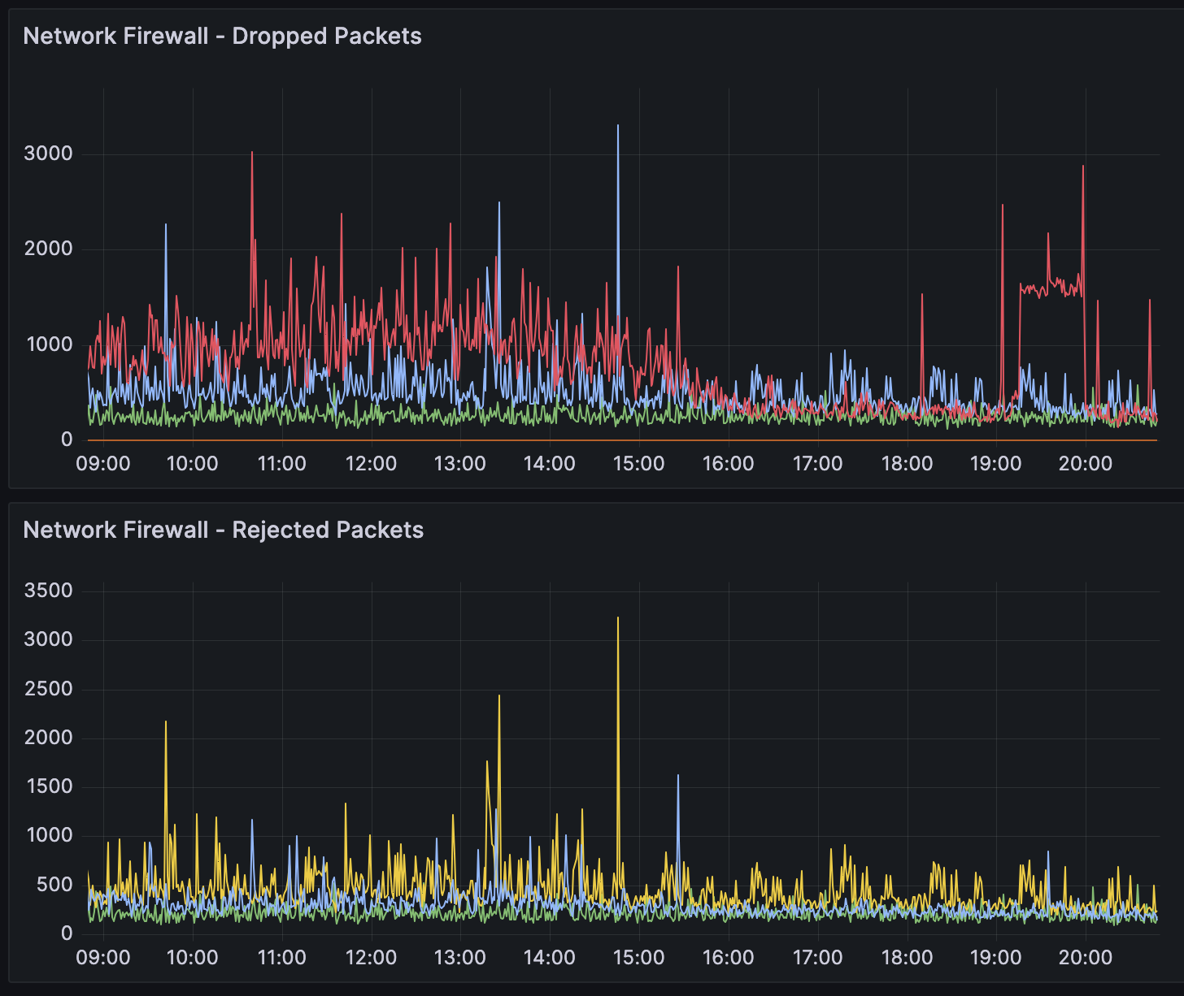
AWS network firewall dropped and rejected packets
Monitor AWS network resources with Telegraf, managed by Fargate | Michl Salanci | Deutsche Telekom Systems Solutions Slovakia | SysAdminDay Leipzig | 26.72024

Slide 16
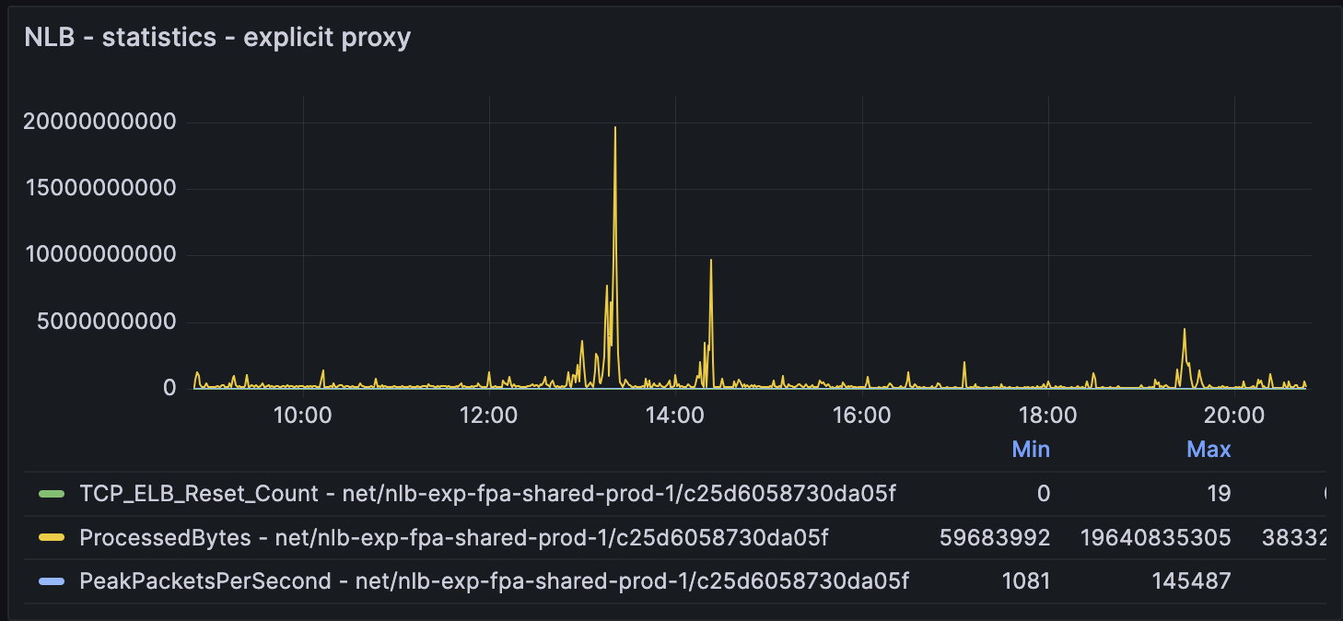
Network loadbalancer statistics
Monitor AWS network resources with Telegraf, managed by Fargate | Michl Salanci | Deutsche Telekom Systems Solutions Slovakia | SysAdminDay Leipzig | 26.72024

Slide 17
Customer VPC 1
Customer VPC 2
Private subnet
Private subnet
EC2 instance
EC2 instance
Outbound VPC
Private subnet
Private subnet
Internet Gateway
Public subnet
Transit Gateway att.
Transit Gateway att.
Customer VPC 3
Customer VPC n
Service VPC
NAT Gateway
Private subnet
Private subnet
Log gathering and Analytics:
Athena , Synthetics, etc...
Whitelist
EC2 instance
EC2 instance
Squid Proxy
Dnsmasq
AWS NFW
Private subnet
Private subnet
Fargate
FluentBit
AWS NFW endpoint
Transit Gateway att.
Transit Gateway att.
Private subnet
Private subnet
Network LB on ports:
- 3129 for explicit proxy
- 53 for DNS requesrs
Transit Gateway
Transit Gateway att.
Transit Gateway
Transit Gateway att.
Monitor AWS network resources with Telegraf, managed by Fargate | Michl Salanci | Deutsche Telekom Systems Solutions Slovakia | SysAdminDay Leipzig | 26.72024

Slide 18
Customer VPC 1
Customer VPC 2
Private subnet
Private subnet
Service VPC
EC2 instance
EC2 instance
Outbound VPC
Private subnet
Private subnet
Internet Gateway
Public subnet
Transit Gateway att.
Transit Gateway att.
Log gathering and Analytics:
Athena , Synthetics, etc...
Customer VPC 3
Customer VPC n
NAT Gateway
Private subnet
Private subnet
Private subnet
Whitelist
EC2 instance
EC2 instance
Squid Proxy
Telegraf
Dnsmasq
AWS NFW
Private subnet
Private subnet
Fargate
FluentBit
AWS NFW endpoint
Fargate
Transit Gateway att.
Transit Gateway att.
Private subnet
Private subnet
Network LB on ports:
- 3129 for explicit proxy
- 53 for DNS requesrs
Transit Gateway
Transit Gateway att.
Transit Gateway
Transit Gateway att.
Monitor AWS network resources with Telegraf, managed by Fargate | Michl Salanci | Deutsche Telekom Systems Solutions Slovakia | SysAdminDay Leipzig | 26.72024

Slide 19
Server agent for collecting metrics
Integrationwith AWS Cloudwatch
Monitor AWS network resources with Telegraf, managed by Fargate | Michl Salanci | Deutsche Telekom Systems Solutions Slovakia | SysAdminDay Leipzig | 26.72024

Slide 20
Server agent for collecting metrics
Custom scripts possible
Monitor AWS network resources with Telegraf, managed by Fargate | Michl Salanci | Deutsche Telekom Systems Solutions Slovakia | SysAdminDay Leipzig | 26.72024

Slide 21
Server agent for collecting metrics
Built-in plugins
Custom scripts possible
Monitor AWS network resources with Telegraf, managed by Fargate | Michl Salanci | Deutsche Telekom Systems Solutions Slovakia | SysAdminDay Leipzig | 26.72024

Slide 22
Server agent for collecting metrics
Built-in plugins
Custom scripts possible
Integration with AWS Cloudwatch
Monitor AWS network resources with Telegraf, managed by Fargate | Michl Salanci | Deutsche Telekom Systems Solutions Slovakia | SysAdminDay Leipzig | 26.72024

Slide 23
Customer VPC 1
Customer VPC 2
Private subnet
Private subnet
Service VPC
EC2 instance
EC2 instance
Outbound VPC
Private subnet
Private subnet
Internet Gateway
Public subnet
Transit Gateway att.
Transit Gateway att.
Log gathering and Analytics:
Athena , Synthetics, etc...
Customer VPC 3
Customer VPC n
NAT Gateway
Private subnet
Private subnet
Private subnet
Whitelist
EC2 instance
EC2 instance
Squid Proxy
Telegraf
Dnsmasq
AWS NFW
Private subnet
Private subnet
Fargate
FluentBit
AWS NFW endpoint
Fargate
Transit Gateway att.
Transit Gateway att.
Private subnet
Private subnet
Network LB on ports:
- 3129 for explicit proxy
- 53 for DNS requesrs
Transit Gateway
Transit Gateway att.
Transit Gateway
Transit Gateway att.
Monitor AWS network resources with Telegraf, managed by Fargate | Michl Salanci | Deutsche Telekom Systems Solutions Slovakia | SysAdminDay Leipzig | 26.72024
Notes:
So what did we came up with?
We tiped 5 commercial sites in the internet, where is high probability to be stable 24x7. it’s sites of social media or music plaftorms, software vendors, etc… and we are sending http request over there and getting back the http response.

Slide 24
Sends http request
Monitor AWS network resources with Telegraf, managed by Fargate | Michl Salanci | Deutsche Telekom Systems Solutions Slovakia | SysAdminDay Leipzig | 26.72024

Slide 25
Sends http request
Receive http response
Monitor AWS network resources with Telegraf, managed by Fargate | Michl Salanci | Deutsche Telekom Systems Solutions Slovakia | SysAdminDay Leipzig | 26.72024

Slide 26
Sends http request
Collect data
Receive http response
Monitor AWS network resources with Telegraf, managed by Fargate | Michl Salanci | Deutsche Telekom Systems Solutions Slovakia | SysAdminDay Leipzig | 26.72024

Slide 27
Sends http request
Collect data
Receive http response
Send to cloudwatch
Monitor AWS network resources with Telegraf, managed by Fargate | Michl Salanci | Deutsche Telekom Systems Solutions Slovakia | SysAdminDay Leipzig | 26.72024

Slide 28
Custom scripts in Telegtraf
#!/bin/sh
target=$1
host=`echo $target | awk -F'/' '{print $3}'`
vpc_id=$VPC_ID
response=`curl -I -s "%{time_connect};%{time_total};%{http_code}" $target -vk`
timeconnect=`echo $response | awk -F';' '{print $1}'`
timetotal=`echo $response | awk -F';' '{print $2}'`
httpcode=`echo $response | awk -F';' '{print $3}’`
echo "canary,target=$host,vpc=$VPC_ID timetotal=$timetotal,timeconnect=$timeconnect,httpcode=$httpcode,response=$response"
Monitor AWS network resources with Telegraf, managed by Fargate | Michl Salanci | Deutsche Telekom Systems Solutions Slovakia | SysAdminDay Leipzig | 26.72024

Slide 29
#### EXPLICIT PROXY
### EXTERNAL SITES
## HTTP Response Input Plugin to measure HTTP response of EXTERNAL SITES through EXPLICIT PROXY
## https://github.com/influxdata/telegraf/tree/master/plugins/inputs/http_response
[[inputs.http_response]]
## List of urls to query.
urls = [
"https://www.google.com",
"https://github.com",
"https://docs.aws.amazon.com",
"https://www.apple.com",
"https://www.youtube.com"
]
## Set http_proxy.
http_proxy = "http://${PROXY_WO_PORT}:3128"
## Set response_timeout (default is 5 seconds)
response_timeout = "5s"
## HTTP Request Method, can be "GET" or "HEAD"
method = "HEAD"
## Whether to follow redirects from the server (defaults to false)
follow_redirects = true
## defining custom tags
[inputs.http_response.tags]
vpcid = "${VPC_ID}"
proxy = "${PROXY_WO_PORT}"
## Tag Limit Processor Plugin to limit the tags of EXTERNAL SITES sent to CloudWatch for Explicit Proxy
## https://github.com/influxdata/telegraf/tree/master/plugins/processors/tag_limit
[[processors.tag_limit]]
## Maximum number of tags to preserve
limit = 3
## List of tags to preferentially preserve for explicit proxy
keep = ["proxy","server","vpcid"]
# namepass, to which that particular metric will be applied
namepass = [ "externals_explicit" ]
Monitor AWS network resources with Telegraf, managed by Fargate | Michl Salanci | Deutsche Telekom Systems Solutions Slovakia | SysAdminDay Leipzig | 26.72024

Slide 30
#### TRANSPARENT PROXY
### EXTERNAL SITES
## HTTP Response Input Plugin to measure HTTP response of external sites through Transparent Proxy
## https://github.com/influxdata/telegraf/tree/master/plugins/inputs/http_response
[[inputs.http_response]]
## List of urls to query.
urls = [
"https://www.google.com",
"https://github.com",
"https://docs.aws.amazon.com",
"https://www.apple.com",
"https://www.youtube.com"
]
## Set response_timeout (default is 5 seconds)
response_timeout = "5s"
## HTTP Request Method, can be "GET" or "HEAD"
method = "HEAD"
## Whether to follow redirects from the server (defaults to false)
follow_redirects = true
## Adding custom tags
[inputs.http_response.tags]
vpcid = "${VPC_ID}"
## Tag Limit Processor Plugin to limit the tags of EXTERNAL SITES sent to CloudWatch for Transparent Proxy
## https://github.com/influxdata/telegraf/tree/master/plugins/processors/tag_limit
[[processors.tag_limit]]
## Maximum number of tags to preserve
limit = 2
## List of tags to preferentially preserve for transparent proxy
keep = ["server","vpcid"]
# namepass, to which that particular metric will be applied
namepass = [ "externals_transparent" ]
Monitor AWS network resources with Telegraf, managed by Fargate | Michl Salanci | Deutsche Telekom Systems Solutions Slovakia | SysAdminDay Leipzig | 26.72024

Slide 31
#### OUTPUTS
## File Output Plugin to send outputs in stdout
## https://github.com/influxdata/telegraf/blob/master/plugins/outputs/file
[[outputs.file]]
# Files to write to, "stdout" is a specially handled file.
files = [ "stdout" ]
## Amazon CloudWatch Output Plugin for CloudWatch
## https://github.com/influxdata/telegraf/blob/master/plugins/outputs/cloudwatch
[[outputs.cloudwatch]]
# Amazon REGION
region = "${AWS_REGION}"
## Namespace for the CloudWatch Metric
namespace = "InfluxData/NetworkMonitoringTelegraf"
# Enable high resolution metrics of 1 second (if not enabled, standard resolution are of 60 seconds precision)
high_resolution_metrics = true
Monitor AWS network resources with Telegraf, managed by Fargate | Michl Salanci | Deutsche Telekom Systems Solutions Slovakia | SysAdminDay Leipzig | 26.72024

Slide 32
‘http_response’ plugin automatically creates metric named ‘Result Code’
0 - success
1 - response_string_mismatch
2 - body_read_error
3 - connection_failed
4 - timeout
5 - dns_error
6 - response_status_code_mismatch
Monitor AWS network resources with Telegraf, managed by Fargate | Michl Salanci | Deutsche Telekom Systems Solutions Slovakia | SysAdminDay Leipzig | 26.72024

Slide 33
Metric in CloudWatch
myforwardproxy
www.google.com
Vpc ID
Result code
www.google.com
Vpc ID
Result code
Monitor AWS network resources with Telegraf, managed by Fargate | Michl Salanci | Deutsche Telekom Systems Solutions Slovakia | SysAdminDay Leipzig | 26.72024

Slide 34
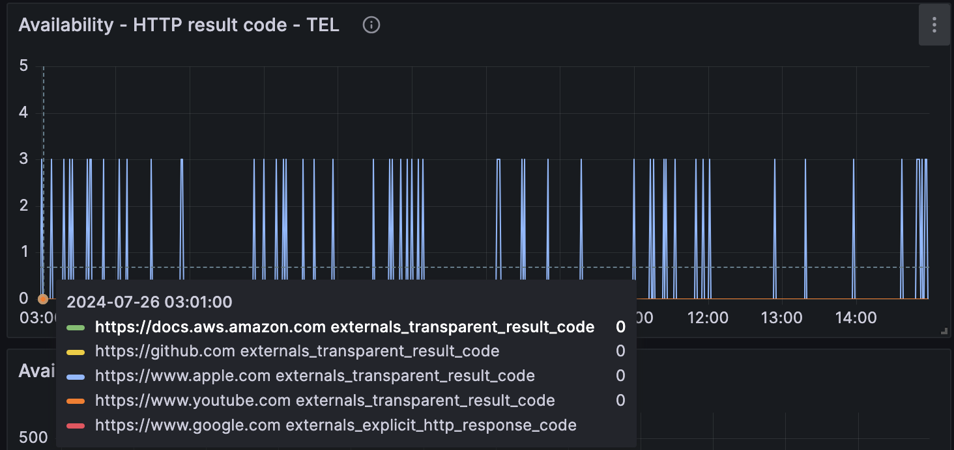
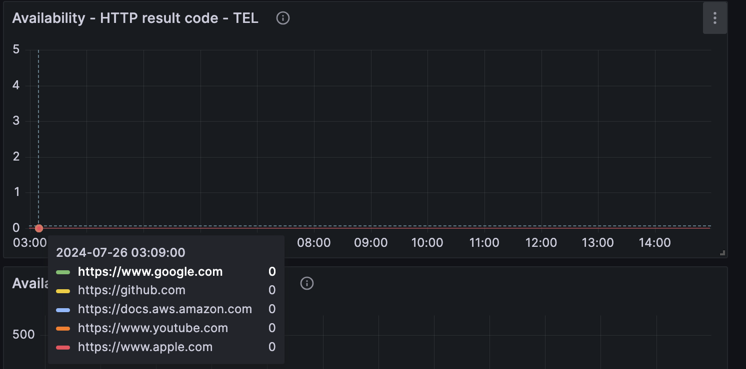
Metrics in Grafana
Explicit Proxy (Squid)
Transparent Proxy (AWS Network FW)
Monitor AWS network resources with Telegraf, managed by Fargate | Michl Salanci | Deutsche Telekom Systems Solutions Slovakia | SysAdminDay Leipzig | 26.72024

Slide 35
Plugins, plugins ewerywhere…
Update ‘telegraf.conf’ file
Monitor AWS network resources with Telegraf, managed by Fargate | Michl Salanci | Deutsche Telekom Systems Solutions Slovakia | SysAdminDay Leipzig | 26.72024

Slide 36
Plugins, plugins ewerywhere…
FROM ubuntu
# update ubuntu and install telegraf, curl and dnsutils
RUN apt-get update \
&& apt-get install -y telegraf \
&& apt install -y curl\
&& apt-get install -y dnsutils
RUN apt-get install -y ca-certificates \
&& update-ca-certificates
# copy the scripts and assign appropriate rights
COPY monitoring-explicit.sh /etc/telegraf/telegraf.d/monitoring-explicit.sh
COPY monitoring.sh /etc/telegraf/telegraf.d/monitoring.sh
RUN chmod 755 /etc/telegraf/telegraf.d/monitoring-explicit.sh
RUN chmod 755 /etc/telegraf/telegraf.d/monitoring.sh
# copy telegraf.conf and assign appropriate rights
COPY telegraf.conf /etc/telegraf/telegraf.conf
RUN chmod 755 /etc/telegraf/telegraf.conf
# copy sntrypoint script, assign appropriate rights and call it
COPY entrypoint.sh /sbin/entrypoint.sh
RUN chmod 755 /sbin/entrypoint.sh
ENTRYPOINT ["/sbin/entrypoint.sh"]
Update ‘telegraf.conf’ file
Call it to Dockerfile
Monitor AWS network resources with Telegraf, managed by Fargate | Michl Salanci | Deutsche Telekom Systems Solutions Slovakia | SysAdminDay Leipzig | 26.72024

Slide 37
Customer VPC 1
Customer VPC 2
Private subnet
Private subnet
Service VPC
EC2 instance
EC2 instance
Outbound VPC
Private subnet
Private subnet
Internet Gateway
Public subnet
Transit Gateway att.
Transit Gateway att.
Log gathering and Analytics:
Athena , Synthetics, etc...
Customer VPC 3
Customer VPC n
NAT Gateway
Private subnet
Private subnet
Private subnet
Whitelist
EC2 instance
EC2 instance
Squid Proxy
Telegraf
Dnsmasq
AWS NFW
Private subnet
Private subnet
Fargate
FluentBit
AWS NFW endpoint
Fargate
Transit Gateway att.
Transit Gateway att.
Private subnet
Private subnet
Network LB on ports:
- 3129 for explicit proxy
- 53 for DNS requesrs
Transit Gateway
Transit Gateway att.
Transit Gateway
Transit Gateway att.
Monitor AWS network resources with Telegraf, managed by Fargate | Michl Salanci | Deutsche Telekom Systems Solutions Slovakia | SysAdminDay Leipzig | 26.72024

Slide 38
## DNS Query Input Plugin to measure DNS reponses
## https://github.com/influxdata/telegraf/tree/master/plugins/inputs/dns_query
[[inputs.dns_query]]
servers = [ "${PROXY_WO_PORT}" ]
domains = [ "www.google.com", "github.com", "docs.aws.amazon.com", "www.microsoft.com", "www.apple.com" ]
record_type = "A"
[[processors.tag_limit]]
## Maximum number of tags to preserve
limit = 2
## List of tags to preferentially preserve
keep = ["domain","server"]
namepass = [ "dns_query" ]
Monitor AWS network resources with Telegraf, managed by Fargate | Michl Salanci | Deutsche Telekom Systems Solutions Slovakia | SysAdminDay Leipzig | 26.72024

Slide 39
Customer VPC 1
Customer VPC 2
Private subnet
Private subnet
Service VPC
EC2 instance
EC2 instance
1
Outbound VPC
Private subnet
Private subnet
Internet Gateway
2
Public subnet
Transit Gateway att.
Transit Gateway att.
Log gathering and Analytics:
Athena , Synthetics, etc...
3
Customer VPC 3
Customer VPC n
NAT Gateway
Private subnet
Private subnet
4
Private subnet
EC2 instance
EC2 instance
Squid Proxy
Telegraf
AWS NFW
Private subnet
Private subnet
Dnsmasq
Fargate
FluentBit
AWS NFW endpoint
Fargate
Transit Gateway att.
Transit Gateway att.
Private subnet
Private subnet
Network LB on ports:
- 3129 for explicit proxy
- 53 for DNS requesrs
Transit Gateway
Transit Gateway att.
Transit Gateway
Transit Gateway att.
Monitor AWS network resources with Telegraf, managed by Fargate | Michl Salanci | Deutsche Telekom Systems Solutions Slovakia | SysAdminDay Leipzig | 26.72024

Slide 40
Customer VPC 1
Customer VPC 2
Private subnet
Private subnet
Service VPC
EC2 instance
EC2 instance
1
Outbound VPC
Private subnet
Private subnet
Internet Gateway
2
Public subnet
Transit Gateway att.
Transit Gateway att.
Log gathering and Analytics:
Athena , Synthetics, etc...
3
Customer VPC 3
Customer VPC n
NAT Gateway
Private subnet
Private subnet
4
Private subnet
EC2 instance
EC2 instance
Squid Proxy
Telegraf
AWS NFW
Private subnet
Private subnet
Dnsmasq
Fargate
FluentBit
AWS NFW endpoint
Fargate
Transit Gateway att.
Transit Gateway att.
Private subnet
Private subnet
Network LB on ports:
- 3129 for explicit proxy
- 53 for DNS requesrs
Transit Gateway
Transit Gateway att.
Transit Gateway
Transit Gateway att.
Monitor AWS network resources with Telegraf, managed by Fargate | Michl Salanci | Deutsche Telekom Systems Solutions Slovakia | SysAdminDay Leipzig | 26.72024

Slide 41
Thank you
Michal Salanci
michal.salanci@t-systems.com
https://www.linkedin.com/in/michal-salanci-3496724b/
https://michal-salanci.s3.eu-central-1.amazonaws.com/index.html
Monitor AWS network resources with Telegraf, managed by Fargate | Michl Salanci | Deutsche Telekom Systems Solutions Slovakia | SysAdminDay Leipzig | 26.72024

