Slide 1
Good bye server !
Going serverless with AWS.
(a real case study).
Michal Salanci
Good bye server! Going serverless with AWS | Michal Salanci | Deutsche Telekom Systems Solutions Slovakia | AWS Global Community Gatherings | 05.08.2024

Slide 2
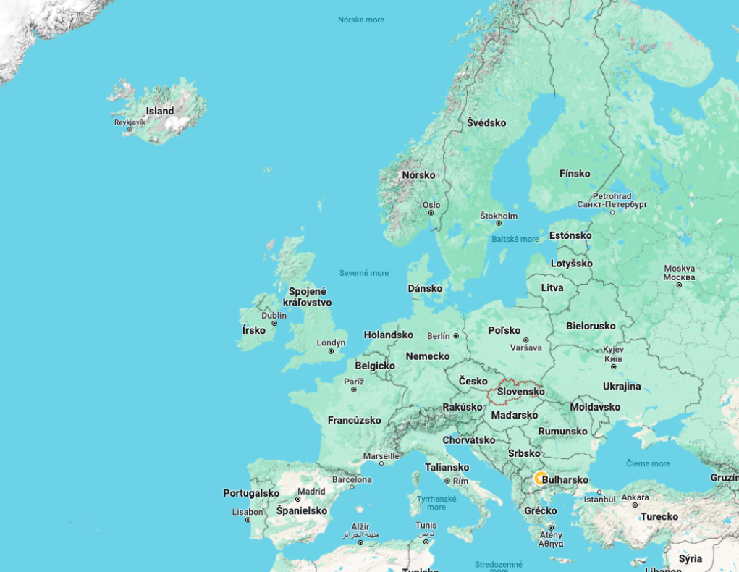
Good bye server! Going serverless with AWS | Michal Salanci | Deutsche Telekom Systems Solutions Slovakia | AWS Global Community Gatherings | 05.08.2024

Slide 3
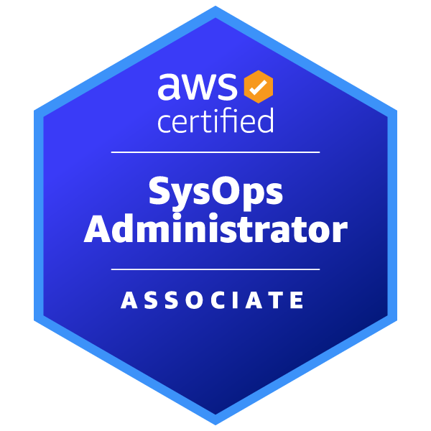
Michal Salanci
Professional Experience
Career Highlights
2011 - 2012
AT&T Global Network Services
24x7 Emergency System Engineer
AT&T Global Network Services
Lead Network Engineer
T-Systems
Senior Network Engineer
T-Systems
Senior DevOps Engineer
AWS Community Builder
AWS User Group Kosice Leader
AWS User Group Meetup Organizer
2012 - 2015
2015 - 2021
Certifications
2021 -
Certifications
Fun fact you might have not known
I hold PhD in history and auxiliary historical sciences
Personal Motto
Who dares wins (British SAS)

Slide 4
Agenda
What is Forward Proxy
Types of proxy
Server-based proxy [2019]
Serverless proxy [2022]
Good bye server! Going serverless with AWS | Michal Salanci | Deutsche Telekom Systems Solutions Slovakia | AWS Global Community Gatherings | 05.08.2024

Slide 5
Customer VPC 1
Customer VPC 2
Serverless forward proxy
Private subnet
Private subnet
Public subnet
EC2 instance
EC2 instance
NAT Gateway
Outbound VPC
Private subnet
Private subnet
Internet Gateway
Internet Gateway
Public subnet
Transit Gateway att.
Transit Gateway att.
Customer VPC 3
Customer VPC n
NAT Gateway
Private subnet
Private subnet
EC2 instance
EC2 instance
Private subnet
Private subnet
Transit Gateway att.
Transit Gateway att.
Private subnet
Transit Gateway
Transit Gateway att.
Good bye server! Going serverless with AWS | Michal Salanci | Deutsche Telekom Systems Solutions Slovakia | AWS Global Community Gatherings | 05.08.2024

Slide 6
Customer VPC 1
Customer VPC 2
Serverless forward proxy
Private subnet
Private subnet
EC2 instance
EC2 instance
Outbound VPC
Private subnet
Private subnet
Internet Gateway
Public subnet
Transit Gateway att.
Transit Gateway att.
Customer VPC 3
Customer VPC n
Service VPC
NAT Gateway
Private subnet
Private subnet
EC2 instance
EC2 instance
Log gathering and Analytics:
Athena , Synthetics, etc...
Private subnet
Private subnet
Transit Gateway att.
Transit Gateway att.
Private subnet
Private subnet
Transit Gateway
Transit Gateway
Transit Gateway att.
Good bye server! Going serverless with AWS | Michal Salanci | Deutsche Telekom Systems Solutions Slovakia | AWS Global Community Gatherings | 05.08.2024

Slide 7
What is Forward Proxy ?
Good bye server! Going serverless with AWS | Michal Salanci | Deutsche Telekom Systems Solutions Slovakia | AWS Global Community Gatherings | 05.08.2024

Slide 8
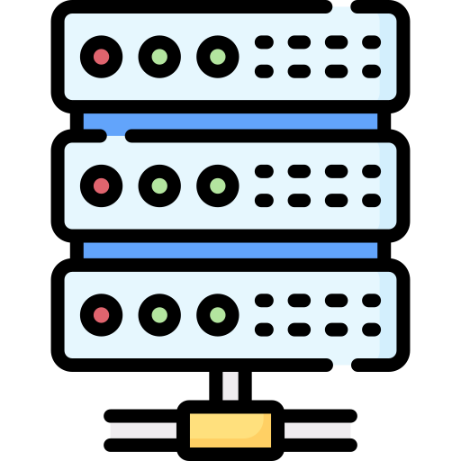
filtering
Forward proxy server
www.somesite.com
Good bye server! Going serverless with AWS | Michal Salanci | Deutsche Telekom Systems Solutions Slovakia | AWS Global Community Gatherings | 05.08.2024

Slide 9
Explicit vs Transparent
TCP termination
Listenng
Client configuration
Bypassing
Good bye server! Going serverless with AWS | Michal Salanci | Deutsche Telekom Systems Solutions Slovakia | AWS Global Community Gatherings | 05.08.2024

Slide 10
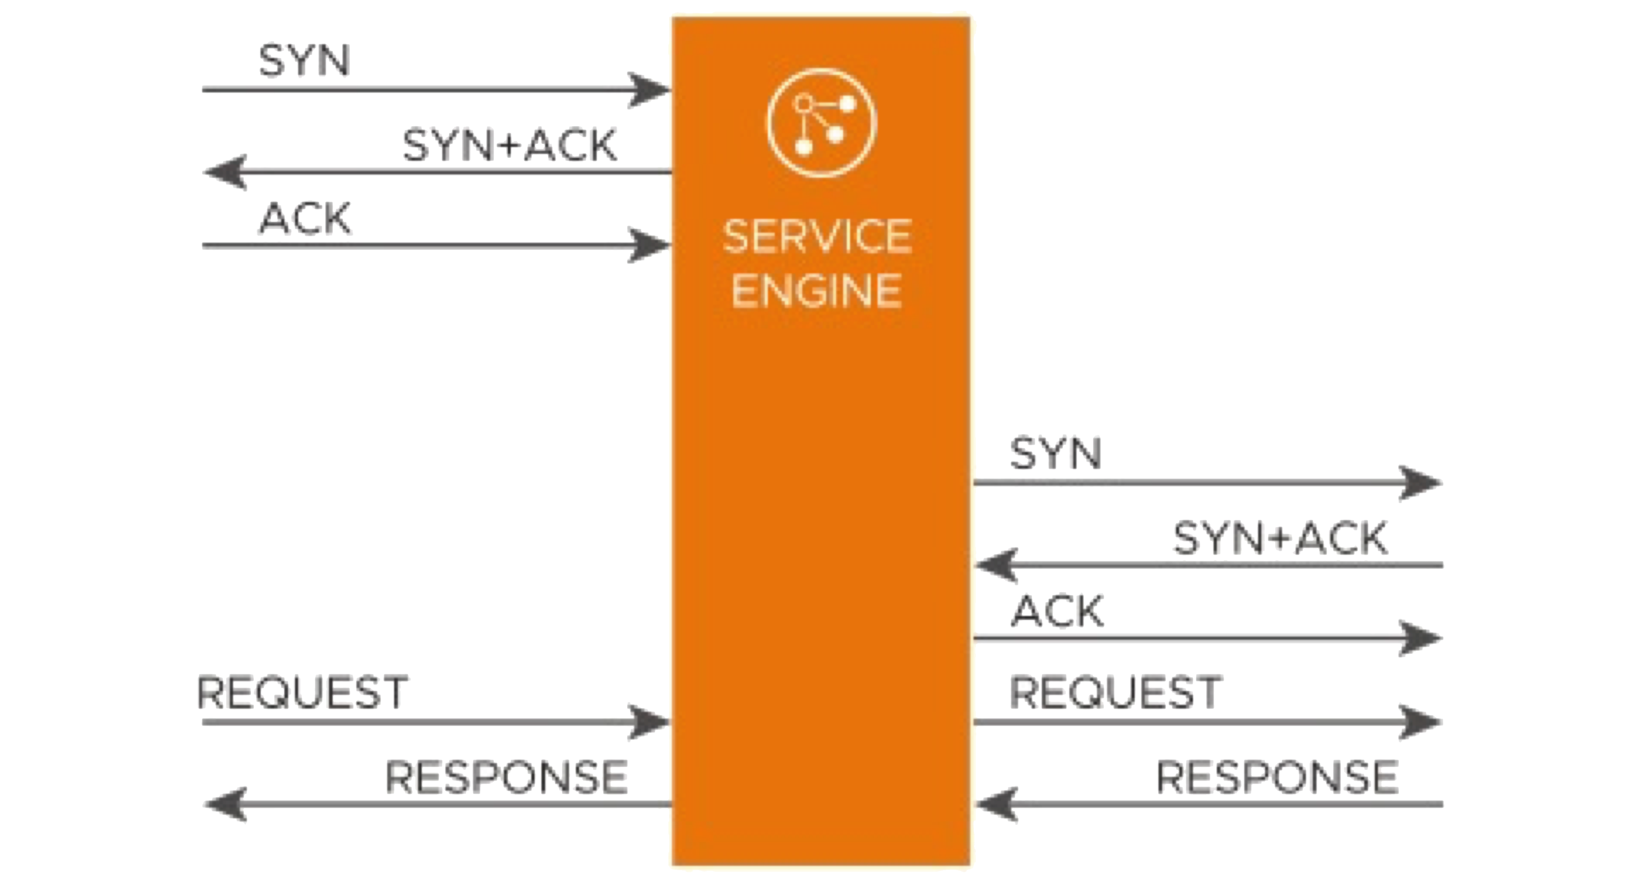
TCP session termination
Explicit
Transparent
Client
Forward Proxy
Server
Client
Forward Proxy
Server
Webserver
Webserver
Good bye server! Going serverless with AWS | Michal Salanci | Deutsche Telekom Systems Solutions Slovakia | AWS Global Community Gatherings | 05.08.2024

Slide 11
Listening the traffic
Explicit
Transparent
myproxy.com:3128
Client
Forward Proxy
Server
Client
Forward Proxy
Server
Webserver
Webserver
Good bye server! Going serverless with AWS | Michal Salanci | Deutsche Telekom Systems Solutions Slovakia | AWS Global Community Gatherings | 05.08.2024

Slide 12
Configuration on client’s side
Explicit
Transparent
curl -x http://myproxy.com:3128 https://www.amazon.com
curl http://www.amazon.com
myproxy.com:3128
myproxy.com:3128
Client
Forward Proxy
Server
Client
Forward Proxy
Server
www.amazon.com
www.amazon.com
Good bye server! Going serverless with AWS | Michal Salanci | Deutsche Telekom Systems Solutions Slovakia | AWS Global Community Gatherings | 05.08.2024

Slide 13
Bypassing the proxy
Explicit
Transparent
curl -x http://www.amazon.com
curl -x http://myproxy.com:3128 http://www.amazon.com
curl http://www.amazon.com
myproxy.com:3128
Client
Forward Proxy
Server
Client
Forward Proxy
Server
www.amazon.com
www.amazon.com
Good bye server! Going serverless with AWS | Michal Salanci | Deutsche Telekom Systems Solutions Slovakia | AWS Global Community Gatherings | 05.08.2024

Slide 14
Server-based proxy
Good bye server! Going serverless with AWS | Michal Salanci | Deutsche Telekom Systems Solutions Slovakia | AWS Global Community Gatherings | 05.08.2024

Slide 15
Customer VPC
Customer VPC
Private subnet
Private subnet
EC2 instance
EC2 instance
Private subnet
Private subnet
Whitelist
Whitelist
Blacklist
Squid.conf
Transit Gateway att.
Transit Gateway att.
Customer VPC
Customer VPC
Service VPC
Outbound VPC
Private subnet
Private subnet
Internet Gateway
Public subnet
EC2 instance
EC2 instance
Whitelist
Log gathering and Analytics:
Athena , Synthetics, etc...
Private subnet
Private subnet
NAT Gateway
NAT Gateway
Squid proxy EC2
Squid proxy EC2
0.0.0.0/0
Transit Gateway att.
Transit Gateway att.
Private subnet
Private subnet
Transit Gateway
Transit Gateway att.
Transit Gateway
Transit Gateway att.
Good bye server! Going serverless with AWS | Michal Salanci | Deutsche Telekom Systems Solutions Slovakia | AWS Global Community Gatherings | 05.08.2024

Slide 16
Serverless proxy
Good bye server! Going serverless with AWS | Michal Salanci | Deutsche Telekom Systems Solutions Slovakia | AWS Global Community Gatherings | 05.08.2024

Slide 17
Customer VPC 1
Customer VPC 2
Serverless forward proxy
Private subnet
Private subnet
EC2 instance
EC2 instance
Outbound VPC
Private subnet
Private subnet
Internet Gateway
Transit Gateway att.
Transit Gateway att.
Customer VPC 3
Customer VPC n
Service VPC
Private subnet
Private subnet
EC2 instance
EC2 instance
Whitelist
Log gathering and Analytics:
Athena , Synthetics, etc...
Logs in CloudWatch
Private subnet
Private subnet
Transit Gateway att.
Transit Gateway att.
Private subnet
Private subnet
Transit Gateway
Transit Gateway att.
Transit Gateway
Transit Gateway att.
Good bye server! Going serverless with AWS | Michal Salanci | Deutsche Telekom Systems Solutions Slovakia | AWS Global Community Gatherings | 05.08.2024

Slide 18
Forward proxy options in AWS
3rd party proxy in EC2 / Container
3rd party appliance in GWLB
AWS native options
Good bye server! Going serverless with AWS | Michal Salanci | Deutsche Telekom Systems Solutions Slovakia | AWS Global Community Gatherings | 05.08.2024

Slide 19
EC2 vs Serverless ?
AWS native vs 3rd party?
Good bye server! Going serverless with AWS | Michal Salanci | Deutsche Telekom Systems Solutions Slovakia | AWS Global Community Gatherings | 05.08.2024

Slide 20
In EC2? Serverless? AWS Native? 3rd party?
Squid Proxy
Squid Proxy
NGINX
NGINX
Fargate
HA Proxy
EC2
HA Proxy
Good bye server! Going serverless with AWS | Michal Salanci | Deutsche Telekom Systems Solutions Slovakia | AWS Global Community Gatherings | 05.08.2024

Slide 21
In EC2? Serverless? AWS Native? 3rd party?
Palo Alto NFW
Firepower
BIG-IP LTM/APM
GW LoadBalancer
Fortigate
Good bye server! Going serverless with AWS | Michal Salanci | Deutsche Telekom Systems Solutions Slovakia | AWS Global Community Gatherings | 05.08.2024

Slide 22
In EC2? Serverless? AWS Native? 3rd party?
VPC
Stateful rules
Inspection subnet
Stateless rules
Domain name rules
Suricata compatible rules
AWS Network Firewall endpoint
AWS Network Firewall
Good bye server! Going serverless with AWS | Michal Salanci | Deutsche Telekom Systems Solutions Slovakia | AWS Global Community Gatherings | 05.08.2024

Slide 23
Transparent proxy decision
Inspection subnet
Squid Proxy
Squid Proxy
NGINX
NGINX
AWS NFW
EC2
HA Proxy
Fargate
HA Proxy
AWS NFW endpoint
Palo Alto NFW
Inspection subnet
Firepower
BIG-IP LTM/APM
AWS Network Firewall endpoint
GW LB
AWS Network Firewall
Fortigate
Good bye server! Going serverless with AWS | Michal Salanci | Deutsche Telekom Systems Solutions Slovakia | AWS Global Community Gatherings | 05.08.2024

Slide 24
Explicit proxy decision
Inspection subnet
Squid Proxy
Squid Proxy
Squid Proxy
NGINX
NGINX
EC2
HA Proxy
Fargate
HA Proxy
Fargate
Forward proxy ECS Task
Palo Alto NFW
Inspection subnet
Firepower
BIG-IP LTM/APM
AWS Network Firewall endpoint
GW LB
AWS Network Firewall
Fortigate
Good bye server! Going serverless with AWS | Michal Salanci | Deutsche Telekom Systems Solutions Slovakia | AWS Global Community Gatherings | 05.08.2024

Slide 25
Serverless forward proxy
Inspection subnet
Explicit
Transparent
Squid Proxy
AWS NFW
FluentBit
Fargate
AWS NFW endpoint
Forward proxy ECS Task
Good bye server! Going serverless with AWS | Michal Salanci | Deutsche Telekom Systems Solutions Slovakia | AWS Global Community Gatherings | 05.08.2024

Slide 26
Customer VPC 1
Customer VPC 2
Serverless forward proxy
Private subnet
Private subnet
EC2 instance
EC2 instance
Outbound VPC
Private subnet
Private subnet
Internet Gateway
Public subnet
Transit Gateway att.
Transit Gateway att.
Inspection subnet
Customer VPC 3
Customer VPC n
Service VPC
NAT Gateway
Private subnet
Private subnet
Squid Proxy
Whitelist
EC2 instance
EC2 instance
Squid Proxy
Log gathering and Analytics:
Athena , Synthetics, etc...
Logs in CloudWatch
AWS NFW
Private subnet
Private subnet
FluentBit
AWS NFW
Fargate
AWS NFW endpoint
Forward proxy ECS Task
FluentBit
AWS NFW endpoint
Transit Gateway att.
Transit Gateway att.
Private subnet
Private subnet
Fargate
Forward proxy ECS Task
Transit Gateway
Transit Gateway att.
Transit Gateway
Transit Gateway att.
Network LB
internal-fwdproxynlb-1234567890-eu-central-1.elb.amazonanaws.com
192.168.3.10
Good bye server! Going serverless with AWS | Michal Salanci | Deutsche Telekom Systems Solutions Slovakia | AWS Global Community Gatherings | 05.08.2024

Slide 27
Client VPC 10.0.0.0/16
Transparent proxy
network flow
Outbound VPC – 192.168.0.0/16
Public subnet
192.168.0.0/16 | Local
10.0.0.0/16 | NFW
0.0.0.0/0 | IGW
Public subnet – 192.168.1.0/24
VPC main RT
10.0.0.0/16 | Local
0.0.0.0/0 | TGW
192.168.1.20
3.48.29.55
Private subnet 1 – 10.0.1.0/24
Inspection subnet
192.168.0.0/16 | Local
10.0.0.0/16 | TGW
0.0.0.0/0 | NATGW
Inspection subnet – 192.168.2.0/24
curl –I http://www.amazon.com
10.0.1.130
192.168.2.28
Private subnet 2 – 10.0.2.0/24
Private subnet
192.168.0.0/16 | Local
0.0.0.0/0 | NFW
Private subnet – 192.168.3.0/24
www.amazon.com
internal-fwdproxynlb-1234567890-eu-central-1.elb.amazonaws.com
192.168.3.10
Transity Gateway RT
10.0.0.0/16 | Client VPC TGW attachment
192.168.0.0/16 | Outbound VPC TGW attachment
0.0.0.0/0 | Outbound VPC TGW attachment
Good bye server! Going serverless with AWS | Michal Salanci | Deutsche Telekom Systems Solutions Slovakia | AWS Global Community Gatherings | 05.08.2024

Slide 28
Client VPC 10.0.0.0/16
Explicit proxy
network flow
Outbound VPC– 192.168.0.0/16
Public subnet
192.168.0.0/16 | Local
10.0.0.0/16 | NFW
0.0.0.0/0 | IGW
Public subnet – 192.168.1.0/24
VPC main RT
10.0.0.0/16 | Local
0.0.0.0/0 | TGW
192.168.1.20
3.48.29.55
Private subnet 1 – 10.0.1.0/24
Inspection subnet
192.168.0.0/16 | Local
10.0.0.0/16 | TGW
0.0.0.0/0 | NATGW
Inspection subnet – 192.168.2.0/24
curl –x internal-fwdproxynlb-1234567890-eu-central-1.elb.amazonaws.com
–I http://www.amazon.com
10.0.1.130
192.168.2.28
Private subnet 2 – 10.0.2.0/24
Private subnet
192.168.0.0/16 | Local
0.0.0.0/0 | NFW
Private subnet – 192.168.3.0/24
www.amazon.com
internal-fwdproxynlb-1234567890-eu-central-1.elb.amazonaws.com
192.168.3.10
SRC | DST
TCP Termination Webpage IP : 192.168.2.28 (Task IP) | 192.168.2.28 (Task IP) 10.0.1.130 (EC2 IP)
SRC | DST
NAT 192.168.2.28 (ECS Task IP) : 3.48.29.55 (NATGW IP) | Webpage IP
SRC | DST
Webpage IP | 3.48.29.55 (NATGW IP)
SRC | DST
TCP Termination 10.1.0.130 : 192.168.2.28 (ECS Task IP) | Network LoadBalancer 192.168.3.10 Webpage IP
SRC | DST
10.0.1.130 (EC2 IP) | Network LoadBalancer 192.168.3.10
SRC | DST
Webpage IP | NAT 3.48.29.55 (NATGW IP) : 192.168.2.28 (Task IP)
Transity Gateway RT
10.0.0.0/16 | Client VPC TGW attachment
192.168.0.0/16 | Outbound VPC TGW attachment
0.0.0.0/0 | Outbound VPC TGW attachment
Good bye server! Going serverless with AWS | Michal Salanci | Deutsche Telekom Systems Solutions Slovakia | AWS Global Community Gatherings | 05.08.2024

Slide 29
Customer VPC 1
Customer VPC 2
A true serverless ?
Private subnet
Private subnet
EC2 instance
EC2 instance
Outbound VPC
Private subnet
Private subnet
Internet Gateway
Public subnet
Transit Gateway att.
Transit Gateway att.
Customer VPC 3
Customer VPC n
Service VPC
NAT Gateway
Private subnet
Private subnet
Whitelist
EC2 instance
EC2 instance
Squid Proxy
Log gathering and Analytics:
Athena , Synthetics, etc...
Logs in CloudWatch
AWS NFW
Private subnet
Private subnet
FluentBit
Fargate
AWS NFW endpoint
Forward proxy ECS Task
Transit Gateway att.
Transit Gateway att.
Private subnet
Private subnet
Transit Gateway
Transit Gateway att.
Transit Gateway
Transit Gateway att.
Network LB
internal-fwdproxynlb-1234567890-eu-central-1.elb.amazonanaws.com
192.168.3.10
Good bye server! Going serverless with AWS | Michal Salanci | Deutsche Telekom Systems Solutions Slovakia | AWS Global Community Gatherings | 05.08.2024

Slide 30
Thank you
Michal Salanci
michal.salanci@t-systems.com
https://www.linkedin.com/in/michal-salanci-3496724b/
https://michal-salanci.s3.eu-central-1.amazonaws.com/index.html
Good bye server! Going serverless with AWS | Michal Salanci | Deutsche Telekom Systems Solutions Slovakia | AWS Global Community Gatherings | 05.08.2024

