Slide 1

Cloud Day Prague
FORUM KARLíN| 24 OCTOber 2023

Slide 2


Building serverless Forward Proxy solution with AWS
COM307
Lydia Delyova
Michal Salanci
Senior DevOps Engineer
Deutsche Telekom Systems Solutions, Slovakia
Senior DevOps Engineer
Deutsche Telekom Systems Solutions, Slovakia

Slide 3
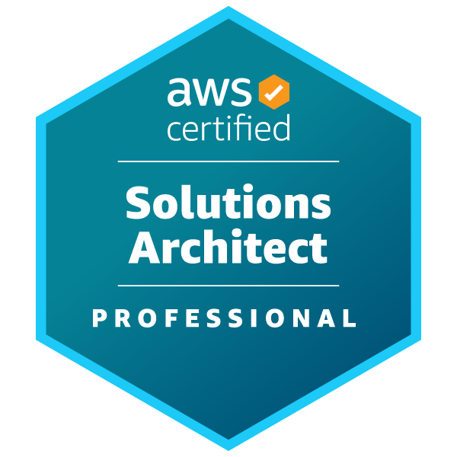
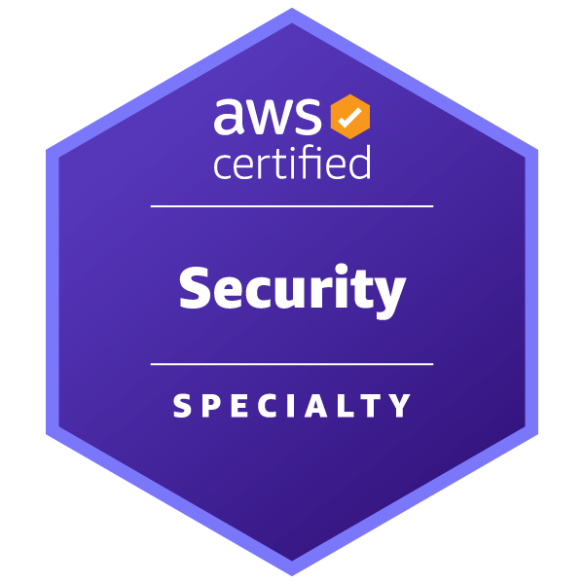
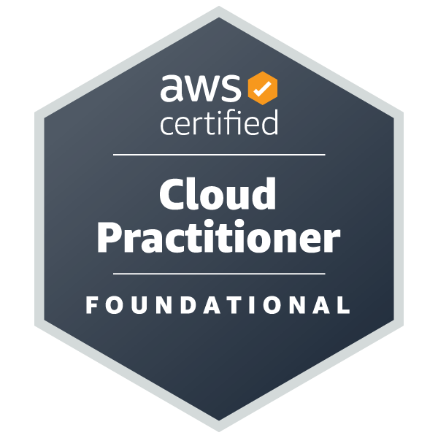
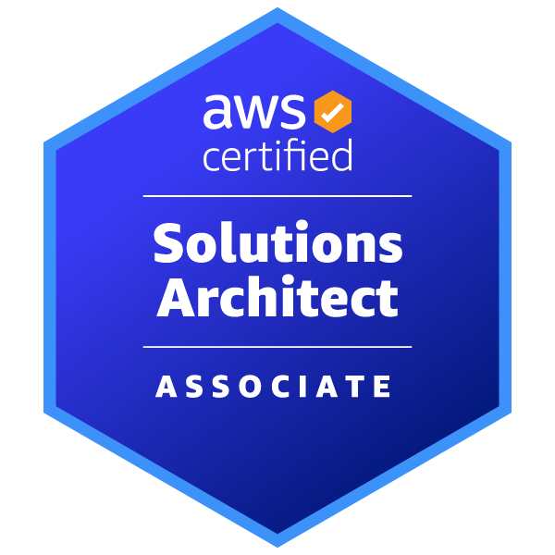
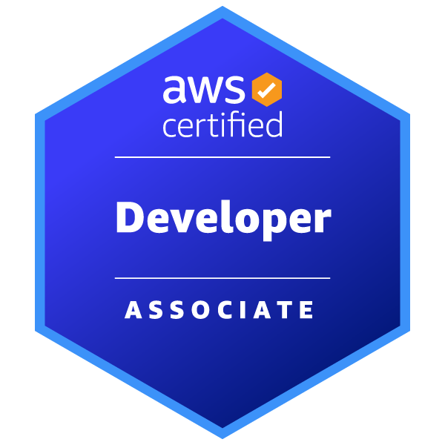
Introduction Lydia Delyova
Senior DevOps engineer in Deutsche Telekom (formerly T-Systems)
7+ years of experience in OS environment (AIX)
Switched to AWS DevOps in 2020
Focus on automation with IaC, Landing Zone, AI integration
Aspiring to become AWS Community builder in 2024
Interesting fact: Graduated from the Technical University of Aeronautics

Slide 4
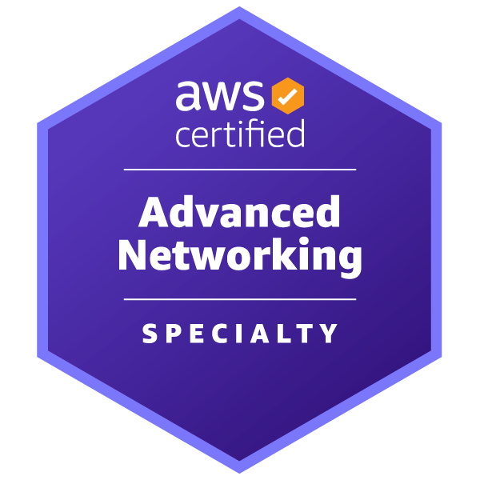
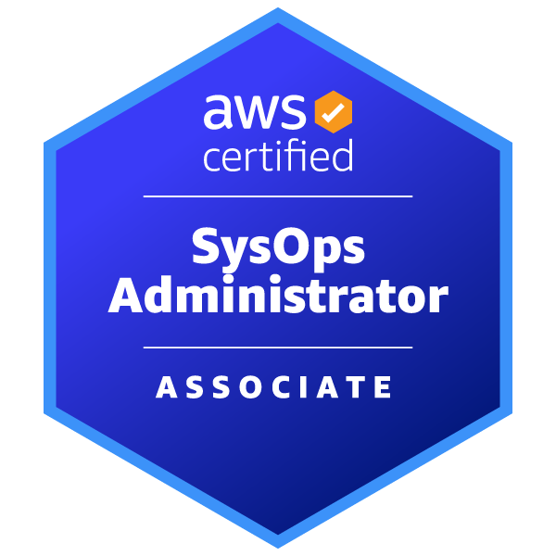
Introduction Michal Salanci
Senior DevOps engineer in Deutsche Telekom (formerly T-Systems)
AWS Community builder since 2023
10+ years of experience in classic networking
Switched to AWS DevOps in 2021
Focus on networking, serverless, containers, IaC

Slide 5
Agenda
BRIEF INTRODUCTION TO FORWARD PROXY
WHY FORWARD PROXY
INTRODUCING FORWARD PROXY v1 (2017)
Main issues we were facing
REFACTORING TO FORWARD PROXY v2 (2023)
AWS Network Firewall– Transparent Proxy
Squid Proxy in ECS container – Explicit Proxy
Logging
Routing and network flow
Comparison between v1 and v2

Slide 6
Brief introduction to forward proxy

Slide 7
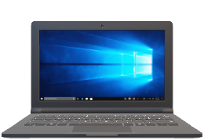







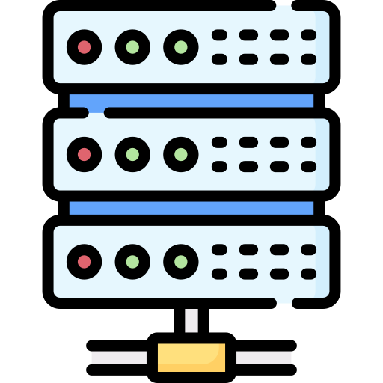
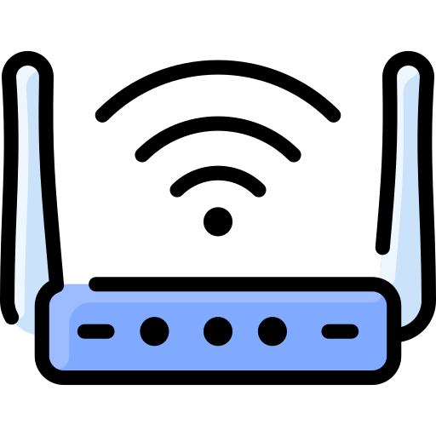



filtering
request
request
Forward proxy server
www.amazon.com
www.scamsite.com
response
response

Slide 8
Explicit proxy
Transparent proxy
Listening on specific IP address or URL
Terminates TCP session
Client need explicit configuration
Can be bypassed

Slide 9




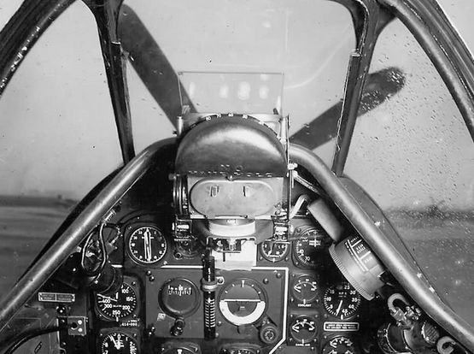
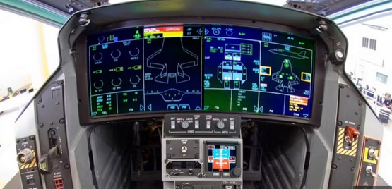
From P-51 Mustang to F-35 Lightning II
EC2 instance
NAT Gateway
Fargate
Network Firewall

Slide 10










It’s all about security
Customer _A VPC
Customer_B VPC
Private subnet
Private subnet
Secure the outbound connections
EC2 instance
EC2 instance
Prevent employees from accessing certain webs
Private subnet
Private subnet
Transit Gateway att.
Transit Gateway att.
Customer_C VPC
Customer_D VPC
Service VPC
Outbound VPC
Private subnet
Private subnet
Internet Gateway
Public subnet
EC2 instance
EC2 instance
Log gathering and Analytics:
Athena , Synthetics, etc...
Private subnet
Private subnet
NAT Gateway
Transit Gateway att.
Transit Gateway att.
Private subnet
Private subnet
Transit Gateway
Transit Gateway att.
Transit Gateway
Transit Gateway att.

Slide 11

Introducing Forward Proxy v1 (2017)

Slide 12



Customer VPC
Customer VPC
Private subnet
Private subnet
EC2 instance
EC2 instance
Private subnet
Private subnet
Whitelist
Whitelist
Blacklist
Squid.conf
Transit Gateway att.
Transit Gateway att.
Customer VPC
Customer VPC
Service VPC
Outbound VPC
Private subnet
Private subnet
Internet Gateway
Public subnet
EC2 instance
EC2 instance
Whitelist
Log gathering and Analytics:
Athena , Synthetics, etc...
Private subnet
Private subnet
NAT Gateway
Squid proxy EC2
Squid proxy EC2
NAT Gateway
0.0.0.0/0
Transit Gateway att.
Transit Gateway att.
Private subnet
Private subnet
Transit Gateway
Transit Gateway att.
Transit Gateway
Transit Gateway att.

Slide 13

It worked well… until it didn’t
Patching issues
Packet processing performance
No horizontal scaling
Refactoring was necessary !
Manual restart of squid
Manual S3 files edit
Outage

Slide 14
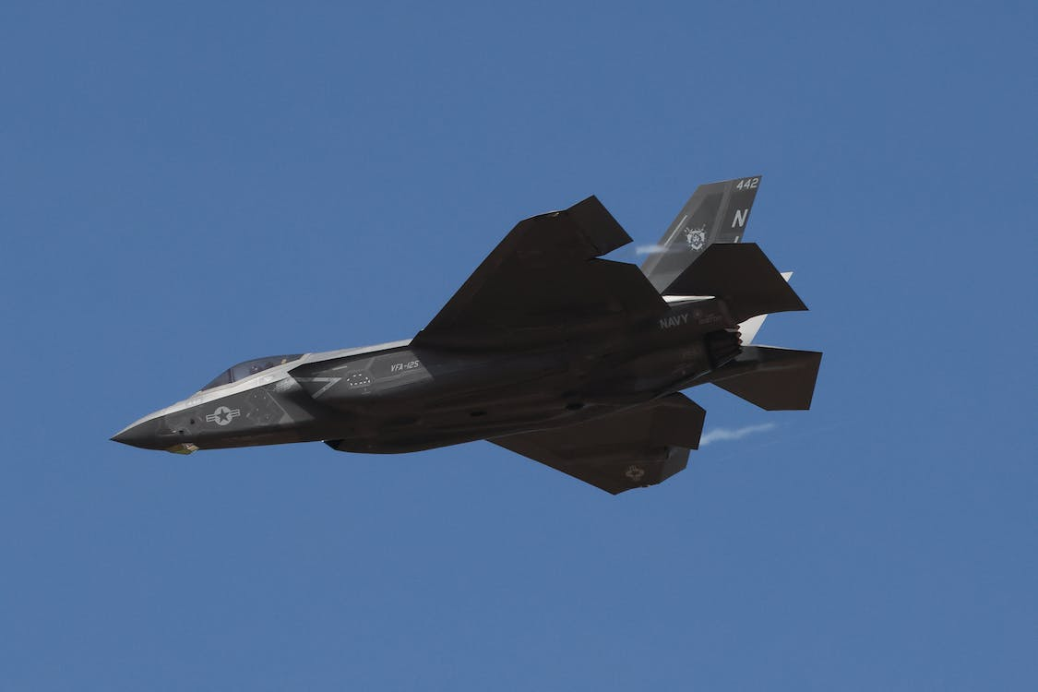
Refactoring to Forward Proxy v2 (2023)
From Mustang to Lightning II

Slide 15




Refactoring to Forward Proxy v2 (2023)
Customer VPC
Customer VPC
Private subnet
Private subnet
EC2 instance
EC2 instance
Outbound VPC
Private subnet
Private subnet
Internet Gateway
Whitelist
Blacklist
Squid.conf
Public subnet
Transit Gateway att.
Transit Gateway att.
Customer VPC
Customer VPC
Service VPC
Outbound VPC
Private subnet
Private subnet
Internet Gateway
Inspection subnet
Public subnet
EC2 instance
EC2 instance
Log gathering and Analytics:
Athena , Synthetics, etc...
AWS NFW
Private subnet
Private subnet
AWS NFW endpoint
Squid proxy EC2
Forward proxy container
Transit Gateway att.
Transit Gateway att.
Private subnet
Private subnet
Transit Gateway
Transit Gateway att.
Transit Gateway
Transit Gateway att.

Slide 16

Refactoring to Forward Proxy v2 (2023)
Customer VPC
Customer VPC
Private subnet
Private subnet
EC2 instance
EC2 instance
Outbound VPC
Private subnet
Private subnet
Internet Gateway
Whitelist
Blacklist
Squid.conf
Public subnet
Transit Gateway att.
Transit Gateway att.
Customer VPC
Customer VPC
Service VPC
NAT Gateway
Private subnet
Private subnet
Inspection subnet
Public subnet
EC2 instance
EC2 instance
Log gathering and Analytics:
Athena , Synthetics, etc...
AWS NFW
Private subnet
Private subnet
AWS NFW endpoint
Forward proxy container
Transit Gateway att.
Transit Gateway att.
Private subnet
Private subnet
Network loadbalaner
Transit Gateway
Transit Gateway att.
Transit Gateway
Transit Gateway att.

Slide 17
AWS Network Firewall – Transparent Proxy
VPC
Stateful rules
Inspection subnet
Stateless rules
Suricata compatible rules
Suricata compatible rules
Domain name rules
AWS Network Firewall endpoint
AWS Network Firewall

Slide 18

Squid Proxy in ECS Container – Explicit Proxy
Inspection subnet
Whitelist
Squid.conf
Squid in ECS container
Private subnet
Network Loadbalancer

Slide 19
Inspection subnet
ECS Task 192.168.2.33
ECS Task 192.168.2.112
ECS Task 192.168.2.247
ECS Task 192.168.2.148
curl –x internal-fwdproxynlb-1234567890-eu-central-1.elb.amazonaws.com
–I http://www.amazon.com
Private subnet
Network Loadbalancer
internal-fwdproxynlb-1234567890-eu-central-1.elb.amazonaws.com

Slide 20
Inspection subnet
v3.5
v3.5
v4.0
v4.0
ECS Task 192.168.2.33
ECS Task 192.168.2.112
ECS Task 192.168.2.247
ECS Task 192.168.2.148
curl –x internal-fwdproxynlb-1234567890-eu-central-1.elb.amazonaws.com
–I http://www.amazon.com
Private subnet
Network Loadbalancer
internal-fwdproxynlb-1234567890-eu-central-1.elb.amazonaws.com

Slide 21



Logging
AWS Network Firewall
Need stdout !
AWS CloudWatch
Squid in ECS container
stdout

Slide 22
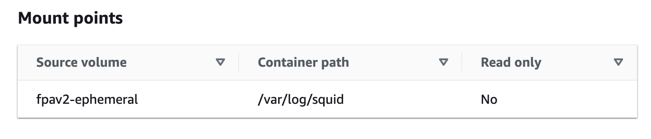
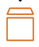
Fargate instance 1
Fargate instance 2
ECS Cluster
ECS Service
Task 1 – 192.168.2.28
Task 2 192.168.2.69
Squid container
Fluentbit container
Squid container
Fluentbit container
stdout
stdout
Instance store
Instance store
stdout
stdout
CloudWatch

Slide 23
Outbound VPC
New container deployed
AWS Network Firewall endpoint
Squid in ECS container
Suricata ruleset update
AWS Network Firewall
Notes:
There is also an automation implemented with CICD pipeline.
Every time there is any modification, like an whitelist entry, pipeline creates new docker image and deploys it as a new container
ANIMATE
In the same time, it also updates the network firewall ruleset.
this is how we make sure, we have the same rules on both proxies.

Slide 24
Comparing to v1 - What have we eliminated and what have we received
Patching issues
Packet processing performance
No horizontal scaling
Manual restart of squid
Manual S3 files edit
Outage

Slide 25

Comparing to v1 - What have we eliminated and what have we received
Smooth upgrades
Higher networking throughput
Better resiliency
Less ops overhead
High Availability

Slide 26
Routing and network flow

Slide 27




Client VPC 10.0.0.0/16
Transparent proxy
network flow
Outbound VPC – 192.168.0.0/16
Public subnet
192.168.0.0/16 | Local
10.0.0.0/16 | NFW
0.0.0.0/0 | IGW
Public subnet – 192.168.1.0/24
VPC main RT
10.0.0.0/16 | Local
0.0.0.0/0 | TGW
192.168.1.20
3.48.29.55
Private subnet 1 – 10.0.1.0/24
Inspection subnet
192.168.0.0/16 | Local
10.0.0.0/16 | TGW
0.0.0.0/0 | NATGW
Inspection subnet – 192.168.2.0/24
curl –I http://www.amazon.com
10.0.1.130
192.168.2.28
Private subnet 2 – 10.0.2.0/24
Private subnet
192.168.0.0/16 | Local
0.0.0.0/0 | NFW
Private subnet – 192.168.3.0/24
www.amazon.com
internal-fwdproxynlb-1234567890-eu-central-1.elb.amazonaws.com
192.168.3.10
Transity Gateway RT
10.0.0.0/16 | Client VPC TGW attachment
192.168.0.0/16 | Outbound VPC TGW attachment
0.0.0.0/0 | Outbound VPC TGW attachment

Slide 28
Client VPC 10.0.0.0/16
Explicit proxy
network flow
Outbound VPC– 192.168.0.0/16
Public subnet
192.168.0.0/16 | Local
10.0.0.0/16 | NFW
0.0.0.0/0 | IGW
Public subnet – 192.168.1.0/24
VPC main RT
10.0.0.0/16 | Local
0.0.0.0/0 | TGW
192.168.1.20
3.48.29.55
Private subnet 1 – 10.0.1.0/24
Inspection subnet
192.168.0.0/16 | Local
10.0.0.0/16 | TGW
0.0.0.0/0 | NATGW
Inspection subnet – 192.168.2.0/24
curl –x internal-fwdproxynlb-1234567890-eu-central-1.elb.amazonaws.com
–I http://www.amazon.com
10.0.1.130
192.168.2.28
Private subnet 2 – 10.0.2.0/24
Private subnet
192.168.0.0/16 | Local
0.0.0.0/0 | NFW
Private subnet – 192.168.3.0/24
www.amazon.com
internal-fwdproxynlb-1234567890-eu-central-1.elb.amazonaws.com
192.168.3.10
Transity Gateway RT
10.0.0.0/16 | Client VPC TGW attachment
192.168.0.0/16 | Outbound VPC TGW attachment
0.0.0.0/0 | Outbound VPC TGW attachment
SRC | DST
TCP Termination Webpage IP : 192.168.2.28 (Task IP) | 192.168.2.28 (Task IP) 10.0.1.130 (EC2 IP)
SRC | DST
NAT 192.168.2.28 (ECS Task IP) : 3.48.29.55 (NATGW IP) | Webpage IP
SRC | DST
Webpage IP | 3.48.29.55 (NATGW IP)
SRC | DST
TCP Termination 10.1.0.130 : 192.168.2.28 (ECS Task IP) | Network LoadBalancer 192.168.3.10 Webpage IP
SRC | DST
10.0.1.130 (EC2 IP) | Network LoadBalancer 192.168.3.10
SRC | DST
Webpage IP | NAT 3.48.29.55 (NATGW IP) : 192.168.2.28 (Task IP)

Slide 29


Lydia Delyova
Michal Salanci
Lydia.Delyova@t-systems.com
https://www.linkedin.com/in/lydia-delyova-26905216a/
michal.salanci@t-systems.com
https://www.linkedin.com/in/michal-salanci-3496724b/

Slide 30
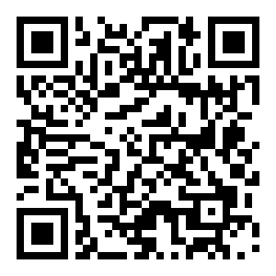
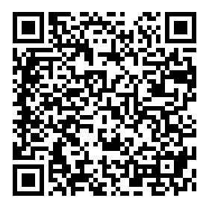
!
Please complete the session survey in the Events App
App Store
Google Play Store

