Slide 1

Cloud Day Prague
O2 Universum| 23 OCTOber 2024

Slide 2
Goodbye server!
Refactoring an application to serverless with AWS
COM306
Lydia Delyova
Michal Salanci
Cloud Architect
Deutsche Telekom IT Solutions
Lead Architect
Deutsche Telekom IT Solutions

Slide 3



Michal Salanci
Lead Architect Cybersecurity in Detusche Telekom IT Solutions Slovakia
AWS Community Builder since 2023, cat. Containers
AWS UG Kosice Leader

Slide 4
Agenda
01 | The customer demand | 05 | Limitations on ‘serverbased’ version
02 | Proxy 101 | 06 | Mitigating issues and going serverless [2022]
03 | ‘serverbased’ version [2019] | 07 | Liitations of serverless version

Slide 5
Customer demands

Slide 6





Customer demands
Customer VPC 1
Customer VPC 2
Private subnet
Private subnet
Internet access
Forward Proxy - secure the outgoing web traffic
Explicit and transparent capabilities of the proxy
Cost efficiency
EC2 instance
EKS
Customer VPC 3
Customer VPC n
Private subnet
Private subnet
ECS
EC2 instance

Slide 7








Customer VPC 1
Customer VPC 2
Internet access
Private subnet
Private subnet
EC2 instance
EKS
Outbound VPC
Private subnet
Private subnet
Internet Gateway
Public subnet
Transit Gateway att.
Transit Gateway att.
Customer VPC 3
Customer VPC n
Service VPC
NAT Gateway
Private subnet
Private subnet
ECS
EC2 instance
Log gathering and Analytics:
Athena, etc...
Private subnet
Private subnet
Transit Gateway att.
Transit Gateway att.
Private subnet
Private subnet
Transit Gateway
Transit Gateway
Transit Gateway att.

Slide 8
Forward Proxy 101

Slide 9

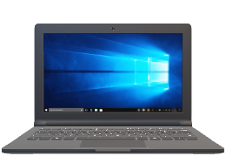



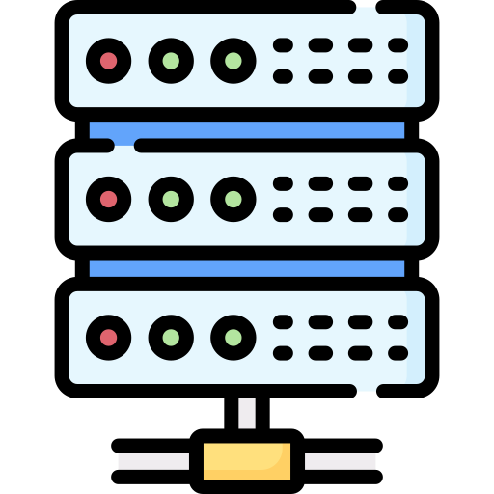

The concept of Forward Proxy
Data Center
filtering
Forward proxy server
www.somesite.com

Slide 10



The concept of Forward Proxy
AWS Cloud
filtering
Forward proxy server
www.somesite.com

Slide 11
Explicit proxy vs Transparent proxy
Explicit
Transparent

Slide 12
Listening the traffic
Explicit
Transparent
myproxy.com:3128
Client
Forward Proxy
Server
Client
Forward Proxy
Server
Webserver
Webserver

Slide 13
Client interaction
Explicit
Transparent
curl https://www.amazon.com
curl -x http://myproxy.com:3128 https://www.amazon.com
curl -x https://www.amazon.com
myproxy.com:3128
Client
Forward Proxy
Server
Client
Forward Proxy
Server
www.amazon.com
www.amazon.com

Slide 14
TCP termination
Explicit
Transparent
curl -x http://myproxy.com:3128 https://www.amazon.com
curl -x https://www.amazon.com
myproxy.com:3128
Client
Forward Proxy
Server
Client
Forward Proxy
Server
www.amazon.com
www.amazon.com
TCP session 1
TCP session 2
TCP session 1

Slide 15
‘Serverbased’ version [2019]

Slide 16
Customer VPC
Customer VPC
'Serverbased‘ version
Private subnet
Private subnet
EC2 instance
EC2 instance
Private subnet
Private subnet
Transit Gateway att.
Transit Gateway att.
Customer VPC
Customer VPC
Service VPC
Outbound VPC
Private subnet
Private subnet
Internet Gateway
Public subnet
EC2 instance
EC2 instance
Log gathering and Analytics:
Athena, etc...
Private subnet
Private subnet
NAT Gateway
Transit Gateway att.
Transit Gateway att.
Private subnet
Private subnet
Transit Gateway
Transit Gateway att.
Transit Gateway
Transit Gateway att.

Slide 17
Customer VPC
Customer VPC
'Serverbased‘ version
Private subnet
Private subnet
EC2 instance
EC2 instance
Private subnet
Private subnet
Transit Gateway att.
Transit Gateway att.
Customer VPC
Customer VPC
Service VPC
Outbound VPC
Private subnet
Private subnet
Internet Gateway
Public subnet
EC2 instance
EC2 instance
Log gathering and Analytics:
Athena, etc...
Private subnet
Private subnet
NAT Instance
Transit Gateway att.
Transit Gateway att.
Private subnet
Private subnet
Transit Gateway
Transit Gateway att.
Transit Gateway
Transit Gateway att.

Slide 18

Customer VPC
Customer VPC
'Serverbased‘ version
Private subnet
Private subnet
EC2 instance
EC2 instance
Private subnet
Private subnet
Transit Gateway att.
Transit Gateway att.
Customer VPC
Customer VPC
Service VPC
Outbound VPC
Private subnet
Private subnet
Internet Gateway
Public subnet
EC2 instance
EC2 instance
Log gathering and Analytics:
Athena, etc...
Private subnet
Private subnet
NAT Instance + Squid proxy
Transit Gateway att.
Transit Gateway att.
Private subnet
Private subnet
Transit Gateway
Transit Gateway att.
Transit Gateway
Transit Gateway att.

Slide 19

Customer VPC
Customer VPC
'Serverbased‘ version
Private subnet
Private subnet
EC2 instance
EC2 instance
Private subnet
Private subnet
Whitelist
Whitelist
Blacklist
Squid.conf
Transit Gateway att.
Transit Gateway att.
Customer VPC
Customer VPC
Service VPC
Outbound VPC
Private subnet
Private subnet
Internet Gateway
Public subnet
EC2 instance
EC2 instance
Whitelist
Log gathering and Analytics:
Athena , etc...
Private subnet
Private subnet
NAT Instance + Squid proxy
Transit Gateway att.
Transit Gateway att.
Private subnet
Private subnet
Transit Gateway
Transit Gateway att.
Transit Gateway
Transit Gateway att.

Slide 20

Customer VPC
Customer VPC
'Serverbased‘ version
Private subnet
Private subnet
EC2 instance
EC2 instance
Private subnet
Private subnet
Whitelist
Blacklist
Squid.conf
Transit Gateway att.
Transit Gateway att.
Customer VPC
Customer VPC
Service VPC
Outbound VPC
Private subnet
Private subnet
Internet Gateway
Public subnet
EC2 instance
EC2 instance
Log gathering and Analytics:
Athena, etc...
EIP
Private subnet
Private subnet
NAT Instance + Squid proxy
0.0.0.0/0
Transit Gateway att.
Transit Gateway att.
Private subnet
Private subnet
Transit Gateway
Transit Gateway att.
Transit Gateway
Transit Gateway att.

Slide 21
Limitations
Whitelist
Blacklist
Squid.conf
SCALING | Not possible because of EIP
Outbound VPC
NETWORK TRANSFER | Nerwork interface limits
Internet Gateway
Public subnet
RESILIENCY | Took some time to recover
UPGRADING | Unupgradable instance
NAT Instance + Squid proxy
0.0.0.0/0
OPS OVERHEAD | A lot of manual jobs
Private subnet
Transit Gateway att.

Slide 22
Mitigating issues by going serverless

Slide 23

EC2 vs Serverless ?
AWS native vs 3rd party?

Slide 24



EC2? Serverless? AWS Native? 3rd party?
Squid Proxy
Squid Proxy
NGINX
NGINX
Fargate
HA Proxy
EC2
HA Proxy

Slide 25





EC2? Serverless? AWS Native? 3rd party?
Palo Alto NFW
Firepower
BIG-IP LTM/APM
GW LoadBalancer
Fortigate

Slide 26



EC2? Serverless? AWS Native? 3rd party?
VPC
Stateful rules
Inspection subnet
Stateless rules
Domain name rules
Suricata compatible rules
AWS Network Firewall endpoint
AWS Network Firewall
Transparent mode only

Slide 27
Transparent proxy final decision
Squid Proxy
Squid Proxy
NGINX
NGINX
EC2
HA Proxy
Fargate
HA Proxy
Palo Alto NFW
Inspection subnet
Firepower
BIG-IP LTM/APM
AWS Network Firewall endpoint
GW LB
AWS Network Firewall
Fortigate

Slide 28
Explicit proxy final decision
Inspection subnet
Squid Proxy
Squid Proxy
Squid Proxy
NGINX
NGINX
EC2
HA Proxy
Fargate
HA Proxy
Fargate
Forward proxy ECS Task
Palo Alto NFW
Inspection subnet
Firepower
BIG-IP LTM/APM
AWS Network Firewall endpoint
GW LB
AWS Network Firewall
Fortigate

Slide 29
Serverless forward proxy
Inspection subnet
Explicit
Transparent
Squid Proxy
AWS NFW
Fargate
AWS NFW endpoint
Forward proxy ECS Task

Slide 30
Limitations of serverless explicit proxy

Slide 31

Logging with Squid – introducing FluenbtBit
Task 1 – 192.168.2.28
Squid container
FluentBit container
CloudWatch

Slide 32


Logging with Squid – the storage
Fargate instance 1
Task 1 – 192.168.2.28
Squid container
FluentBit container
CloudWatch
Instance Store

Slide 33

Squid URL and port – make an explicit the explicit again
Inspection subnet – 192.168.2.0/24
Squid Proxy
curl –x internal-fwdproxynlb-1234567890-eu-central-1.elb.amazonaws.com:3128 –I http://www.amazon.com
FluentBit
Fargate
ECS Task
Private subnet – 192.168.3.0/24
Network Loadbalancer
internal-fwdproxynlb-1234567890-eu-central-1.elb.amazonanaws.com:3128

Slide 34
Containers – easy to scale, easy to upgrade
Inspection subnet – 192.168.2.0/24
ECS Task 192.168.2.33
ECS Task 192.168.2.112
ECS Task 192.168.2.247
ECS Task 192.168.2.148
Private subnet – 192.168.3.0/24
Network Loadbalancer
internal-fwdproxynlb-1234567890-eu-central-1.elb.amazonanaws.com:3128

Slide 35
Limitations of serverless transparent proxy

Slide 36
Some news about AWS Network Firewall
VPC
Managed L3-L7 firewall
Inspection subnet
Scales as needed
Direct integration with CloudWatch
Supports multiple ruletypes
AWS Network Firewall endpoint
AWS Network Firewall
???

Slide 37
AWS Network Firewall – the bad news
VPC
Blocked domain visible only
Inspection subnet
CloudWatch logs significant delay
AWS Network Firewall endpoint
AWS Network Firewall

Slide 38


AWS Network Firewall – the good news
VPC
Blocked domain visible only
Inspection subnet
CloudWatch logs significant delay
AWS Network Firewall endpoint
AWS Network Firewall

Slide 39
pass http any any -> any any (http.host; content:”amazon.com"; endswith; sid:5 rev:1;)
alert http any any -> any any (http.host; content :”amazon.com"; endswith; sid:5; rev:1;)
pass http any any -> any any (http.host; content:”amazon.com"; endswith; sid:50; rev:1;)
pass tls any any -> any any (tls.sni; content:" amazon.com "; endswith; sid:6; rev:1;)
pass http any any -> any any (http.host; content:" amazon.com "; endswith; sid:60; rev:1;)
alert tls any any -> any any (tls.sni; content:" amazon.com "; endswith; sid:60; rev:1;)
pass tls any any -> any any (tls.sni; content:" amazon.com "; endswith; sid:6; rev:1;)
alert http any any -> any any (http.host; content :”amazon.com"; endswith; sid:50; rev:1;)
pass http any any -> any any (http.host; content:" amazon.com "; endswith; sid:5; rev:1;)

Slide 40
alert tls any any <> any any (msg:"pass all tls traffic from/to whitelisted IPs"; sid:2;)
alert http any any <> any any (msg:"pass all http traffic from/to whitelisted IPs"; sid:4;)
pass tls any any -> any any (tls.sni; content:" amazon.com"; endswith; sid:6; rev:1;)
pass http any any -> any any (http.host; content:" amazon.com "; endswith; sid:5; rev:1;)
pass tls any any -> any any (tls.sni; content:" google.com "; endswith; sid:7; rev:1;)
pass http any any -> any any (http.host; content:" google.com "; endswith; sid:8; rev:1;)
pass tls any any -> any any (tls.sni; content:"github.com"; endswith; sid:9; rev:1;)
pass http any any -> any any (http.host; content:" github.com "; endswith; sid:10; rev:1;)
pass tls any any -> any any (tls.sni; content:”nhl.com"; endswith; sid:11; rev:1;)
pass http any any -> any any (http.host; content:" nhl.com "; endswith; sid:12; rev:1;)
reject tcp any any -> any any (flow:established; msg:"no pass or alert rule hit - sending TCP RST"; sid:5000; rev:1;)

Slide 41
Going beyond

Slide 42
DNS resolving
Inspection subnet – 192.168.2.0/24
Squid Proxy
FluentBit
Fargate
ECS Task Proxy
Private subnet – 192.168.3.0/24
Network Loadbalancer
internal-fwdproxynlb-1234567890-eu-central-1.elb.amazonanaws.com:3128

Slide 43

DNS resolving
Inspection subnet – 192.168.2.0/24
Squid Proxy
curl –x internal-fwdproxynlb-1234567890-eu-central-1.elb.amazonaws.com:3128 \
–I http://www.amazon.com
Dnsmasq
FluentBit
dig @internal-fwdproxynlb-1234567890-eu-central-1.elb.amazonaws.com \
www.amazon.com
Fargate
ECS Task DNS
ECS Task Proxy
Private subnet – 192.168.3.0/24
Network Loadbalancer
internal-fwdproxynlb-1234567890-eu-central-1.elb.amazonanaws.com:3128
internal-fwdproxynlb-1234567890-eu-central-1.elb.amazonanaws.com:53

Slide 44
Customer VPC 1
Customer VPC 2
Custom monitoring
Private subnet
Private subnet
EC2 instance
EC2 instance
Outbound VPC
Private subnet
Private subnet
Internet Gateway
Public subnet
Transit Gateway att.
Transit Gateway att.
Customer VPC 3
Customer VPC n
Service VPC
NAT Gateway
Private subnet
Private subnet
Log gathering and Analytics:
Athena, etc...
EC2 instance
EC2 instance
AWS NFW
Private subnet
Private subnet
Fargate
AWS NFW endpoint
Transit Gateway att.
Transit Gateway att.
Private subnet
Private subnet
Network LB
Transit Gateway
Transit Gateway att.
Transit Gateway
Transit Gateway att.

Slide 45

Outbound VPC
Cloudwatch
Internet Gateway
Public subnet
Service VPC
NAT Gateway
Log gathering and Analytics:
Athena, etc...
AWS NFW
Fargate
AWS NFW endpoint
Private subnet
Private subnet
Network LB
Transit Gateway att.
Transit Gateway
Transit Gateway att.

Slide 46
Customer VPC 1
Customer VPC 2
Custom monitoring
Private subnet
Private subnet
EC2 instance
EC2 instance
Outbound VPC
Private subnet
Private subnet
Internet Gateway
Public subnet
Transit Gateway att.
Transit Gateway att.
Customer VPC 3
Customer VPC n
Service VPC
NAT Gateway
Private subnet
Private subnet
Log gathering and Analytics:
Athena, etc...
EC2 instance
EC2 instance
AWS NFW
Private subnet
Private subnet
Fargate
AWS NFW endpoint
Transit Gateway att.
Transit Gateway att.
Private subnet
Private subnet
Network LB
Transit Gateway
Transit Gateway att.
Transit Gateway
Transit Gateway att.

Slide 47

Custom monitoring - Telegraf
Service VPC
Outbound VPC
Sends http/DNS request
Internet Gateway
Public subnet
Log gathering and Analytics:
Athena, etc...
Receive http/DNS response
NAT Gateway
Private subnet
Collect metrics
Telegraf
AWS NFW
Fargate
Fargate
AWS NFW endpoint
Send them to cloudwatch
Private subnet
Private subnet
Network LB
Transit Gateway att.
Transit Gateway
Transit Gateway att.

Slide 48
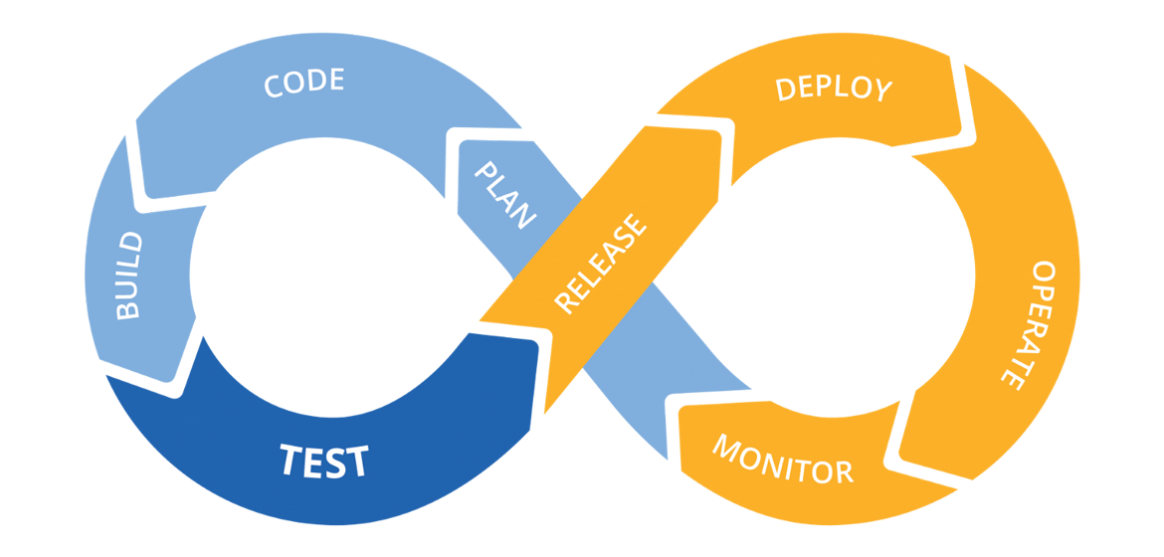
Automation – CI/CD Pipeline
Customer edit the repo and creates merge request
Merged by admin
New Docker image is created for Explicit Proxy
Rule set on NFW are updated
Deployed to Dev, Test, Prod

Slide 49
Automation – CI/CD Pipeline
Customer edit the repo and creates merge request
Merged by admin
New Docker image is created for Explicit Proxy
Rule set on NFW are updated
Deployed to Dev, Test, Prod

Slide 50









The flow – explicit proxy
curl –x internal-fwdproxynlb-1234567890-eu-central-1.elb.amazonaws.com:3128 –I http://www.amazon.com
Client VPC 10.0.0.0/16
Outbound VPC– 192.168.0.0/16
Public subnet
192.168.0.0/16 | Local
10.0.0.0/16 | NFW
0.0.0.0/0 | IGW
Public subnet – 192.168.1.0/24
VPC main RT
10.0.0.0/16 | Local
0.0.0.0/0 | TGW
192.168.1.20
3.48.29.55
Private subnet 1 – 10.0.1.0/24
Inspection subnet
192.168.0.0/16 | Local
10.0.0.0/16 | TGW
0.0.0.0/0 | NATGW
Inspection subnet – 192.168.2.0/24
Transity Gateway RT
10.0.0.0/16 | Client VPC TGW att.
192.168.0.0/16 | Outbound VPC TGW att.
0.0.0.0/0 | Outbound VPC TGW att.
10.0.1.130
192.168.2.28
Network Firewall
Private subnet 2 – 10.0.2.0/24
Private subnet
192.168.0.0/16 | Local
0.0.0.0/0 | NFW
Private subnet – 192.168.3.0/24
Network LB

Slide 51
The flow – explicit proxy
curl –x internal-fwdproxynlb-1234567890-eu-central-1.elb.amazonaws.com:3128 –I http://www.amazon.com
Client VPC 10.0.0.0/16
Outbound VPC– 192.168.0.0/16
Public subnet
192.168.0.0/16 | Local
10.0.0.0/16 | NFW
0.0.0.0/0 | IGW
Public subnet – 192.168.1.0/24
VPC main RT
10.0.0.0/16 | Local
0.0.0.0/0 | TGW
REQUEST ->
RESPONE <-
192.168.1.20
3.48.29.55
Private subnet 1 – 10.0.1.0/24
Inspection subnet
192.168.0.0/16 | Local
10.0.0.0/16 | TGW
0.0.0.0/0 | NATGW
Inspection subnet – 192.168.2.0/24
Transity Gateway RT
10.0.0.0/16 | Client VPC TGW attachment
192.168.0.0/16 | Outbound VPC TGW attachment
0.0.0.0/0 | Outbound VPC TGW attachment
10.0.1.130
192.168.2.28
Network Firewall
Private subnet 2 – 10.0.2.0/24
Private subnet
192.168.0.0/16 | Local
0.0.0.0/0 | NFW
Private subnet – 192.168.3.0/24
Network LB

Slide 52
The flow – Transparent proxy
curl –I http://www.amazon.com
Client VPC 10.0.0.0/16
Outbound VPC– 192.168.0.0/16
Public subnet
192.168.0.0/16 | Local
10.0.0.0/16 | NFW
0.0.0.0/0 | IGW
Public subnet – 192.168.1.0/24
VPC main RT
10.0.0.0/16 | Local
0.0.0.0/0 | TGW
192.168.1.20
3.48.29.55
Private subnet 1 – 10.0.1.0/24
Inspection subnet
192.168.0.0/16 | Local
10.0.0.0/16 | TGW
0.0.0.0/0 | NATGW
Inspection subnet – 192.168.2.0/24
Transity Gateway RT
10.0.0.0/16 | Client VPC TGW attachment
192.168.0.0/16 | Outbound VPC TGW attachment
0.0.0.0/0 | Outbound VPC TGW attachment
10.0.1.130
192.168.2.28
Network Firewall
Private subnet 2 – 10.0.2.0/24
Private subnet
192.168.0.0/16 | Local
0.0.0.0/0 | NFW
Private subnet – 192.168.3.0/24
Network LB

Slide 53
The flow – Transparent proxy
curl –I http://www.amazon.com
Client VPC 10.0.0.0/16
Outbound VPC– 192.168.0.0/16
Public subnet
192.168.0.0/16 | Local
10.0.0.0/16 | NFW
0.0.0.0/0 | IGW
Public subnet – 192.168.1.0/24
VPC main RT
10.0.0.0/16 | Local
0.0.0.0/0 | TGW
REQUEST ->
RESPONE <-
192.168.1.20
3.48.29.55
Private subnet 1 – 10.0.1.0/24
Inspection subnet
192.168.0.0/16 | Local
10.0.0.0/16 | TGW
0.0.0.0/0 | NATGW
Inspection subnet – 192.168.2.0/24
Transity Gateway RT
10.0.0.0/16 | Client VPC TGW attachment
192.168.0.0/16 | Outbound VPC TGW attachment
0.0.0.0/0 | Outbound VPC TGW attachment
10.0.1.130
192.168.2.28
Network Firewall
Private subnet 2 – 10.0.2.0/24
Private subnet
192.168.0.0/16 | Local
0.0.0.0/0 | NFW
Private subnet – 192.168.3.0/24
Network LB

Slide 54
Customer VPC 1
Customer VPC 2
Serverless forward Proxy
Private subnet
Private subnet
Service VPC
EC2 instance
EC2 instance
Outbound VPC
Private subnet
Private subnet
Internet Gateway
Public subnet
Transit Gateway att.
Transit Gateway att.
Log gathering and Analytics:
Athena , Synthetics, etc...
Customer VPC 3
Customer VPC n
NAT Gateway
Private subnet
Private subnet
Private subnet
EC2 instance
EC2 instance
Telegraf
AWS NFW
Private subnet
Private subnet
Fargate
Fargate
AWS NFW endpoint
Transit Gateway att.
Transit Gateway att.
Private subnet
Private subnet
Network LB
Transit Gateway
Transit Gateway att.
Transit Gateway
Transit Gateway att.

Slide 55

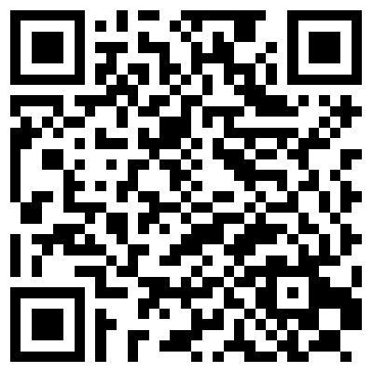
Michal Salanci
salanci_m@yahoo.com

Slide 56


!
Please complete the session survey in the Events App
App Store
Google Play Store

Slide 57
How to use this event template

Slide 58
Font guidance
Font family
Only use the Amazon Ember Display font family (with the exception of code, which should use
Lucida Console).
Use Amazon Ember Display Heavy for titles, sentence case (sentence-style capitalization).
Use Amazon Ember Display for slide text, sentence case.
Font styling
Do not underline text that is not a hyperlink.
Use font sizes that are at least 20 pt. for slide text and at least 12 pt. for diagrams.
If using color for emphasis in text, use bold as well.

Slide 59
Visual accessibility guidelines
For visibility, use a minimum 20 pt for slide text and 12 pt for diagrams. For lines, use a minimum 1.5 pt line weight.
Color also affects visibility. Text (or lines) and the background should have a contrast ratio of at least 4.5:1. Generally, white or black on a strongly contrasting background is the best choice.
Avoid using color as a sole indicator of difference (for example, use labels in addition to color to differentiate lines).

Slide 60
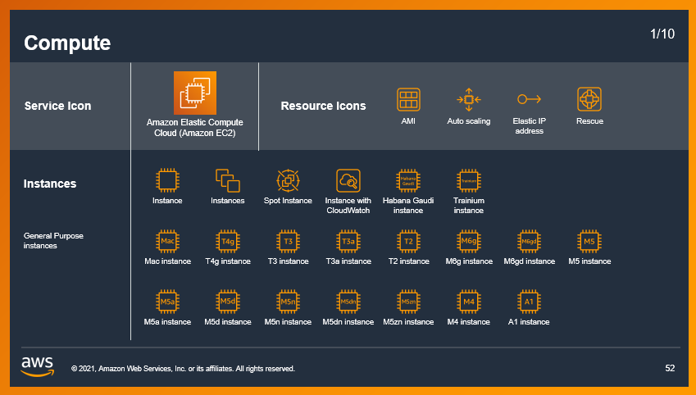

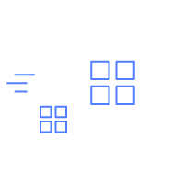

Icons, logos, diagrams, images and links
Only use logos, icons, photos, screenshots, and illustrations that your company has permission (a license) from the copyright owner to use.
Keep slide diagrams as simple as possible; split content over several slides rather than forcing it all onto one.
Use simple, subtle animations as needed to direct audience attention and clarify relationships. Avoid dramatic transitions or animations (such as “Random Bars,” “Dissolve,” or “Spin”).
Please display links as QR Codes if possible (Link to QR Code Generator).
Only use one QR Code per slide to make sure the audience is able to scan those, esp. if they are sitting in the back.
Download AWS architecture icons from the AWS website
AWS speakers, download illustrations, icons, and AWS logos from the brand portal
AWS speakers, find licensed stock photography on Amazon Freeway or ask Event lead for content from Adobe Stock

Slide 61
Examples of how to use the template layouts

Slide 62
Presentation slide examples for reference
ABC229-S
Sponsored by anycompany
XXX (she/her)
XXX (he/him)
Senior Solutions Architect
AnyCompany
Principal Engineer
Example Corp.

Slide 63
Agenda
Where we were
Our roadmap to the solution
Key steps we took and decisions we made
How we solved the problem
Where we are today

Slide 64

Good presentations
Are customer-focused
Are true to the abstract
Tell a story
Provide clear takeaways
Have simple visuals and one message per slide

Slide 65
Every new thing creates two new questions and two new opportunities.
Jeff Bezos
Founder and Executive Chair of Amazon

Slide 66
Tables
USE ONE OF THESE preformatted TABLES AS A STARTING POINT OR MODEL FOR YOUR TABLE
 | Tables | Charts
Main use | Focus on data points | Focus on trends or relationships
Main benefit | Precise | Visual
Second benefit | Drill down on specific data | Simplify complex datasets
Data tips | Table tips | Table formatting | Table don’ts
Be honest and precise | Remove clutter | Left align | Don’t use tiny text
Make a point | Emphasize message | Use consistent sizes | Don’t include it all
Use the right method | Keep it short | Use visible colors | Don’t overcomplicate

Slide 67
Charts
To create a new chart, select Insert tab > Chart. Enter your data and adjust the font sizes to the minimum 12 pt. or larger.
Use a bright color to emphasize the most important data. Use subtle colors for other data.

