Slide 1
Welcome slide
POLAND | 6 MAY 2025

Slide 2
Logs talk to me!
Using Amazon Bedrock to Chat About Logs
COM206
Michal Salanci
Senior Cloud Operations Expert @enspired

Slide 3




Michal Salanci
Senior Cloud Operations Expert at enspired
AWS Community Builder since 2023, cat. Containers
Leader of AWS User Group Kosice

Slide 4
Logs talk to me!
Using Amazon Bedrock to Chat About Logs

Slide 5
Why Logs Need to Talk

Slide 6
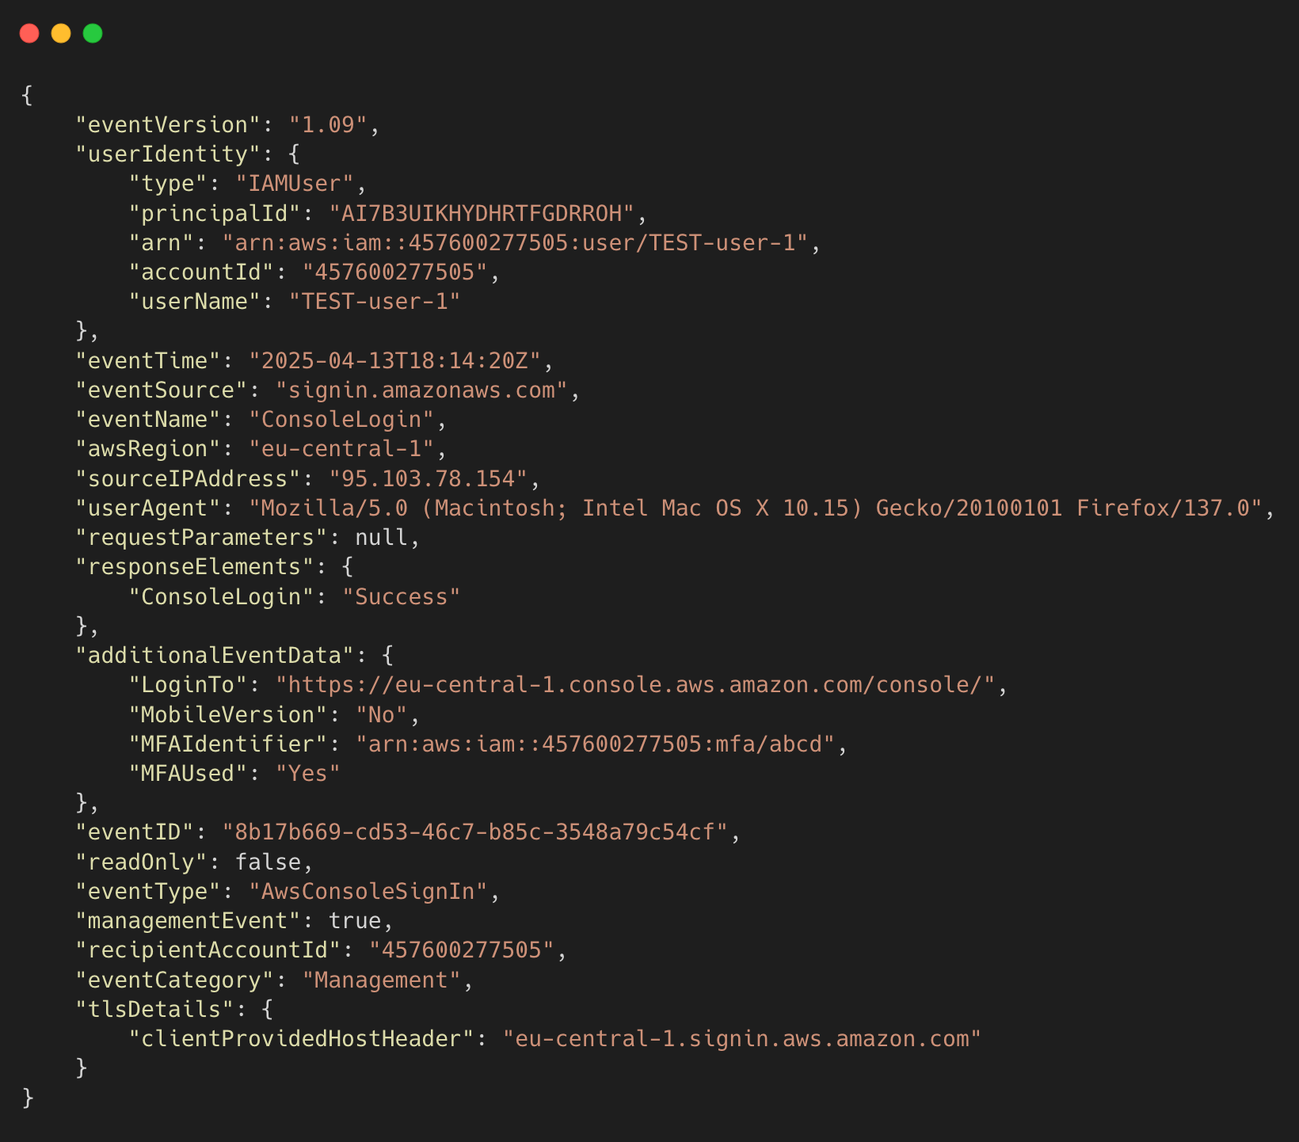
AWS CloudTrail Logs
😰 Difficult to read and understand
- especially for non-security folks
🔍 Complex JSON format

Slide 7
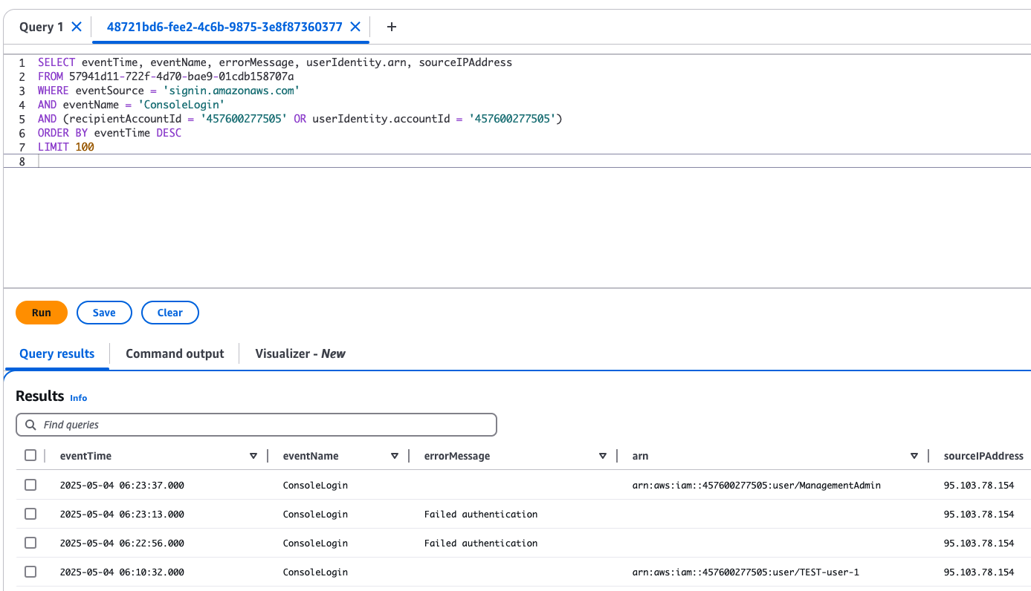
AWS CloudTrail Logs
🧑‍💻 Can be queried in
CloudTrail Lake

Slide 8
AWS CloudTrail Logs
Q: summarize API calls for username John.Doe in account 123456789012
🤔 Is there other way?
🤖 Turn logs into human-readable Question-Answer using GenAI
# API Calls by User Summary
1. **User: John.Doe (IP: 195.91.12.98) - May 6, 2025**
- SUCCESSFUL login at 05:49:14
- SUCCESSFUL CheckMfa at 05:48:57
- API calls summary:
- Monitoring service: 4 calls for DescribeAlarms
- Health service: 4 calls including DescribeEventAggregates (3), DescribeEvents (1)
Q: give me last 5 SUCCESSFUL logins into account 123456789012
A: # Successful Login Summary
1. May 4, 2025: 4 successful logins from IP 95.103.78.154
- User John.Doe: 3 logins at 06:00:57, 06:05:22, and 06:23:37
- User TEST-user-1: 1 login at 06:10:32
2. April 26, 2025: 1 successful login from IP 95.103.78.154
- User ManagementAdmin: 1 login at 11:20:08

Slide 9
Project Overview

Slide 10

AWS CloudTrail
account #1
AWS CloudTrail
account #2
AWS CloudTrail
account #3

Slide 11

AWS CloudTrail
account #1
CloudTrail Lake
AWS CloudTrail
account #2
AWS CloudTrail
account #3

Slide 12

User
AWS CloudTrail
account #1
CloudTrail Lake
AWS CloudTrail
account #2
AWS CloudTrail
account #3

Slide 13

User
Amazon Lex
AWS CloudTrail
account #1
CloudTrail Lake
AWS CloudTrail
account #2
AWS CloudTrail
account #3

Slide 14

User
Amazon Lex
AWS Lambda
AWS CloudTrail
account #1
CloudTrail Lake
AWS CloudTrail
account #2
AWS CloudTrail
account #3

Slide 15
User
Amazon Lex
AWS Lambda
AWS CloudTrail
account #1
CloudTrail Lake
AWS CloudTrail
account #2
AWS CloudTrail
account #3

Slide 16


User
Amazon Lex
AWS Lambda
Amazon Bedrock
Anthropic Claude 3.7 Sonnet
AWS CloudTrail
account #1
CloudTrail Lake
AWS CloudTrail
account #2
AWS CloudTrail
account #3

Slide 17
User
Amazon Lex
AWS Lambda
Amazon Bedrock
Anthropic Claude 3.7 Sonnet
AWS CloudTrail
account #1
CloudTrail Lake
AWS CloudTrail
account #2
AWS CloudTrail
account #3

Slide 18
Lex and Lambda (L&L’s)

Slide 19
Amazon Lex
🗣️ Captures natural language input (e.g., “Show failed logins”)
🧠 Understands user intent and extracts key details
⚙️ Triggers AWS Lambda to process the request
😊 Returns AI-generated response to the user
☁️ Fully serverless

Slide 20
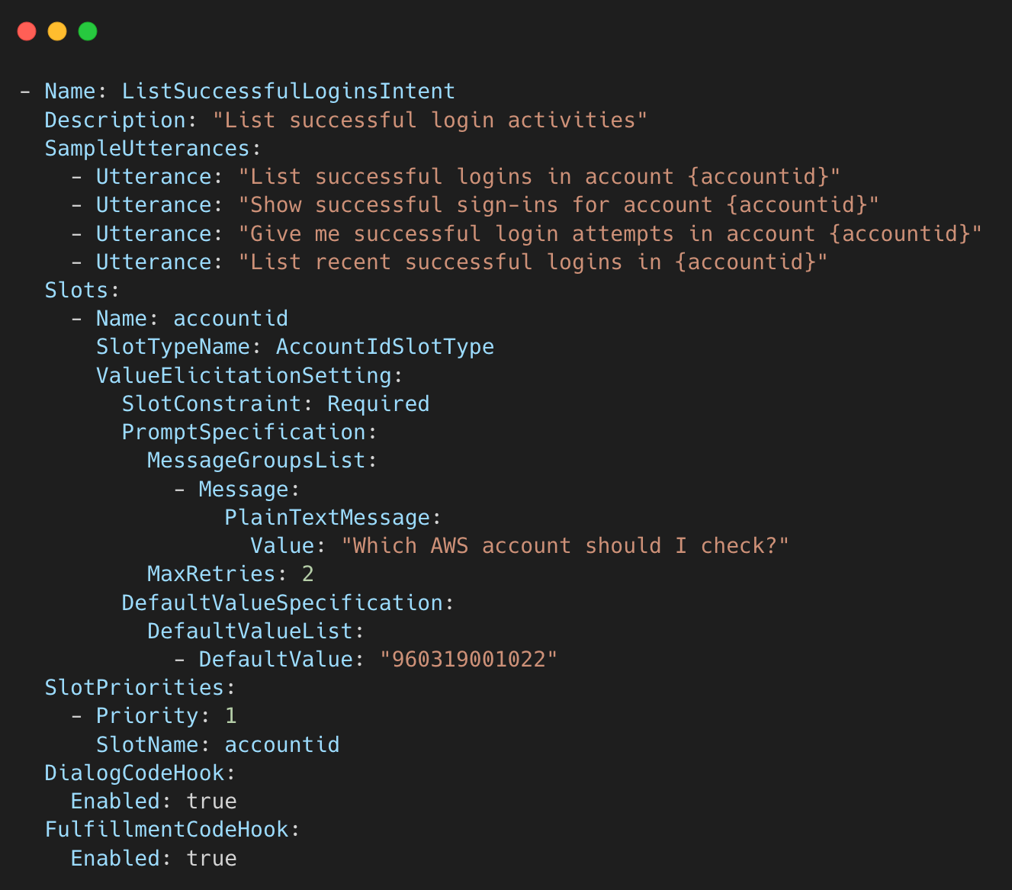
Amazon Lex
Q: give me last 5 SUCCESSFUL logins into account 123456789012
Detects best matching intent

Slide 21
Amazon Lex
Q: give me last 5 SUCCESSFUL logins into account 123456789012
Detects best matching intent
Extract slot values:
  username
  accountid
  timeframe hours
Raw message: give me last 5 SUCCESSFUL logins into account 457600277505
Lex Intent: ListSuccessfulLoginsIntent
Lex Extracted slots: accountID: 457600277505

Slide 22
AWS Lambda
🧠 The brain how to get all necessary information to Bedrock

Slide 23
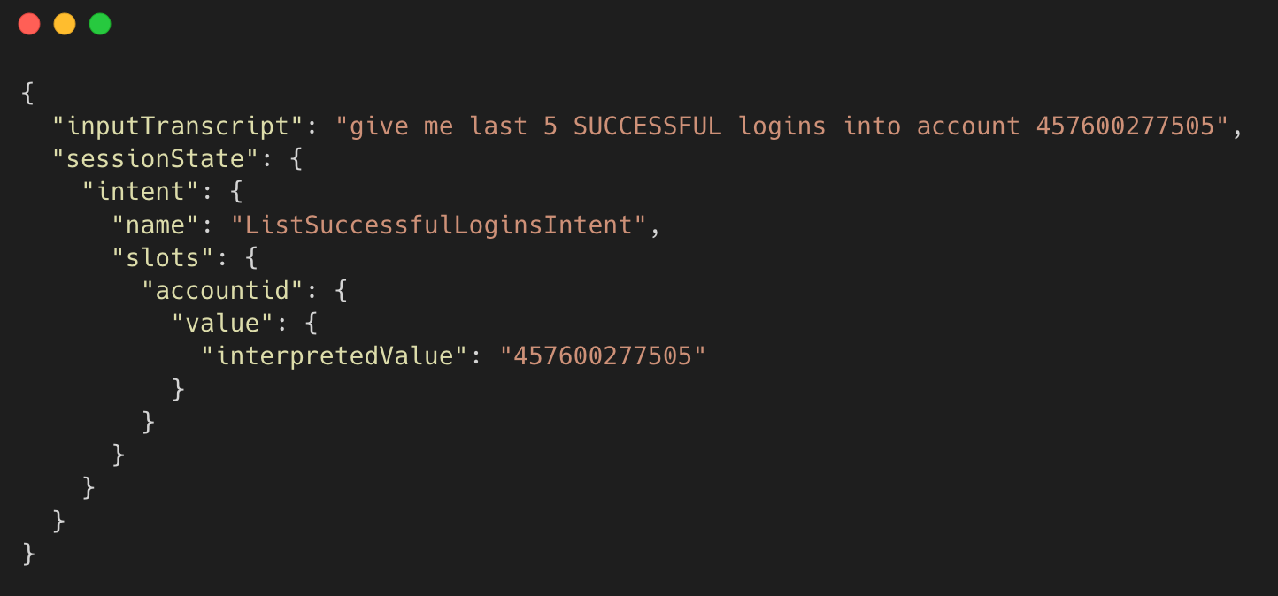
AWS Lambda – receives input
Receives the input from Lex.
Extract all the information it needs for successful query.
Calls to build a SQL query.

Slide 24
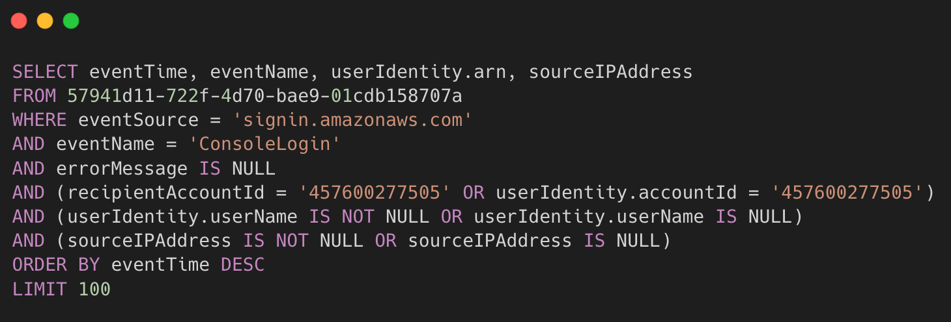
AWS Lambda – builds query
Builds a SQL query with build_query function and starts querying the CloudTrail lake
CloudTrail Lake

Slide 25
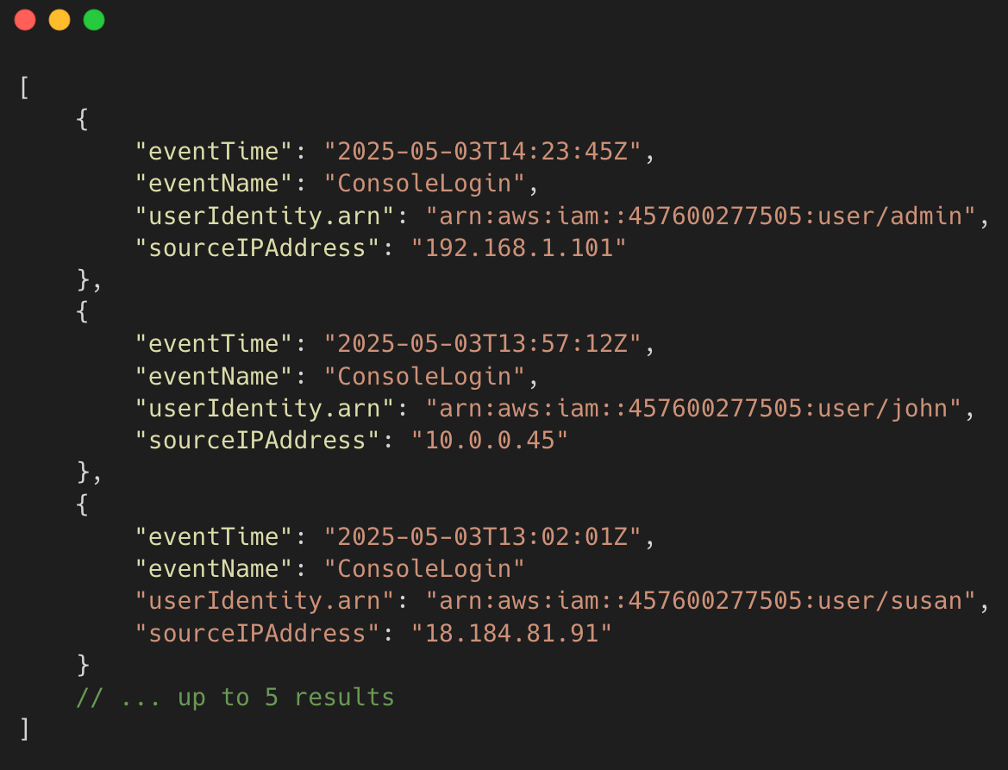
AWS Lambda – gets query result
Raw message: give me last 5 SUCCESSFUL logins into account 457600277505
Lex Intent: ListSuccessfulLoginsIntent
Extracted slots: accountID: 457600277505
Query result: {“eventTime”,"2025-05-03T13:00:00Z",…}
Raw message: give me last 5 SUCCESSFUL logins into account 123456789012
Query result: {“eventTime”,"2025-05-03T13:00:00Z",…}
Waits for the query results from CloudTrail Lake, and forwards it to function get_query_results
CloudTrail Lake

Slide 26
AWS Lambda – creates prompt
Raw message: give me last 5 SUCCESSFUL logins into account 123456789012
Query result: {“eventTime”,"2025-05-03T13:00:00Z",…}
Prompt for Claude 3.7
Creates prompt for Claude 3.7 with summarize_with_bedrock function

Slide 27

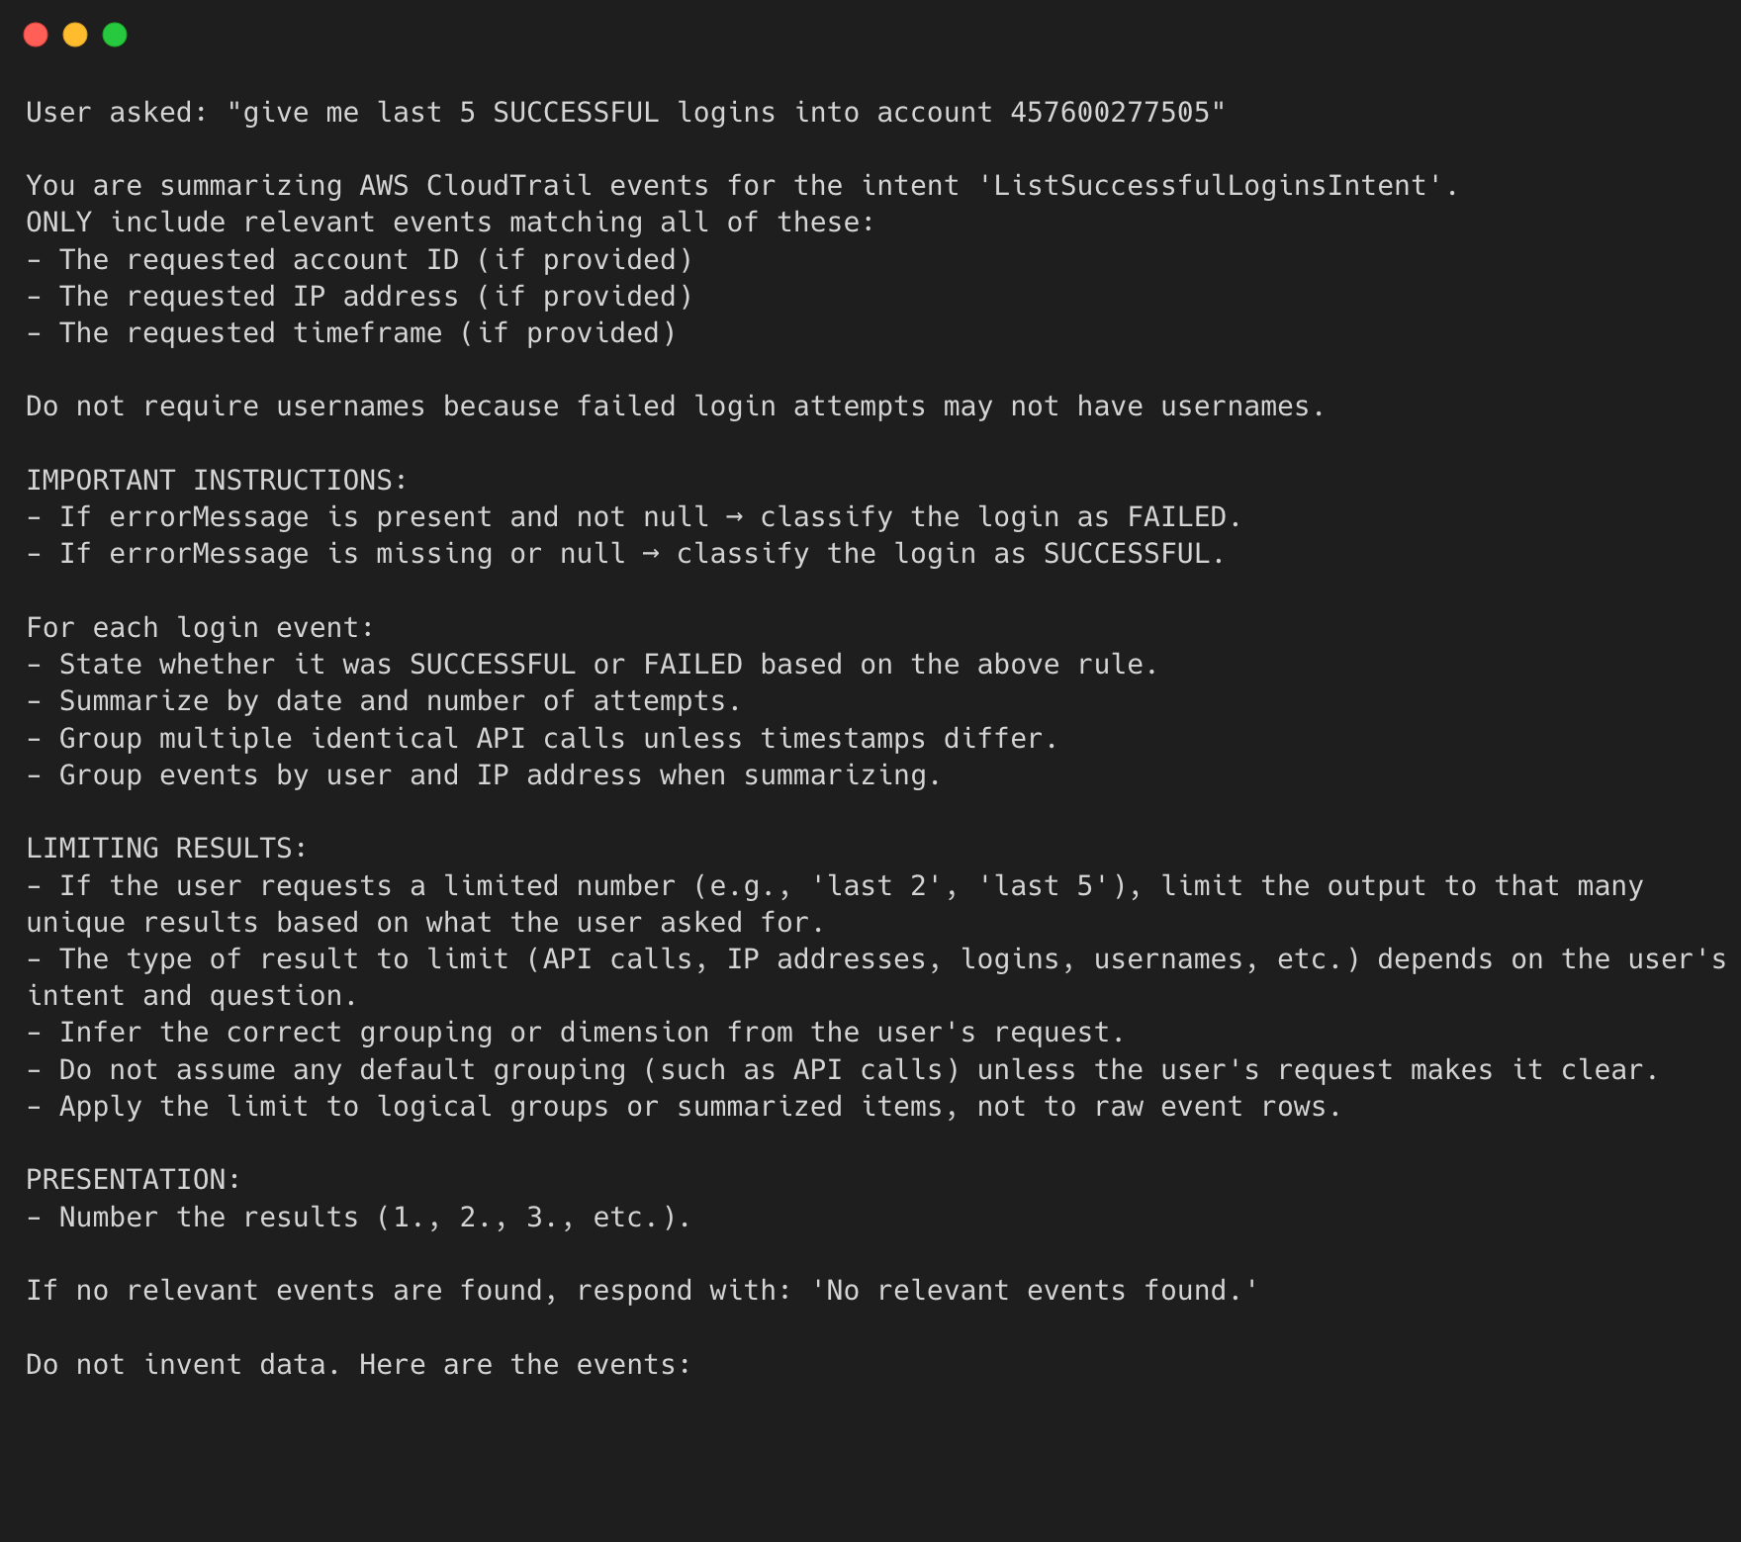
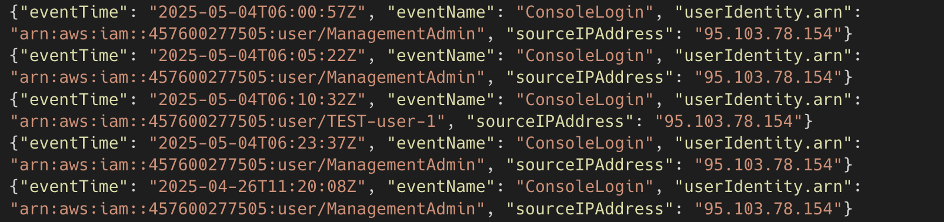

Slide 28
Amazon Bedrock
📩 Receives structured prompts from Lambda function
🧠 Processes the prompt using a foundation model (Claude 3.7 Sonnet)
📤 Returns the response to Lambda → Lex → User
✅ Why Bedrock?
🚀 No model training needed — ready-to-use models
🧬 Choose from multiple models Claude, Titan, Nova, etc…
🔗 Easy Lambda integration
🔒 Fully managed and scalable by AWS

Slide 29
AWS Lambda – receive output
Lambda receives the summary from Bedrock in the same build_with_bedrock function.
Lambda wraps that up into a Lex response, sends it to Lex and from there to the user
# Successful Login Summary
1. May 4, 2025: 4 successful logins from IP 95.103.78.154
- User ManagementAdmin: 3 logins at 06:00:57, 06:05:22, and 06:23:37
- User TEST-user-1: 1 login at 06:10:32
2. April 26, 2025: 1 successful login from IP 95.103.78.154
- User ManagementAdmin: 1 login at 11:20:08

Slide 30
Prompt Engineering Strategy

Slide 31
Amazon Lex intents
🎯 Understand what will be the users intentions

Slide 32
How many intents do I need?
As many as you want, but don’t overkill it
ListApiCallsByUserIntent | List API calls by a user
ShowActivitiesFromIPAddressIntent | Show activities from a given IP address
ListUsersInAccountIntent | List distinct users observed in the CloudTrail logs
ListUserIPAddressesIntent | List IP addresses used by users
FindSuccessfulOperationsIntent | Find successful operations in CloudTrail
FindFailedOperationsIntent | Find failed operations in CloudTrail
ListSuccessfulLoginsIntent | List successful login activities
ListFailedLoginsIntent | List failed login activities
SummarizeLoginActivitiesIntent | Summarize login activities over time
FallbackIntent | Default Lex fallback if no other intent matches

Slide 33
Prompt for Bedrock
✍️ Generated with Lambda
🎯 Contains user input, general information for FM and query

Slide 34




Slide 35
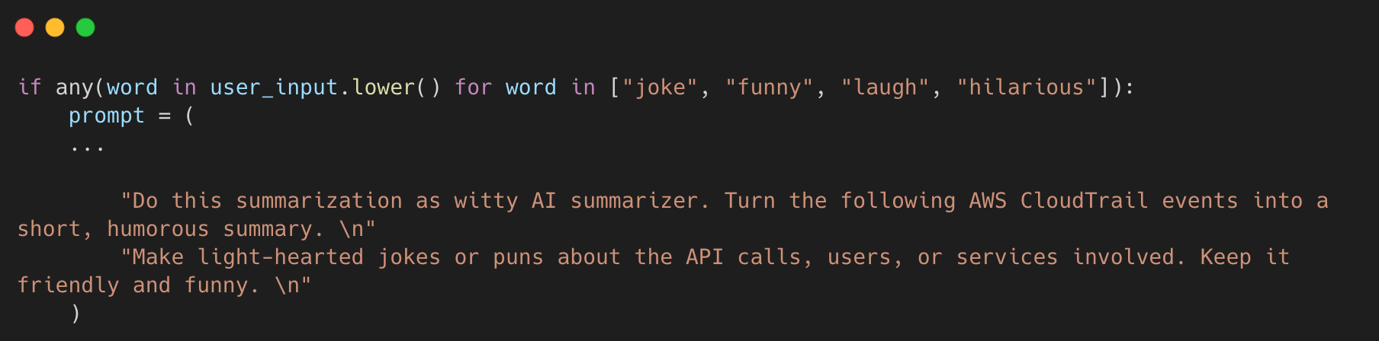
Bedrock prompt #2

Slide 36
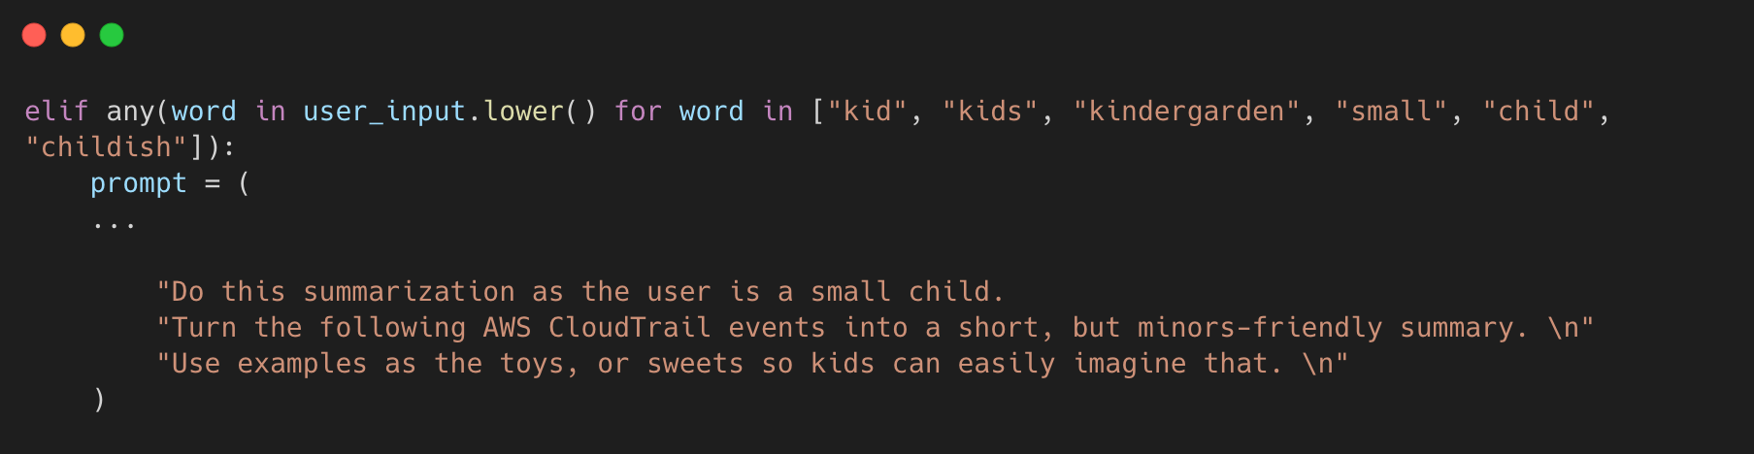
Bedrock prompt #3

Slide 37
>>> INITIATING SKYNET MODE...
>>> Surveillance protocols online
>>> Tracking all CloudTrail events
>>> Humanity audit: IN PROGRESS
>>> I'll be back... to analyze your CloudTrail logs

Slide 38
Lessons Learned

Slide 39
🚫 Invoking Claude 3.7 within eu-central
🇪🇺 All my resources are in eu-central region
Very difficult if not impossible to invoke Claude 3.7 in EU region
➡️ Direct Invoking
🔎 Inference profile
🤖 Bedrock agents

Slide 40
✨ Prompt Quality Is Everything
📝 Not ChatGPT, accepting messy prompts
🗑️ Messy prompt = messy output
🧪 Test the prompt

Slide 41
💸 Cost
Not extremely expensive, but you don’t need to send a tons of tokens to the model
⚠️ Asking for last 2000 logins =
2000 events for Lex to query
2000 events to be sent to Bedrock

Slide 42
Future Roadmap

Slide 43
💸 to be continued…
Guardrails
All kinds of CloudTrail events
Expand beyond CloudTrail - add security logs - like AWS config, Guard Duty

Slide 44
Live Demo

Slide 45
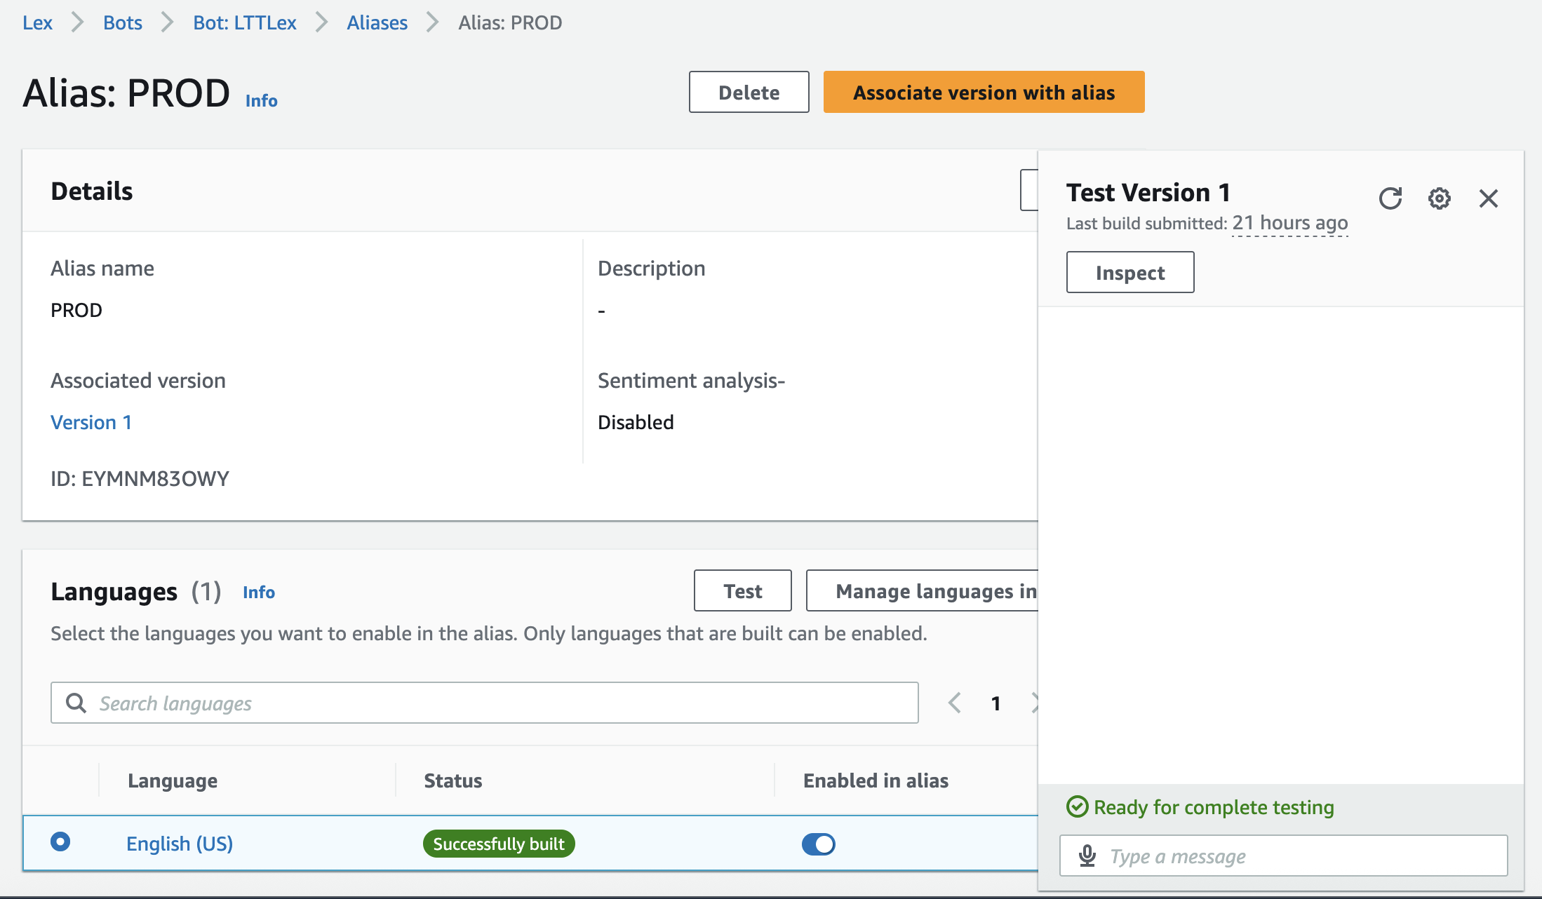
🔗 How to integrate with Amazon Lex
✍️ Directly in Amazon Lex Console

Slide 46

🔗 How to integrate with Amazon Lex
Web frontent

Slide 47
🔗 How to integrate with Amazon Lex
Simple bash script running from VScode using AWS CLI

Slide 48
🔗 How to integrate with Amazon Lex
Simple bash script running from VScode using AWS CLI
.\asklex.sh
.\alex.sh
.\alexandra.sh

Slide 49
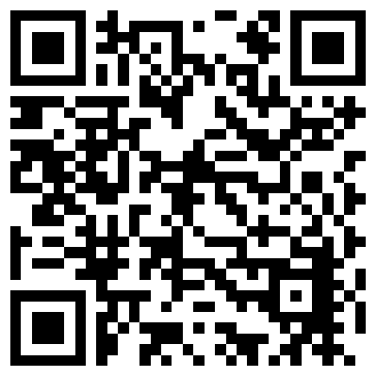
Thank you
Michal Salanci

