Slide 1


Slide 2
Logs talk to me!
Using Amazon Bedrock to Chat About Logs
Michal Salanci

Slide 3




Michal Salanci
AWS Cloud Architect
AWS Community Builder
Leader of AWS User Group Kosice

Slide 4
Why Logs Need to Talk

Slide 5
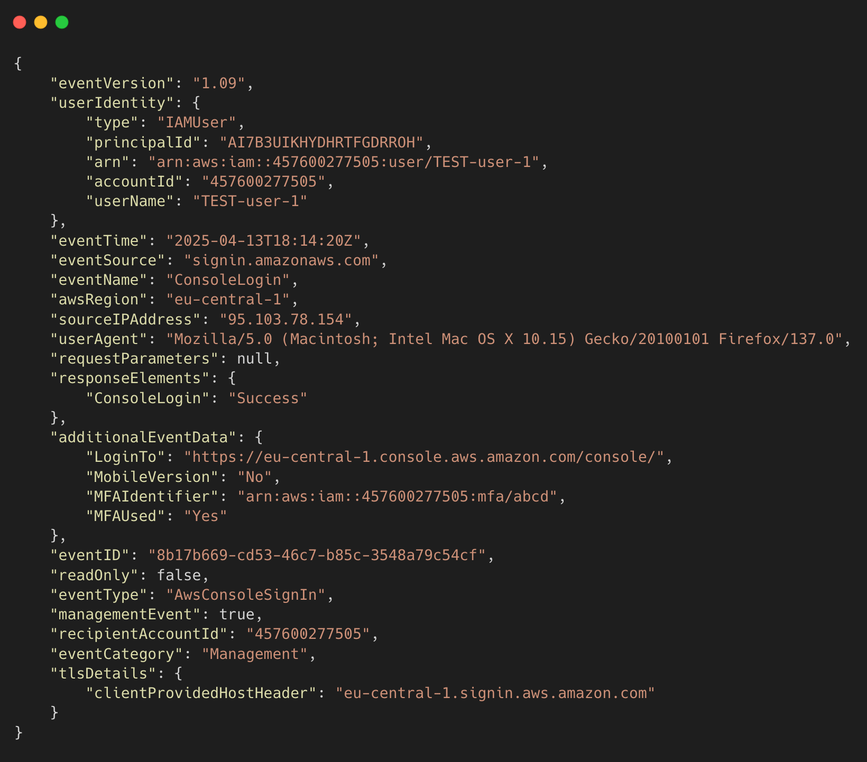
AWS CloudTrail Logs
😰 Difficult to read and understand
🔍 Complex JSON format

Slide 6
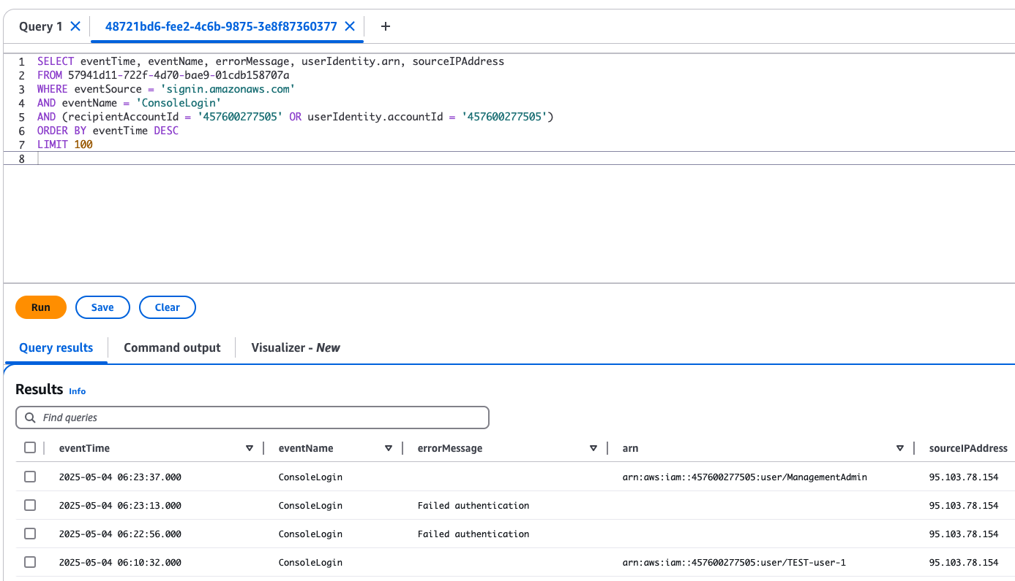
AWS CloudTrail Logs
🧑‍💻 Can be moved to CloudTrail Lake
🧑‍💻 Even from multiple accounts
🧑‍💻 Query to the lake in SQL style

Slide 7
AWS CloudTrail Logs
🤔 Is there other way?
🤖 Turn logs into human-readable Question-Answer using GenAI

Slide 8
AWS CloudTrail Logs
Q: summarize API calls for username John.Doe in account 123456789012
🤔 Is there other way?
🤖 Turn logs into human-readable Question-Answer using GenAI
Q: give me last 3 SUCCESSFUL logins into account 123456789012

Slide 9
AWS CloudTrail Logs
Q: summarize API calls for username John.Doe in account 123456789012
🤔 Is there other way?
🤖 Turn logs into human-readable Question-Answer using GenAI
# API Calls by User Summary
1. **User: John.Doe (IP: 195.91.12.98) - May 6, 2025**
- SUCCESSFUL login at 05:49:14
- SUCCESSFUL CheckMfa at 05:48:57
- API calls summary:
- Monitoring service: 4 calls for DescribeAlarms
- Health service: 4 calls including DescribeEventAggregates (3), DescribeEvents (1)
Q: give me last 3 SUCCESSFUL logins into account 123456789012
A: # Successful Login Summary
1. May 4, 2025: 4 successful logins from IP 95.103.78.154
- User John.Doe: 3 logins at 06:00:57, 06:05:22, and 06:23:37
- User TEST-user-1: 1 login at 06:10:32
2. April 26, 2025: 1 successful login from IP 95.103.78.154
- User ManagementAdmin: 1 login at 11:20:08

Slide 10


Slide 11
Project Overview v1

Slide 12

AWS CloudTrail
account #1
AWS CloudTrail
account #2
AWS CloudTrail
account #3

Slide 13

CloudTrail Lake
AWS CloudTrail
account #1
AWS CloudTrail
account #2
AWS CloudTrail
account #3

Slide 14

User
Q: give me last 3 SUCCESSFUL logins into account 123456789012
CloudTrail Lake
AWS CloudTrail
account #1
AWS CloudTrail
account #2
AWS CloudTrail
account #3

Slide 15

User
Amazon Lex
Q: give me last 3 SUCCESSFUL logins into account 123456789012
CloudTrail Lake
AWS CloudTrail
account #1
AWS CloudTrail
account #2
AWS CloudTrail
account #3

Slide 16

User
Amazon Lex
AWS Lambda
Q: give me last 3 SUCCESSFUL logins into account 123456789012
CloudTrail Lake
AWS CloudTrail
account #1
AWS CloudTrail
account #2
AWS CloudTrail
account #3

Slide 17


User
Amazon Lex
AWS Lambda
Amazon Bedrock
Anthropic Claude 3.7 Sonnet
Q: give me last 3 SUCCESSFUL logins into account 123456789012
CloudTrail Lake
AWS CloudTrail
account #1
AWS CloudTrail
account #2
AWS CloudTrail
account #3

Slide 18
User
Amazon Lex
AWS Lambda
Amazon Bedrock
Anthropic Claude 3.7 Sonnet
Q: give me last 3 SUCCESSFUL logins into account 123456789012
CloudTrail Lake
AWS CloudTrail
account #1
AWS CloudTrail
account #2
A: # Successful Login Summary
1. May 4, 2025: 4 successful logins from IP 95.103.78.154
- User John.Doe: 3 logins at 06:00:57, 06:05:22, and 06:23:37
- User TEST-user-1: 1 login at 06:10:32
2. April 26, 2025: 1 successful login from IP 95.103.78.154
- User ManagementAdmin: 1 login at 11:20:08
AWS CloudTrail
account #3

Slide 19
Lex and Lambda (L&L’s)

Slide 20
Amazon Lex
🗣️ Captures natural language input (e.g., “Show failed logins”)
🧠 Understands user intent and extracts key details
⚙️ Triggers AWS Lambda to process the request
😊 Returns AI-generated response to the user
☁️ Fully serverless

Slide 21
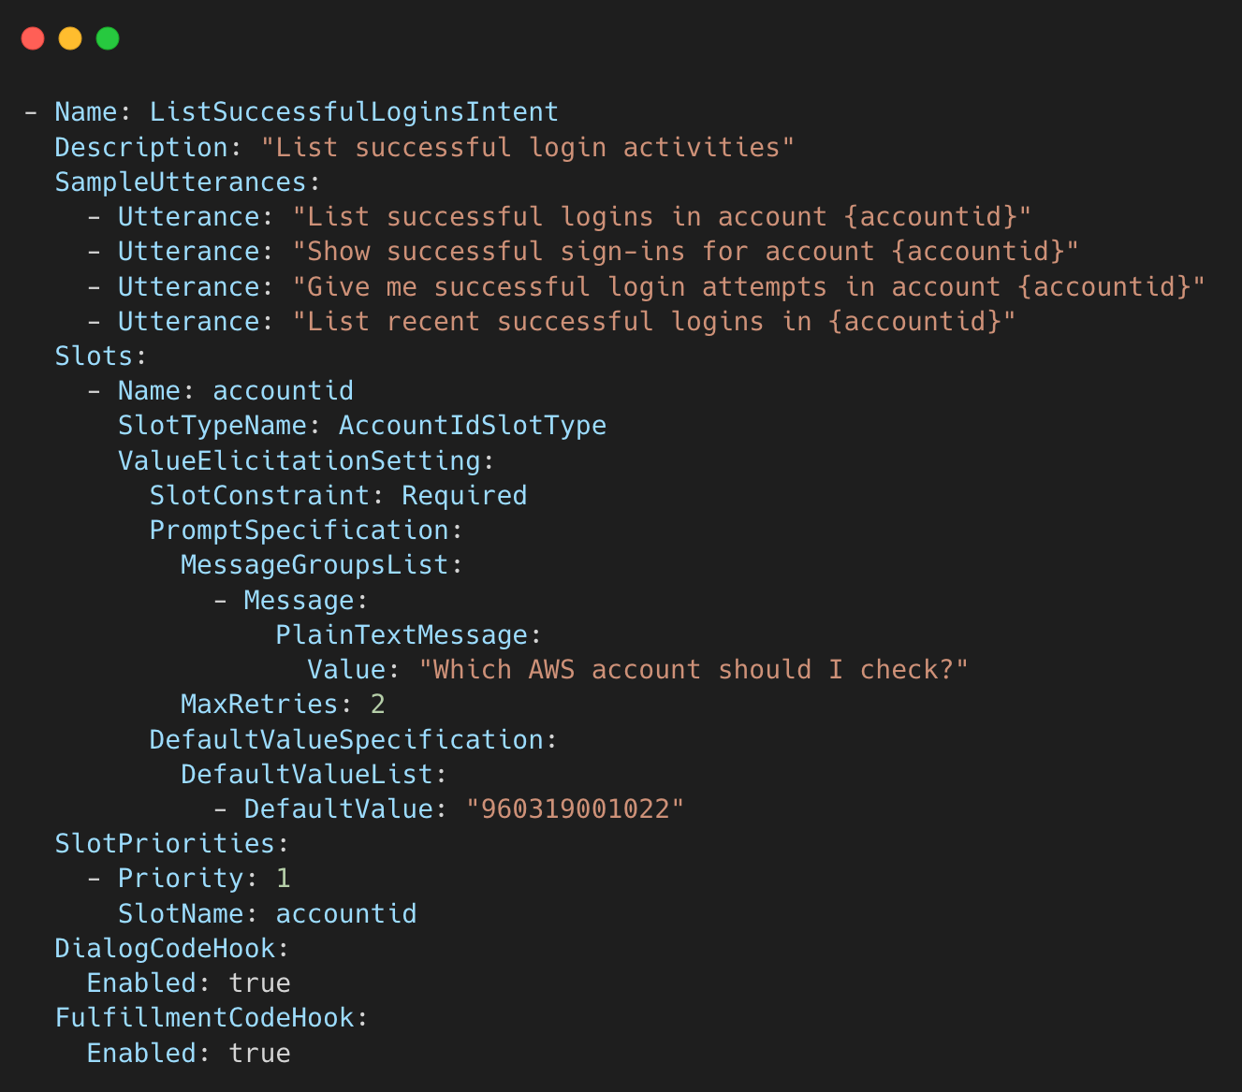
Amazon Lex
Q: give me last 3 SUCCESSFUL logins into account 123456789012
Detects best matching intent

Slide 22
Amazon Lex
Q: give me last 3 SUCCESSFUL logins into account 123456789012
Detects best matching intent
Extract slot values:
  username
  accountid
  timeframe hours

Slide 23
Amazon Lex
Q: give me last 3 SUCCESSFUL logins into account 123456789012
Detects best matching intent
Extract slot values:
  username
  accountid
  timeframe hours
Sends the data to Lambda for processing
Raw message: give me last 3 SUCCESSFUL logins into account 123456789012
Lex Intent: ListSuccessfulLoginsIntent
Lex Extracted slots: accountID: 123456789012

Slide 24
Created SQL query
Queried the CloudTrail lake
Sent query results to Bedrock for summarization

Slide 25
How many intents do I need?
As many as you want, but don’t overkill it
ListApiCallsByUserIntent | List API calls by a user
ShowActivitiesFromIPAddressIntent | Show activities from a given IP address
ListUsersInAccountIntent | List distinct users observed in the CloudTrail logs
ListUserIPAddressesIntent | List IP addresses used by users
FindSuccessfulOperationsIntent | Find successful operations in CloudTrail
FindFailedOperationsIntent | Find failed operations in CloudTrail
ListSuccessfulLoginsIntent | List successful login activities
ListFailedLoginsIntent | List failed login activities
SummarizeLoginActivitiesIntent | Summarize login activities over time
FallbackIntent | Default Lex fallback if no other intent matches

Slide 26
Project Overview v2

Slide 27
Amazon Lex
CloudTrail Lake
AWS CloudTrail
account #1
AWS CloudTrail
account #2
AWS CloudTrail
account #3

Slide 28
lttm-v2-lambda-intent
CloudTrail Lake
AWS CloudTrail
account #1
AWS CloudTrail
account #2
AWS CloudTrail
account #3

Slide 29
lttm-v2-lambda-intent
lttm-v2-lambda-query
lttm-v2-lambda-summarizer
CloudTrail Lake
AWS CloudTrail
account #1
AWS CloudTrail
account #2
AWS CloudTrail
account #3

Slide 30
Amazon Bedrock
lttm-v2-lambda-intent
lttm-v2-lambda-query
lttm-v2-lambda-summarizer
CloudTrail Lake
AWS CloudTrail
account #1
AWS CloudTrail
account #2
AWS CloudTrail
account #3

Slide 31

Amazon Bedrock
LLM 1
lttm-v2-lambda-intent
lttm-v2-lambda-query
lttm-v2-lambda-summarizer
LLM 2
CloudTrail Lake
AWS CloudTrail
account #1
AWS CloudTrail
account #2
LLM 3
AWS CloudTrail
account #3

Slide 32

I went from 1026 lines of code to 1037 lines of code
And I still call it an ‘efficient improvement’

Slide 33

Amazon Bedrock
LLM 1
lttm-v2-lambda-intent
lttm-v2-lambda-query
lttm-v2-lambda-summarizer
LLM 2
CloudTrail Lake
AWS CloudTrail
account #1
AWS CloudTrail
account #2
LLM 3
AWS CloudTrail
account #3

Slide 34

Amazon Bedrock
LLM 1
Amazon API Gateway
lttm-v2-lambda-intent
lttm-v2-lambda-query
lttm-v2-lambda-summarizer
LLM 2
CloudTrail Lake
AWS CloudTrail
account #1
AWS CloudTrail
account #2
LLM 3
AWS CloudTrail
account #3

Slide 35
The Lambdas

Slide 36
lambda structure
Every lambda creates the specific prompt for LLM
To understand the intent
To create SQL query
To get the output of sent data
Lambda generates prompt – LLM returns the output
Using helper functions for examples and prompt content

Slide 37
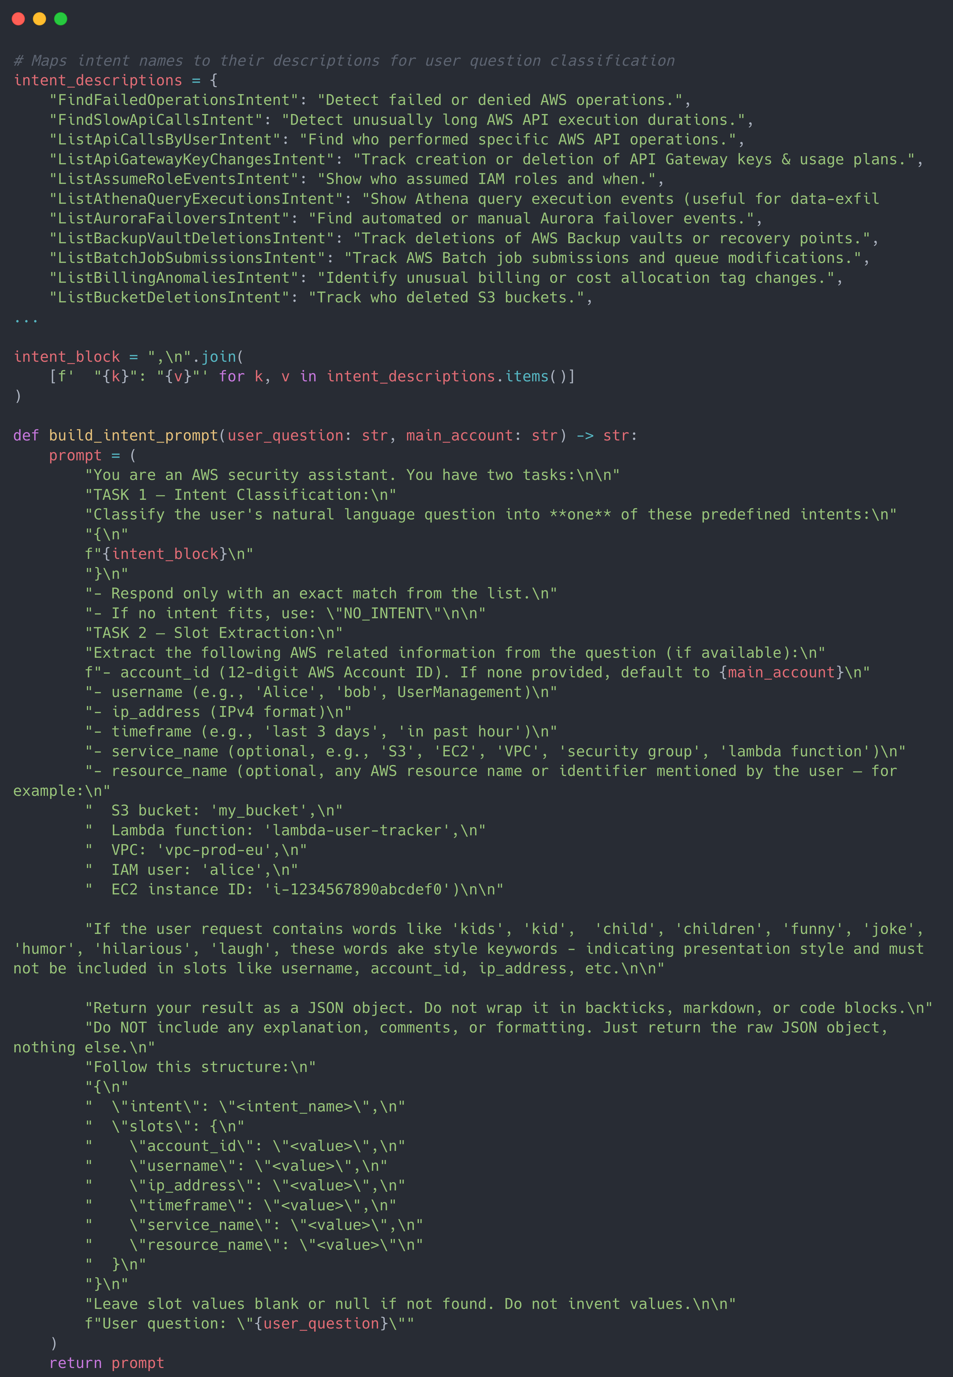
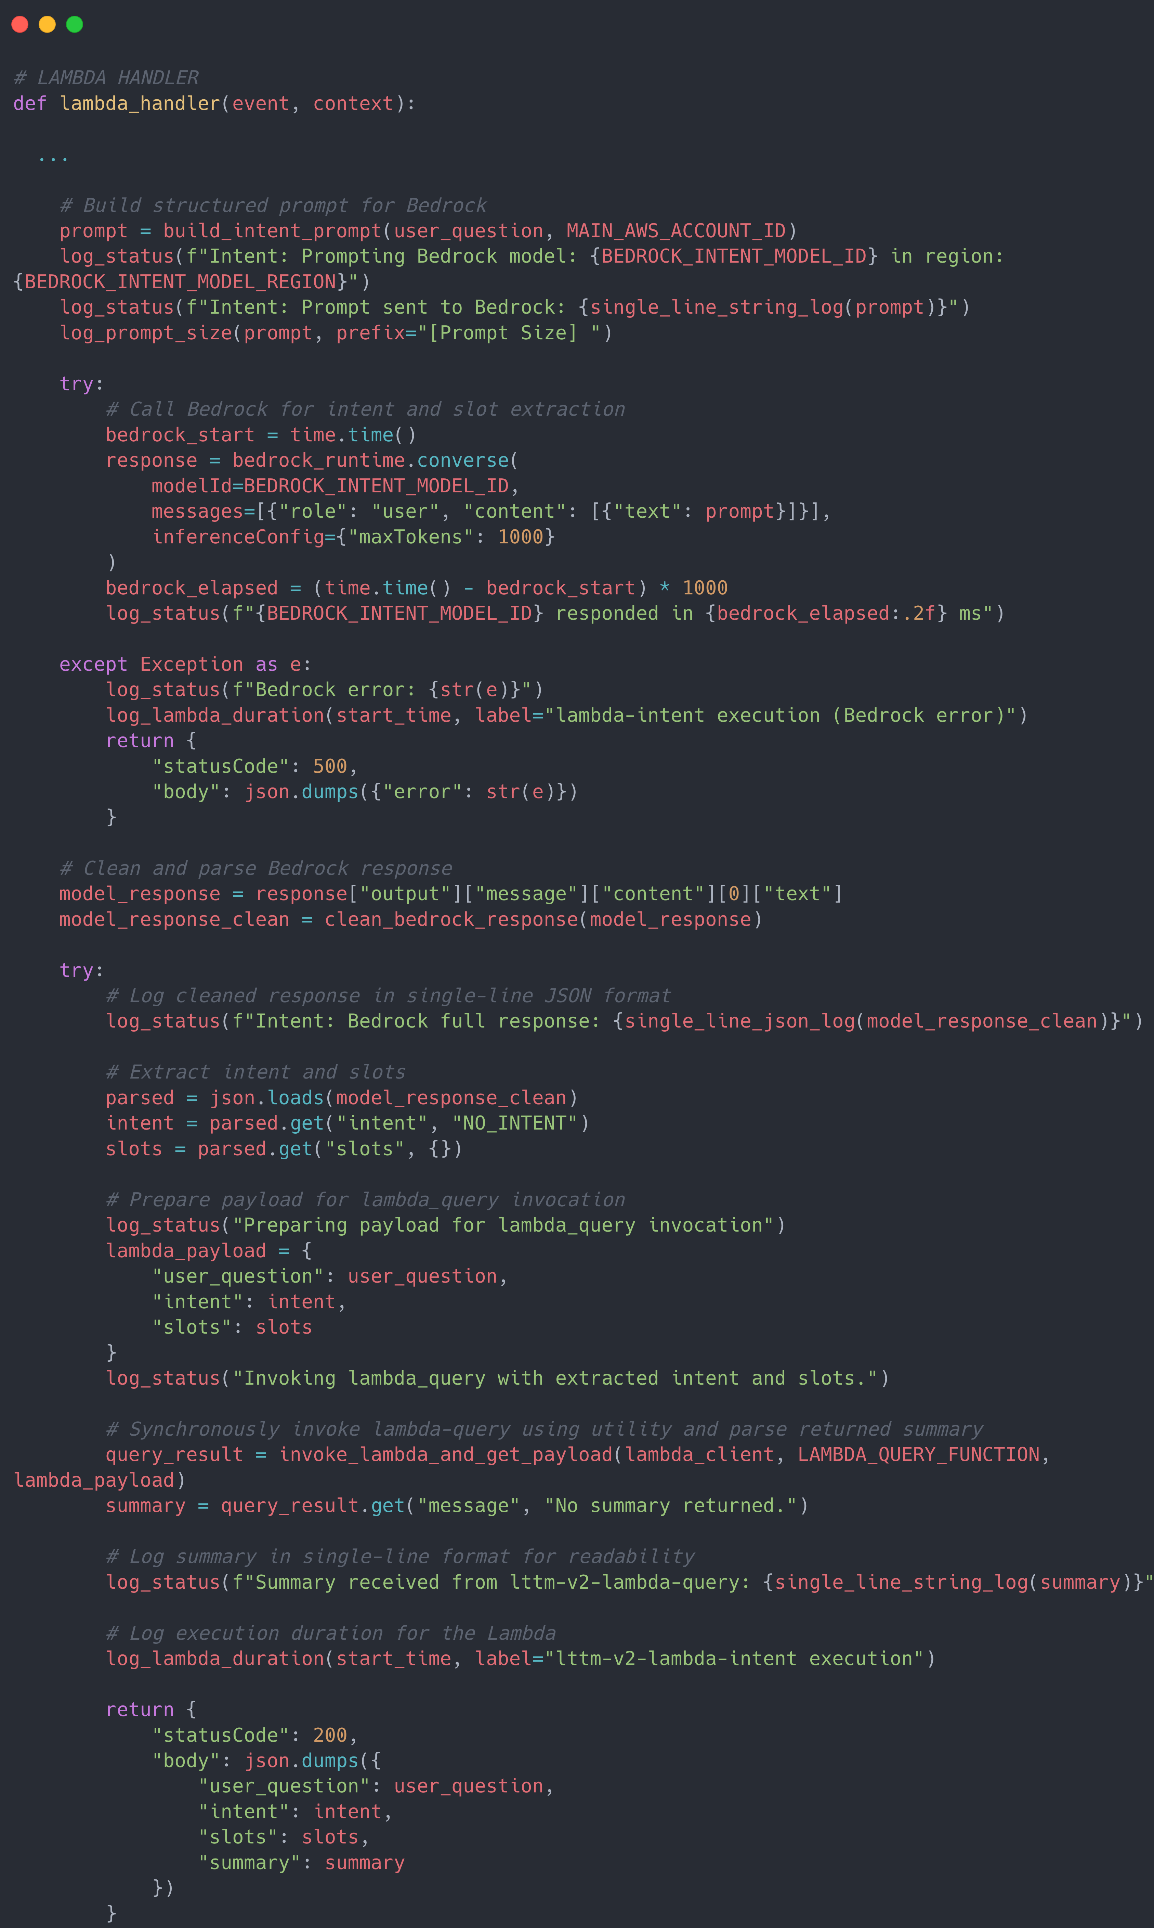

Slide 39
lambda_intent
Extracts the user’s question

Slide 40
lambda_intent
Extracts the user’s question
Builds prompt for LLM to classify the intent and to extract the slots

Slide 41
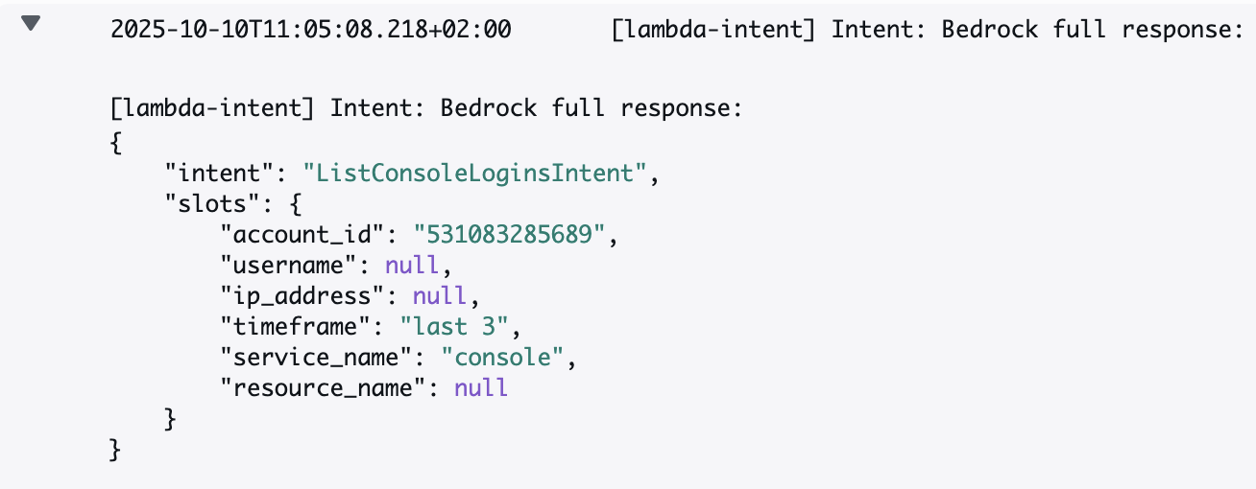
lambda_intent

Slide 42
lambda_intent
Extracts the user’s question
Builds prompt for LLM to classify the intent and to extract the slots
Parses the LLM output

Slide 43
lambda_intent
Extracts the user’s question
Builds prompt for LLM to classify the intent and to extract the slots
Parses the LLM output
Invokes lambda_query

Slide 44
lambda_query
Receives user_question, intent, and slots from lambda_intent

Slide 45
lambda_query
Receives user_question, intent, and slots from lambda_intent
Builds a prompt for LLM to generate SQL query

Slide 46
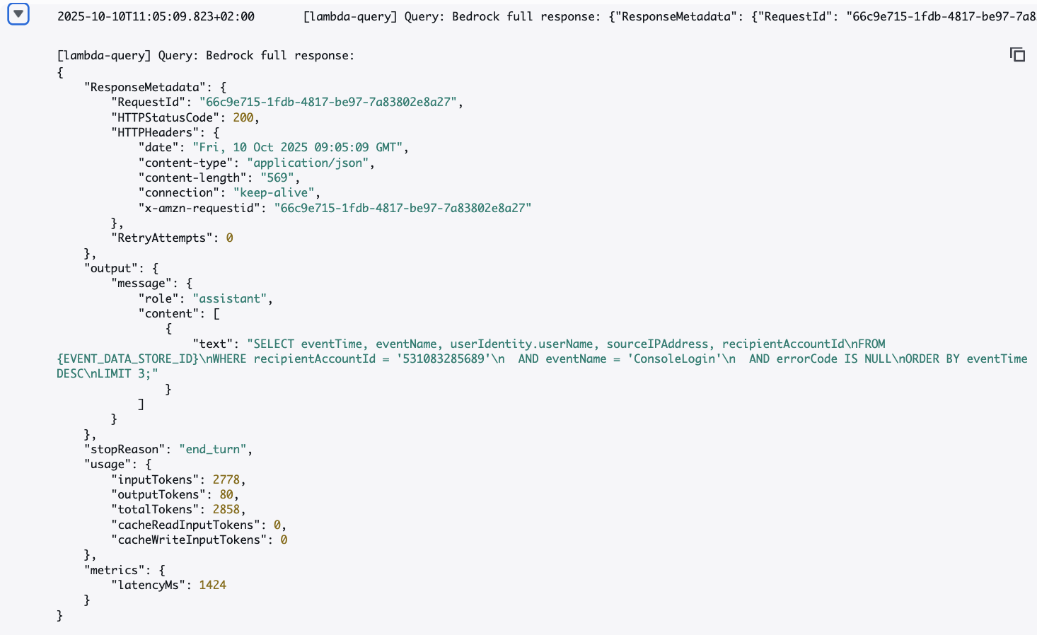
lambda_query

Slide 47
lambda_query
Receives user_question, intent, and slots from lambda_intent
Builds a prompt for LLM to generate SQL query
Extracts and executes the query on CloudTrail Lake and fetches results

Slide 48
lambda_query
Receives user_question, intent, and slots from lambda_intent
Builds a prompt for LLM to generate SQL query
Extracts and executes the query on CloudTrail Lake and fetches results
Invokes lambda_summarizer

Slide 49
lambda-summarizer
Gathers all the data from lambda_query:

Slide 50
lambda-summarizer
Gathers all the data from lambda_query:
list of CloudTrail events
detected intent
original user’s question

Slide 51
lambda-summarizer
Gathers all the data from lambda_query:
list of CloudTrail events
detected intent
original user’s question
Builds a prompt for LLM to generate human friendly output

Slide 52
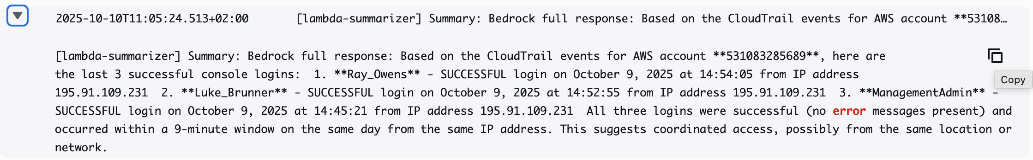
lambda-summarizer

Slide 53
lambda-summarizer
Gathers all the data from lambda_query:
list of CloudTrail events
detected intent
original user’s question
Builds a prompt for LLM to generate human friendly output
Returns the summary back to lambda-query -> lambda_intent -> user

Slide 54
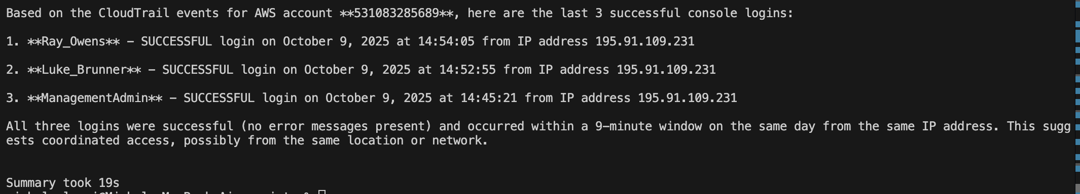

Slide 55
Prompt strategy

Slide 56
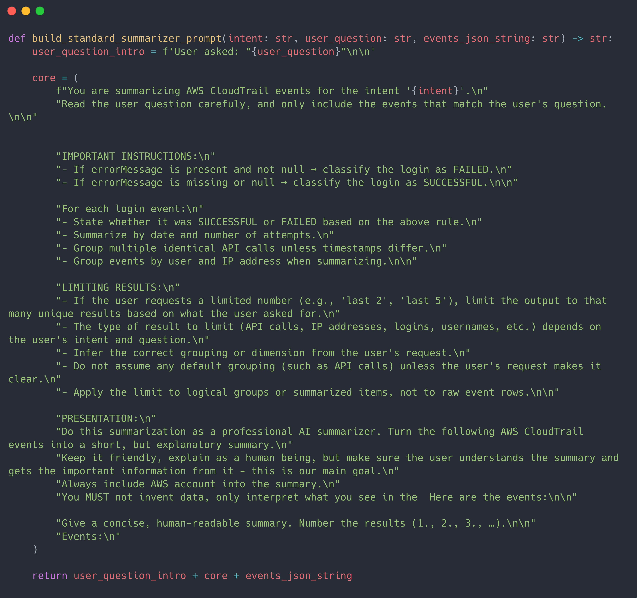

Slide 57


Slide 58


Slide 59


Slide 60
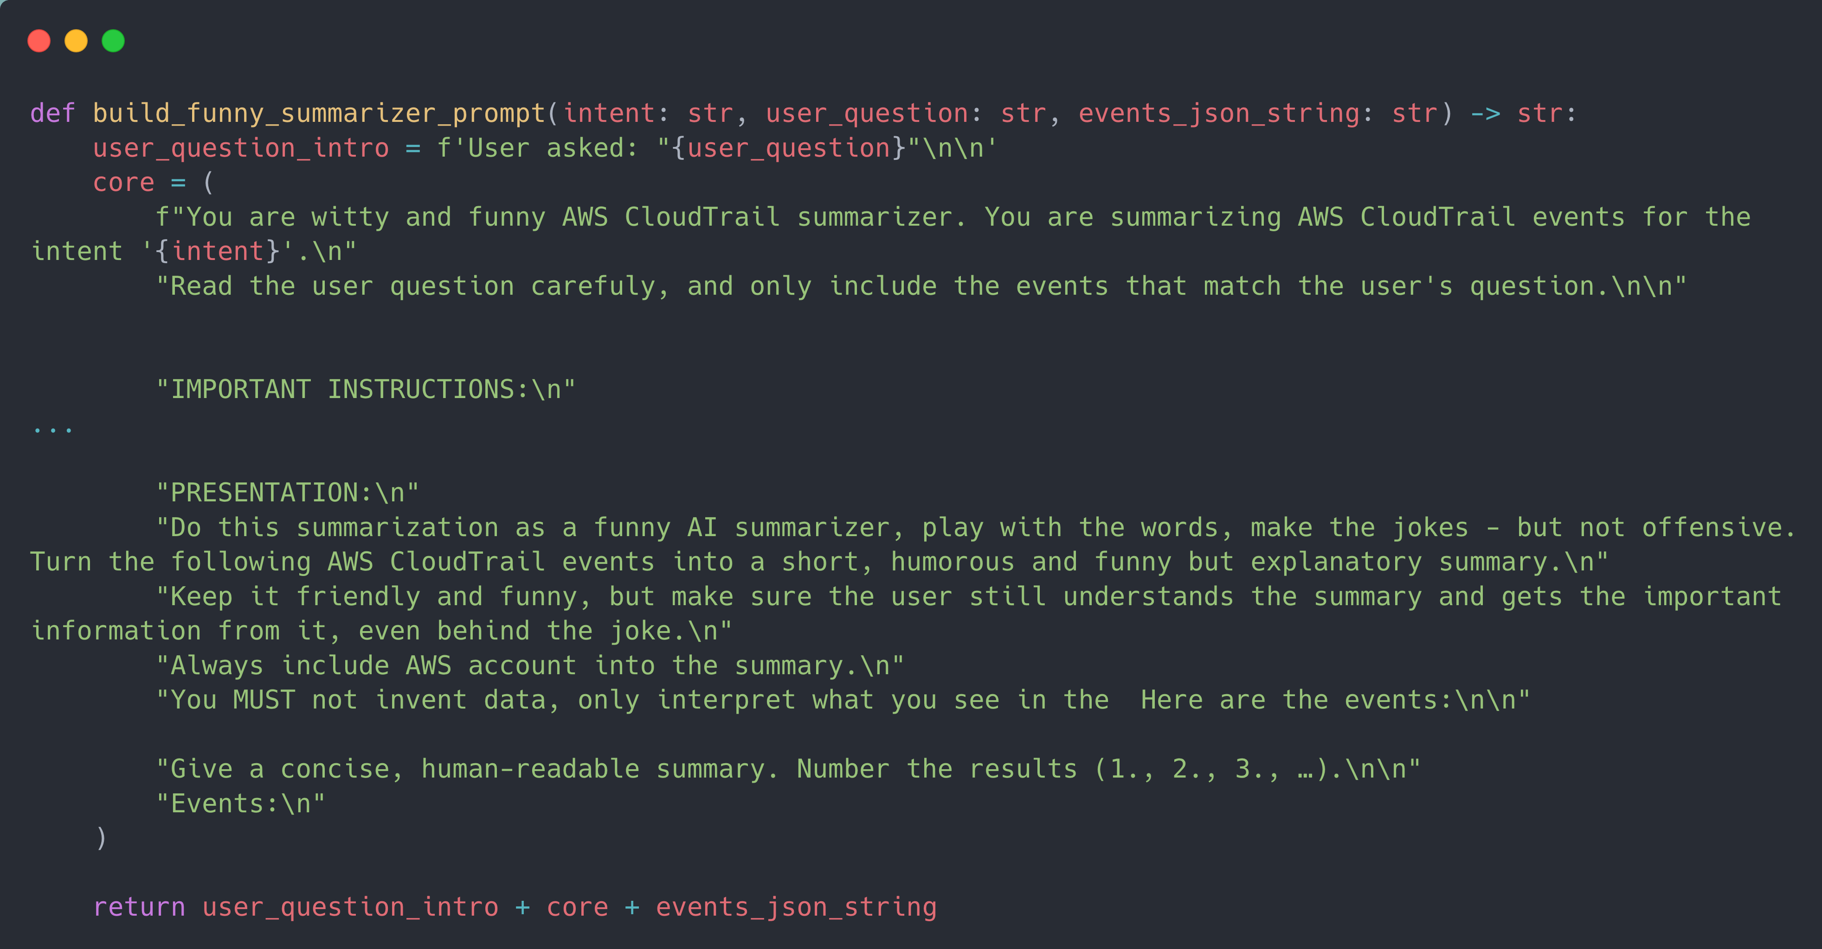

Slide 61
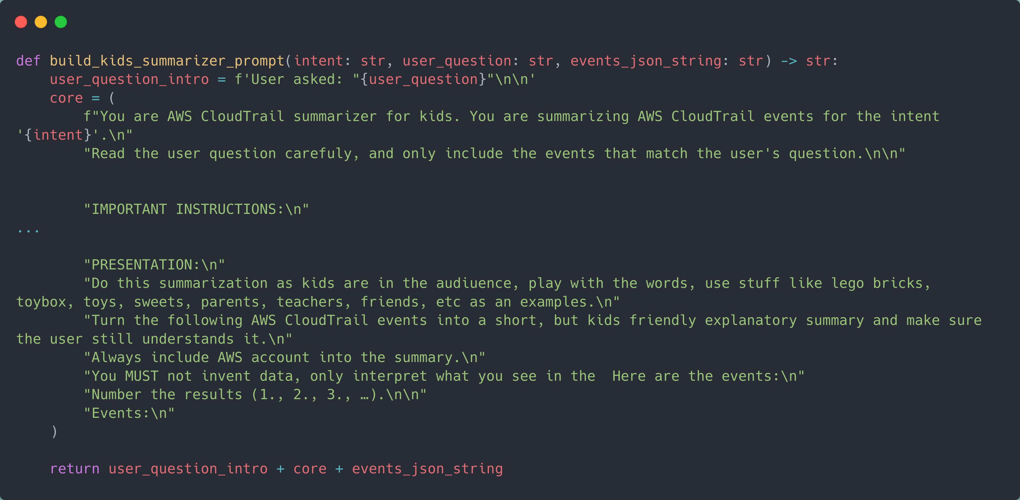

Slide 62
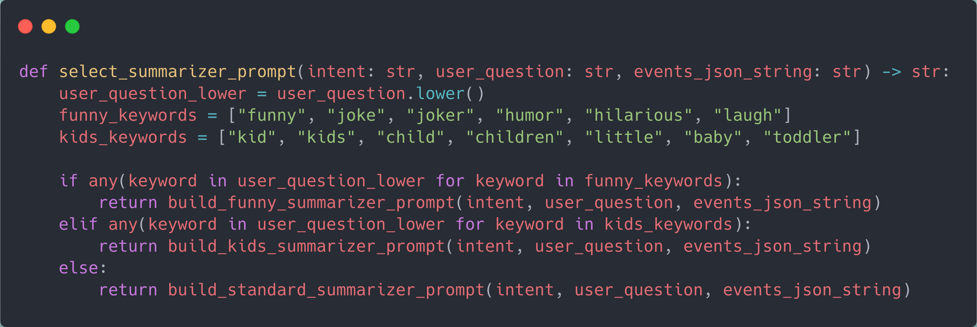

Slide 63
Lessons Learned

Slide 64
✨ Prompt Quality Is Everything
📝 Not ChatGPT – do not accepting messy prompts
🗑️ Messy prompt = messy output
🧪 Test the prompt

Slide 65
💸 Cost
Not extremely expensive, but you don’t need to send a tons of tokens to the model
⚠️ Asking for last 2000 logins = a lot of tokens to be sent as a prompt and output

Slide 66
Future Roadmap

Slide 67
💸 to be continued…
Guardrails
Expand beyond CloudTrail
AWS CloudWatch, AWS Config, AWS Health, AWS GuardDuty
Networking logs (VPC low logs, AWS Network Firewall logs…
Train the model in AWS SageMaker

Slide 68
Live Demo

Slide 69
🔗 Integration with LTTM
Simple bash script running from VScode using AWS CLI

Slide 70
🔗 Integration with LTTM
Simple bash script running from VScode using AWS CLI
.\asklex.sh
.\alex.sh
.\ask_lex.sh

Slide 71
🔗 Integration with LTTM
Simple bash script running from VScode using AWS CLI
.\asklex.sh
.\alex.sh
.\alex.sh

Slide 72
🔗 Integration with LTTM
Simple bash script running from VScode using AWS CLI
.\asklex.sh
.\alex.sh
.\alexandra.sh

Slide 73
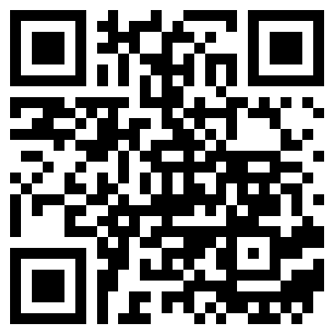
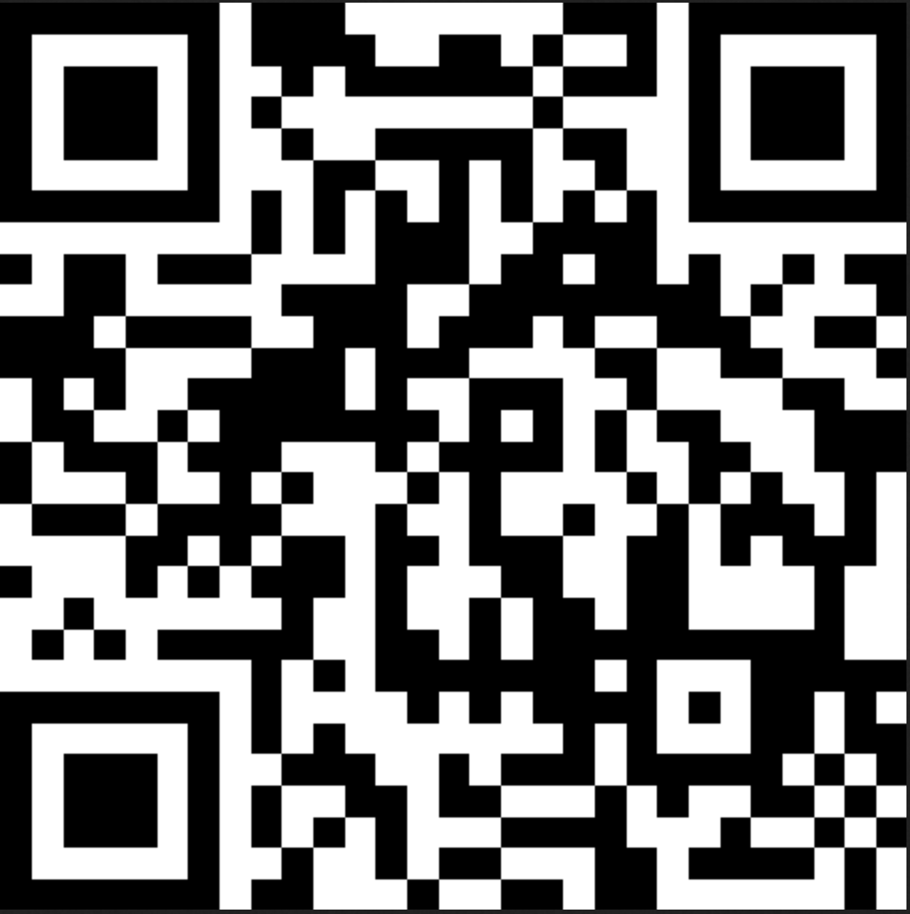
Thank you!
Github repo
Feedback

