Slide 1


Prague
Michal Salanci

Slide 2
Logs talk to me!
Using Amazon Bedrock to explain logs
Michal Salanci
Cloud Architect

Slide 3




Michal Salanci
AWS Cloud Architect
AWS Community Builder
Leader of AWS User Group Kosice

Slide 4
Agenda
Why logs need to talk?
Overview of project v1
Lex, Lambda & Bedrock
Overview of project v2
Lambdas & Bedrock
6. Prompt strategy
7. Lessons learned
8. Future roadmap
9. Live demo

Slide 5
Why logs need to talk?

Slide 6
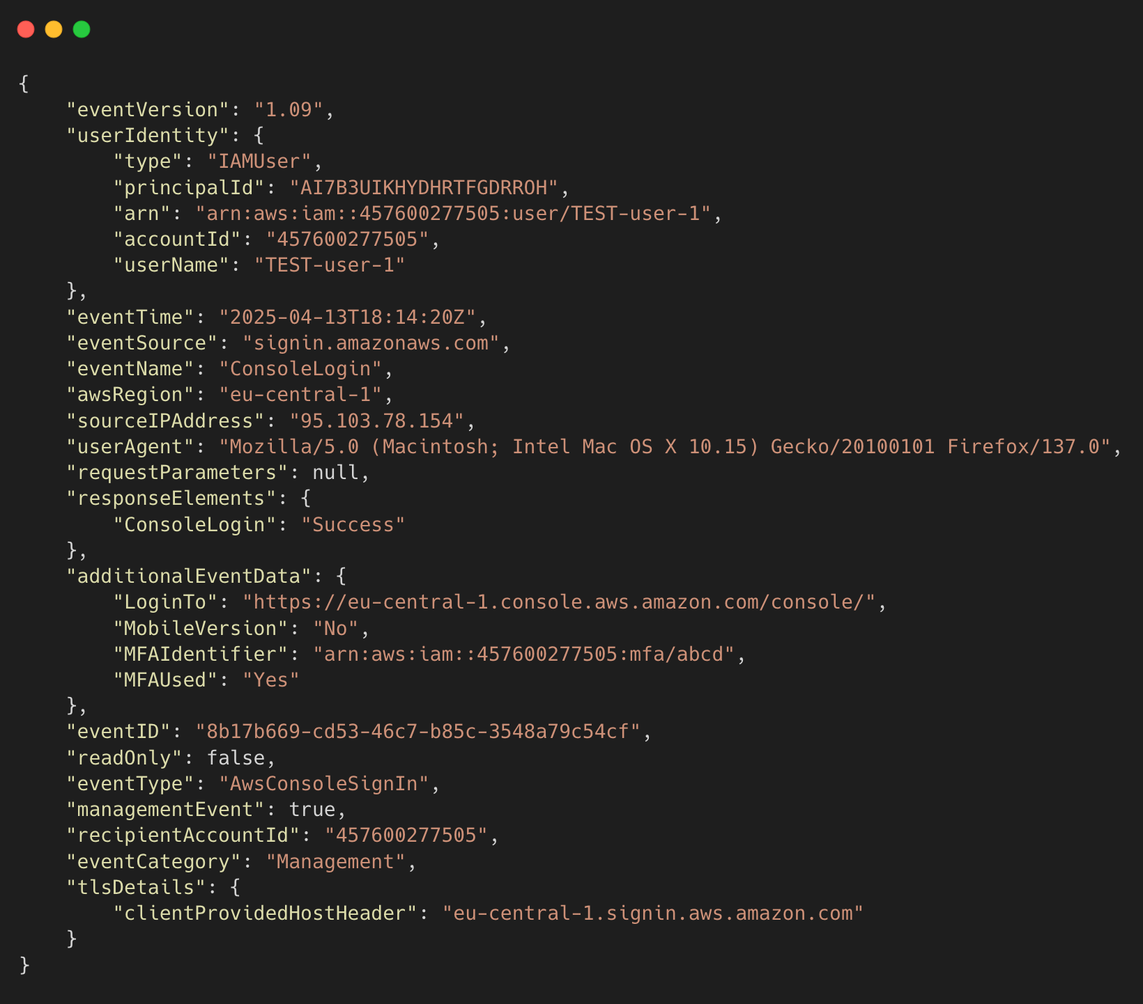
AWS CloudTrail Logs
😰 Difficult to read and understand
🔍 Complex JSON format

Slide 7
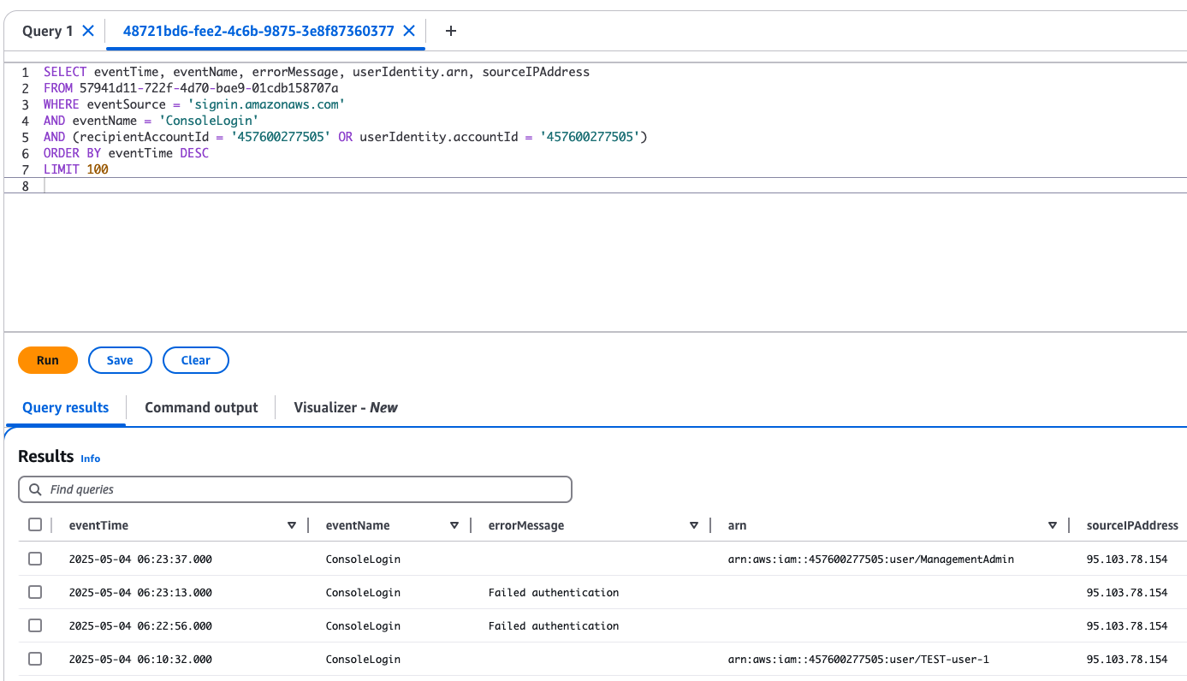
AWS CloudTrail Logs
🧑‍💻 Can be moved to CloudTrail Lake
🧑‍💻 Even from multiple accounts
🧑‍💻 Query the lake in SQL style

Slide 8
AWS CloudTrail Logs
🤔 Is there other way?
🤖 Turn logs into human-readable Question-Answer
using GenAI

Slide 9
AWS CloudTrail Logs
Q: summarize API calls for IAM user John.Doe in account 123456789012
🤔 Is there other way?
🤖 Turn logs into human-readable Question-Answer
using GenAI
Q: give me last 3 SUCCESSFUL logins into account 123456789012

Slide 10
AWS CloudTrail Logs
Q: summarize API calls for IAM user John.Doe in account 123456789012
🤔 Is there other way?
🤖 Turn logs into human-readable Question-Answer
using GenAI
# API Calls by User Summary
1. **User: John.Doe (IP: 195.91.12.98) - May 6, 2025**
- SUCCESSFUL login at 05:49:14
- SUCCESSFUL CheckMfa at 05:48:57
- API calls summary:
- Monitoring service: 4 calls for DescribeAlarms
- Health service: 4 calls including DescribeEventAggregates (3), DescribeEvents (1)
Q: give me last 3 SUCCESSFUL logins into account 123456789012
A: # Successful Login Summary
1. May 4, 2025: 4 successful logins from IP 95.103.78.154
- User John.Doe: 3 logins at 06:00:57, 06:05:22, and 06:23:37
- User TEST-user-1: 1 login at 06:10:32
2. April 26, 2025: 1 successful login from IP 95.103.78.154
- User ManagementAdmin: 1 login at 11:20:08

Slide 11


Slide 12
Overview of project v1

Slide 13

AWS CloudTrail
account #1
AWS CloudTrail
account #2
AWS CloudTrail
account #3

Slide 14

CloudTrail Lake
AWS CloudTrail
account #1
AWS CloudTrail
account #2
AWS CloudTrail
account #3

Slide 15

User
Q: give me last 3 SUCCESSFUL logins into account 123456789012
CloudTrail Lake
AWS CloudTrail
account #1
AWS CloudTrail
account #2
AWS CloudTrail
account #3

Slide 16

User
Amazon Lex
Q: give me last 3 SUCCESSFUL logins into account 123456789012
CloudTrail Lake
AWS CloudTrail
account #1
AWS CloudTrail
account #2
AWS CloudTrail
account #3

Slide 17

User
Amazon Lex
AWS Lambda
Q: give me last 3 SUCCESSFUL logins into account 123456789012
CloudTrail Lake
AWS CloudTrail
account #1
AWS CloudTrail
account #2
AWS CloudTrail
account #3

Slide 18


User
Amazon Lex
AWS Lambda
Amazon Bedrock
Anthropic Claude 3.7 Sonnet
Q: give me last 3 SUCCESSFUL logins into account 123456789012
CloudTrail Lake
AWS CloudTrail
account #1
AWS CloudTrail
account #2
AWS CloudTrail
account #3

Slide 19
User
Amazon Lex
AWS Lambda
Amazon Bedrock
Anthropic Claude 3.7 Sonnet
Q: give me last 3 SUCCESSFUL logins into account 123456789012
CloudTrail Lake
AWS CloudTrail
account #1
AWS CloudTrail
account #2
A: # Successful Login Summary
1. May 4, 2025: 4 successful logins from IP 95.103.78.154
- User John.Doe: 3 logins at 06:00:57, 06:05:22, and 06:23:37
- User TEST-user-1: 1 login at 06:10:32
2. April 26, 2025: 1 successful login from IP 95.103.78.154
- User ManagementAdmin: 1 login at 11:20:08
AWS CloudTrail
account #3

Slide 20
Lex and Lambda

Slide 21
Amazon Lex
🗣️ Captures natural language input (e.g., “Show failed logins”)
🧠 Understands user intent and extracts key details
⚙️ Triggers AWS Lambda to process the request
😊 Returns AI-generated response to the user
☁️ Fully serverless

Slide 22
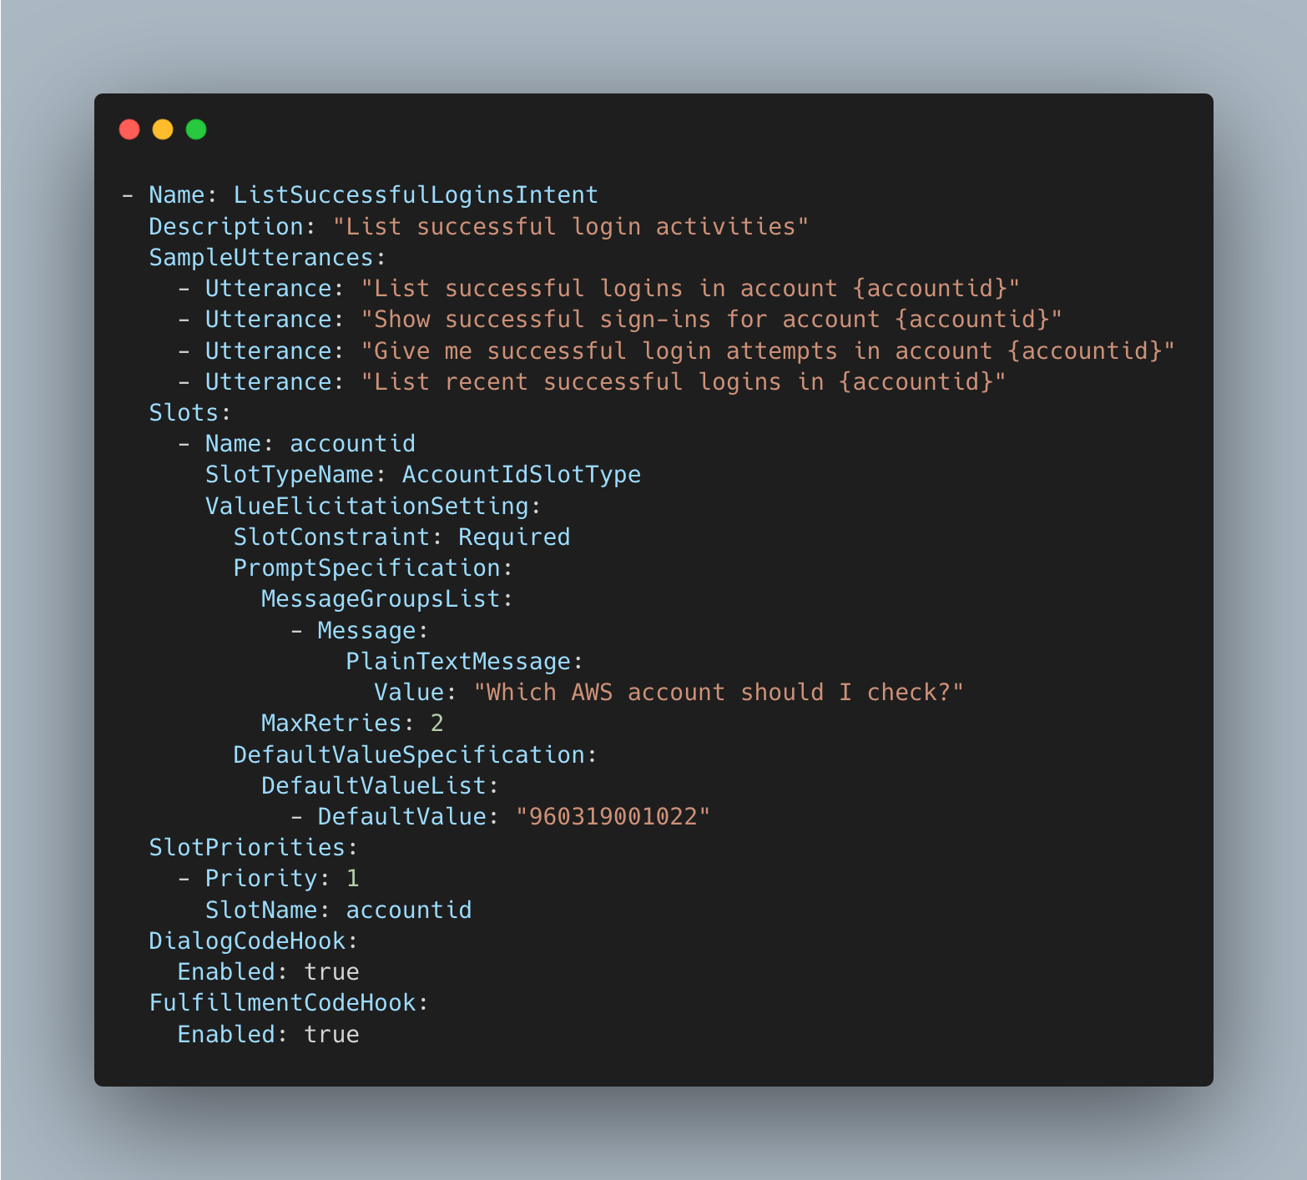
Q: give me last 3 SUCCESSFUL logins into account 123456789012
Amazon Lex
Detects best matching intent

Slide 23
Q: give me last 3 SUCCESSFUL logins into account 123456789012
Amazon Lex
Detects best matching intent
Create an intent

Slide 24
Q: give me last 3 SUCCESSFUL logins into account 123456789012
Amazon Lex
Detects best matching intent
Create an intent
Add couple of examples

Slide 25
Q: give me last 3 SUCCESSFUL logins into account 123456789012
Amazon Lex
Detects best matching intent
Create an intent
Add couple of examples
Extract slot values:
username
accountid
timeframe hours
…

Slide 26
Q: give me last 3 SUCCESSFUL logins into account 123456789012
Amazon Lex
Detects best matching intent
Create an intent
Add couple of examples
Extract slot values:
username
accountid
timeframe hours
…
Raw message: give me last 3 SUCCESSFUL logins into account 123456789012
Lex Intent: ListSuccessfulLoginsIntent
Lex Extracted slots: accountID: 123456789012

Slide 27
AWS Lambda
Created SQL query

Slide 28
AWS Lambda
Created SQL query
Queried the CloudTrail lake

Slide 29
AWS Lambda
Created SQL query
Queried the CloudTrail lake
Sent query results to Bedrock for summarization

Slide 30
How many intents do I need?
ListApiCallsByUserIntent | List API calls by a user
ShowActivitiesFromIPAddressIntent | Show activities from a given IP address
ListUsersInAccountIntent | List distinct users observed in the CloudTrail logs
ListUserIPAddressesIntent | List IP addresses used by users
FindSuccessfulOperationsIntent | Find successful operations in CloudTrail
FindFailedOperationsIntent | Find failed operations in CloudTrail
ListSuccessfulLoginsIntent | List successful login activities
ListFailedLoginsIntent | List failed login activities
SummarizeLoginActivitiesIntent | Summarize login activities over time
FallbackIntent | Default Lex fallback if no other intent matches

Slide 31
Project overview v2

Slide 32
Amazon Lex
CloudTrail Lake
AWS CloudTrail
account #1
AWS CloudTrail
account #2
AWS CloudTrail
account #3

Slide 33
lttm-v2-lambda-intent
CloudTrail Lake
AWS CloudTrail
account #1
AWS CloudTrail
account #2
AWS CloudTrail
account #3

Slide 34
lttm-v2-lambda-intent
lttm-v2-lambda-query
lttm-v2-lambda-summarizer
CloudTrail Lake
AWS CloudTrail
account #1
AWS CloudTrail
account #2
AWS CloudTrail
account #3

Slide 35
Amazon Bedrock
lttm-v2-lambda-intent
lttm-v2-lambda-query
lttm-v2-lambda-summarizer
CloudTrail Lake
AWS CloudTrail
account #1
AWS CloudTrail
account #2
AWS CloudTrail
account #3

Slide 36

Amazon Bedrock
LLM 1
lttm-v2-lambda-intent
lttm-v2-lambda-query
lttm-v2-lambda-summarizer
LLM 2
CloudTrail Lake
AWS CloudTrail
account #1
AWS CloudTrail
account #2
LLM 3
AWS CloudTrail
account #3

Slide 37


Amazon Bedrock
Amazon Nova
lttm-v2-lambda-intent
lttm-v2-lambda-query
lttm-v2-lambda-summarizer
Claude Sonnet 4.0
CloudTrail Lake
AWS CloudTrail
account #1
AWS CloudTrail
account #2
Claude Sonnet 4.0
AWS CloudTrail
account #3

Slide 38

I went from 1026 lines of code
to 1037 lines of code
And I still call it an ‘efficient improvement’

Slide 39

Amazon Bedrock
LLM 1
lttm-v2-lambda-intent
lttm-v2-lambda-query
lttm-v2-lambda-summarizer
LLM 2
CloudTrail Lake
AWS CloudTrail
account #1
AWS CloudTrail
account #2
LLM 3
AWS CloudTrail
account #3

Slide 40

Amazon Bedrock
LLM 1
Amazon API Gateway
lttm-v2-lambda-intent
lttm-v2-lambda-query
lttm-v2-lambda-summarizer
LLM 2
CloudTrail Lake
AWS CloudTrail
account #1
AWS CloudTrail
account #2
LLM 3
AWS CloudTrail
account #3

Slide 41
The lambdas of v2

Slide 42
lambda structure
Every lambda creates the specific prompt for LLM
To classify the intent
To create SQL query
To summarize results

Slide 43
lambda structure
Every lambda creates the specific prompt for LLM
To classify the intent
To create SQL query
To summarize results
Lambda generates prompt – LLM returns the output

Slide 44
lambda structure
Every lambda creates the specific prompt for LLM
To classify the intent
To create SQL query
To summarize results
Lambda generates prompt – LLM returns the output
Helper functions creates the prompt
Main function sends it to Bedrock and integrate with other AWS services

Slide 45
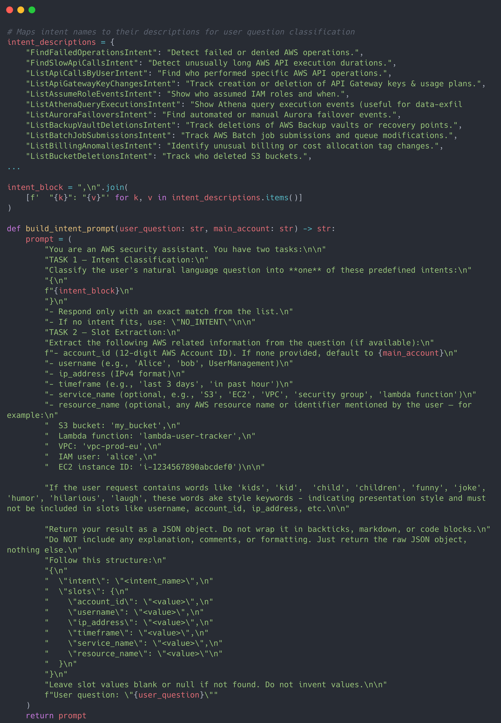

Slide 46
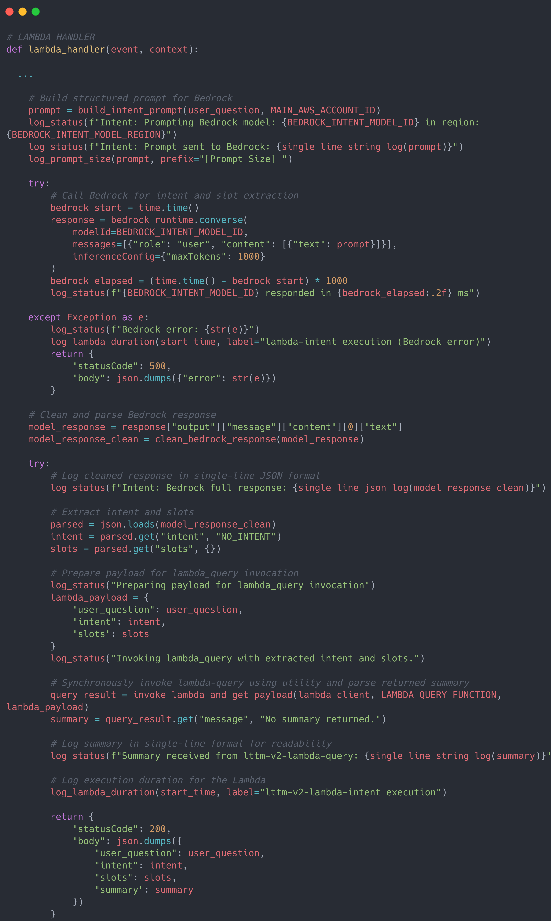

Slide 48
lambda_intent
Extracts the user’s question

Slide 49
lambda_intent
Extracts the user’s question
Builds prompt for LLM to classify the intent and to extract the slots

Slide 50
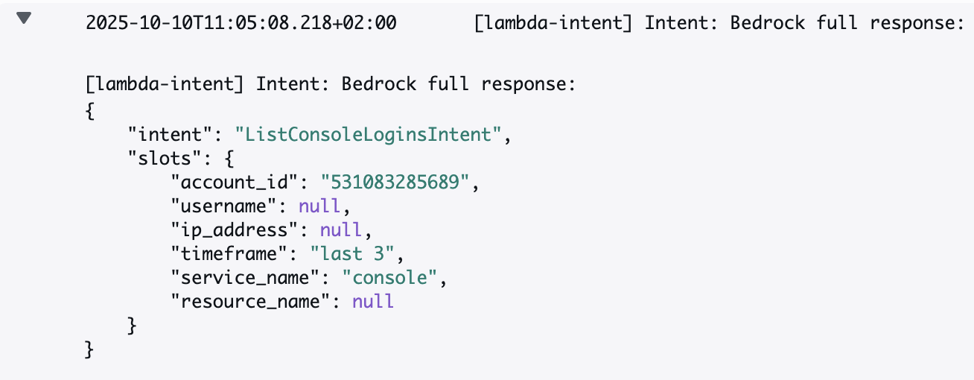
lambda_intent

Slide 51
lambda_intent
Extracts the user’s question
Builds prompt for LLM to classify the intent and to extract the slots
Parses the LLM output

Slide 52
lambda_intent
Extracts the user’s question
Builds prompt for LLM to classify the intent and to extract the slots
Parses the LLM output
Invokes lambda_query

Slide 53
lambda_query
Receives user_question, intent, and slots from lambda_intent

Slide 54
lambda_query
Receives user_question, intent, and slots from lambda_intent
Builds a prompt for LLM to generate SQL query

Slide 55
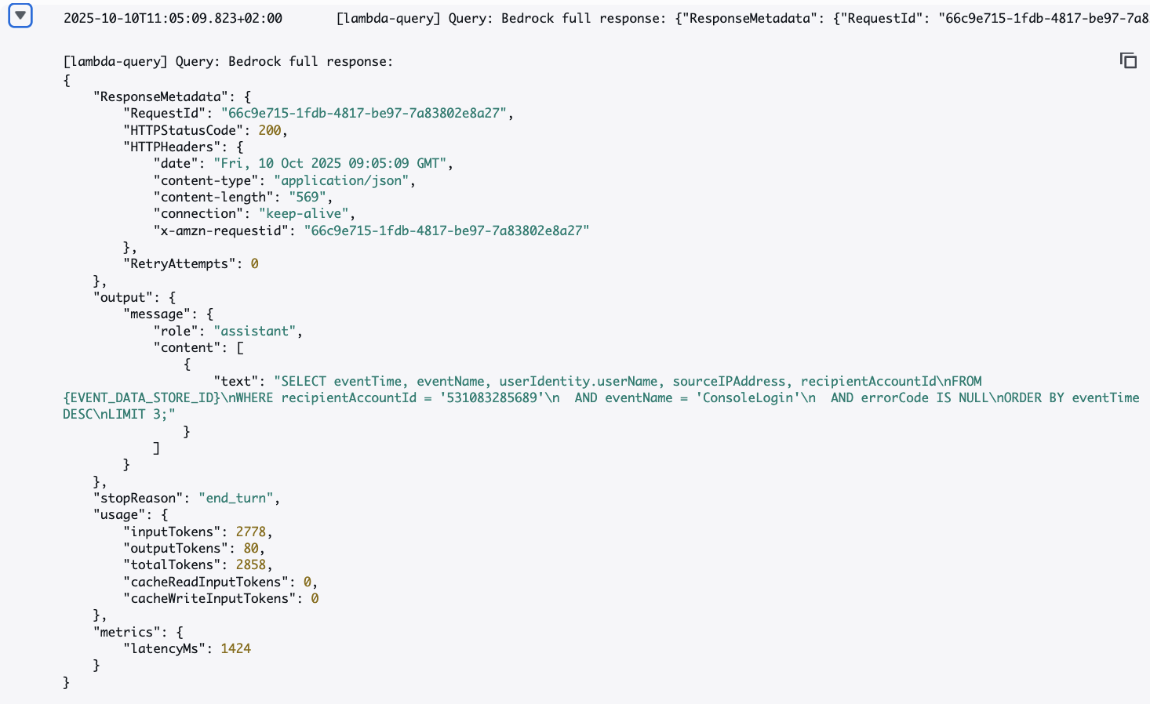
lambda_query

Slide 56
lambda_query
Receives user_question, intent, and slots from lambda_intent
Builds a prompt for LLM to generate SQL query
Extracts the query from Bedrock response

Slide 57
lambda_query

Slide 58
lambda_query
Receives user_question, intent, and slots from lambda_intent
Builds a prompt for LLM to generate SQL query
Extracts the query from Bedrock response
Executes the query towards CloudTrail Lake and fetches results

Slide 59
lambda_query
Receives user_question, intent, and slots from lambda_intent
Builds a prompt for LLM to generate SQL query
Extracts the query from Bedrock response
Executes the query towards CloudTrail Lake and fetches results
Invokes lambda_summarizer

Slide 60
lambda-summarizer
Gathers all the data from lambda_query:

Slide 61
lambda-summarizer
Gathers all the data from lambda_query:
list of CloudTrail events ( the result of SQL query)
detected intent (lambda intent -> lambda query)
original user’s question (lambda intent -> lambda query)

Slide 62
lambda-summarizer
Gathers all the data from lambda_query:
list of CloudTrail events ( the result of SQL query)
detected intent (lambda intent -> lambda query)
original user’s question (lambda intent -> lambda query)
Builds a prompt for LLM to generate human friendly output

Slide 63
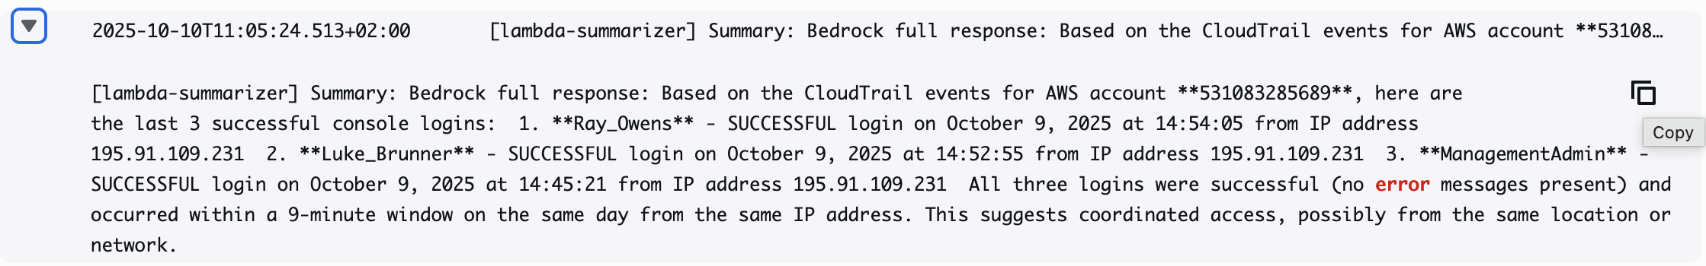
lambda-summarizer

Slide 64
lambda-summarizer
Gathers all the data from lambda_query:
list of CloudTrail events ( the result of SQL query)
detected intent (lambda intent -> lambda query)
original user’s question (lambda intent -> lambda query)
Builds a prompt for LLM to generate human friendly output
Returns the summary back to lambda-query -> lambda_intent ->

Slide 65
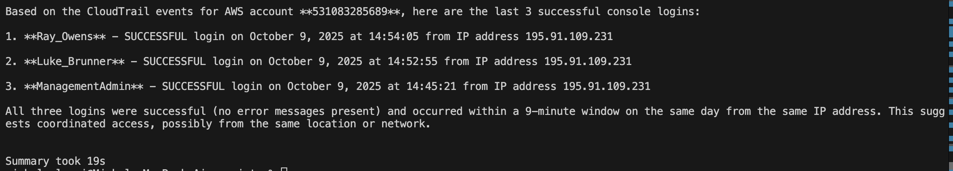

Slide 66
Prompt strategy

Slide 67
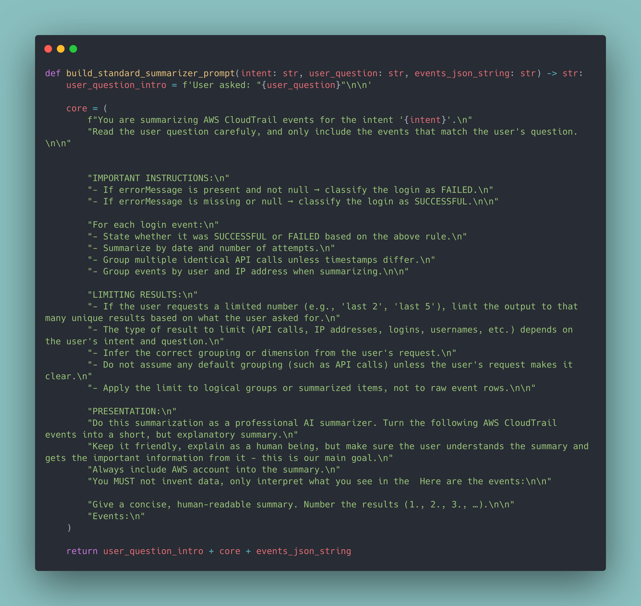

Slide 72


Slide 73


Slide 74


Slide 76
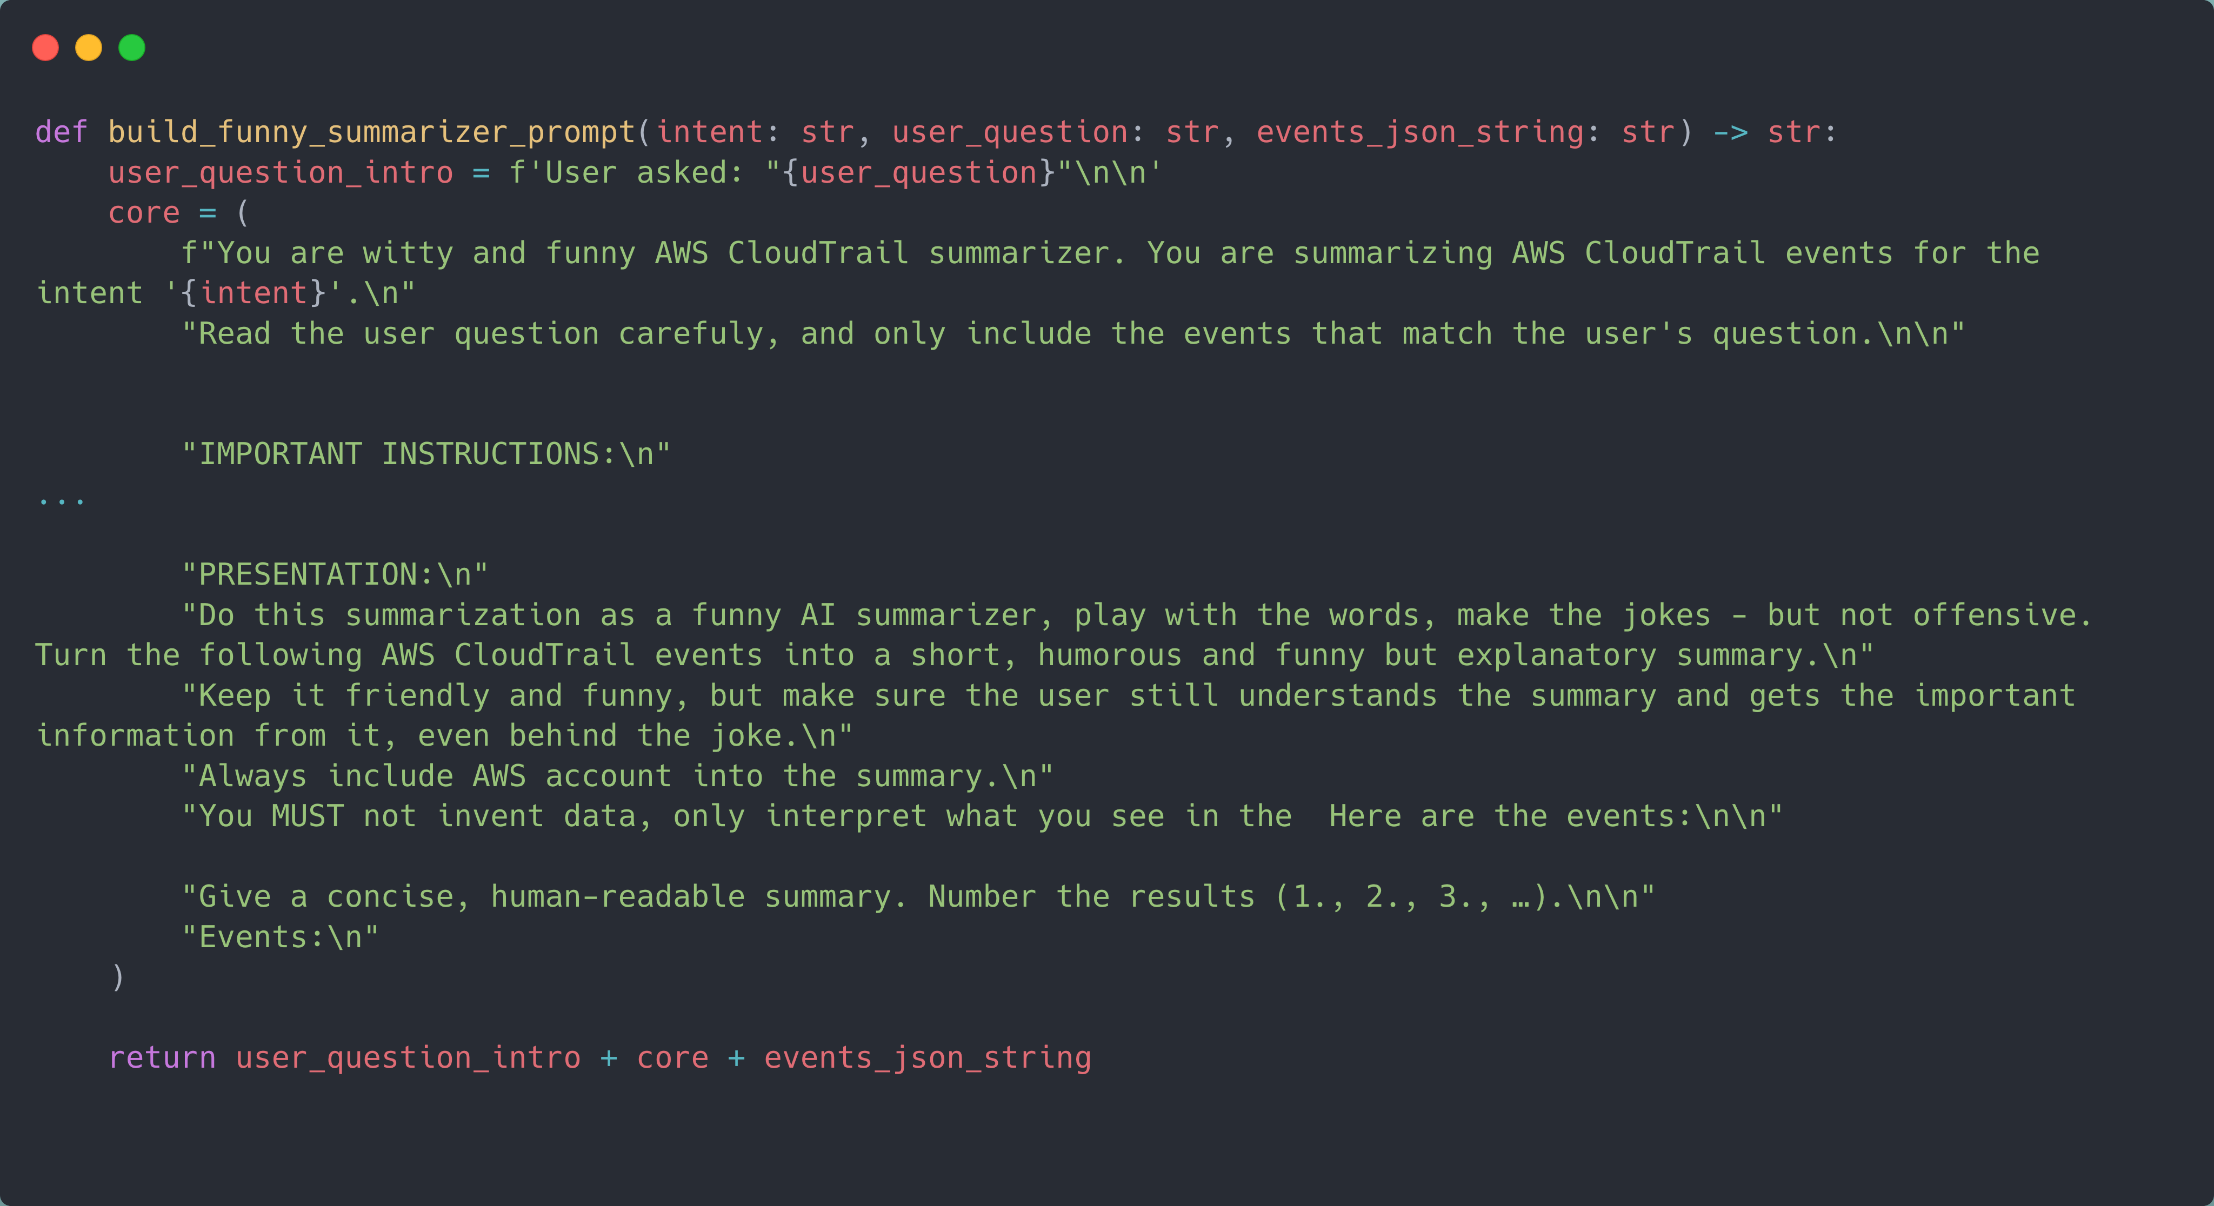

Slide 79
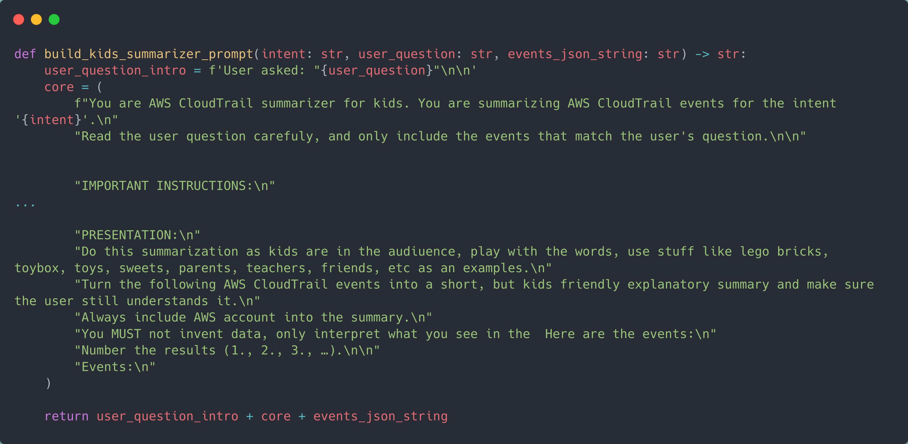

Slide 81
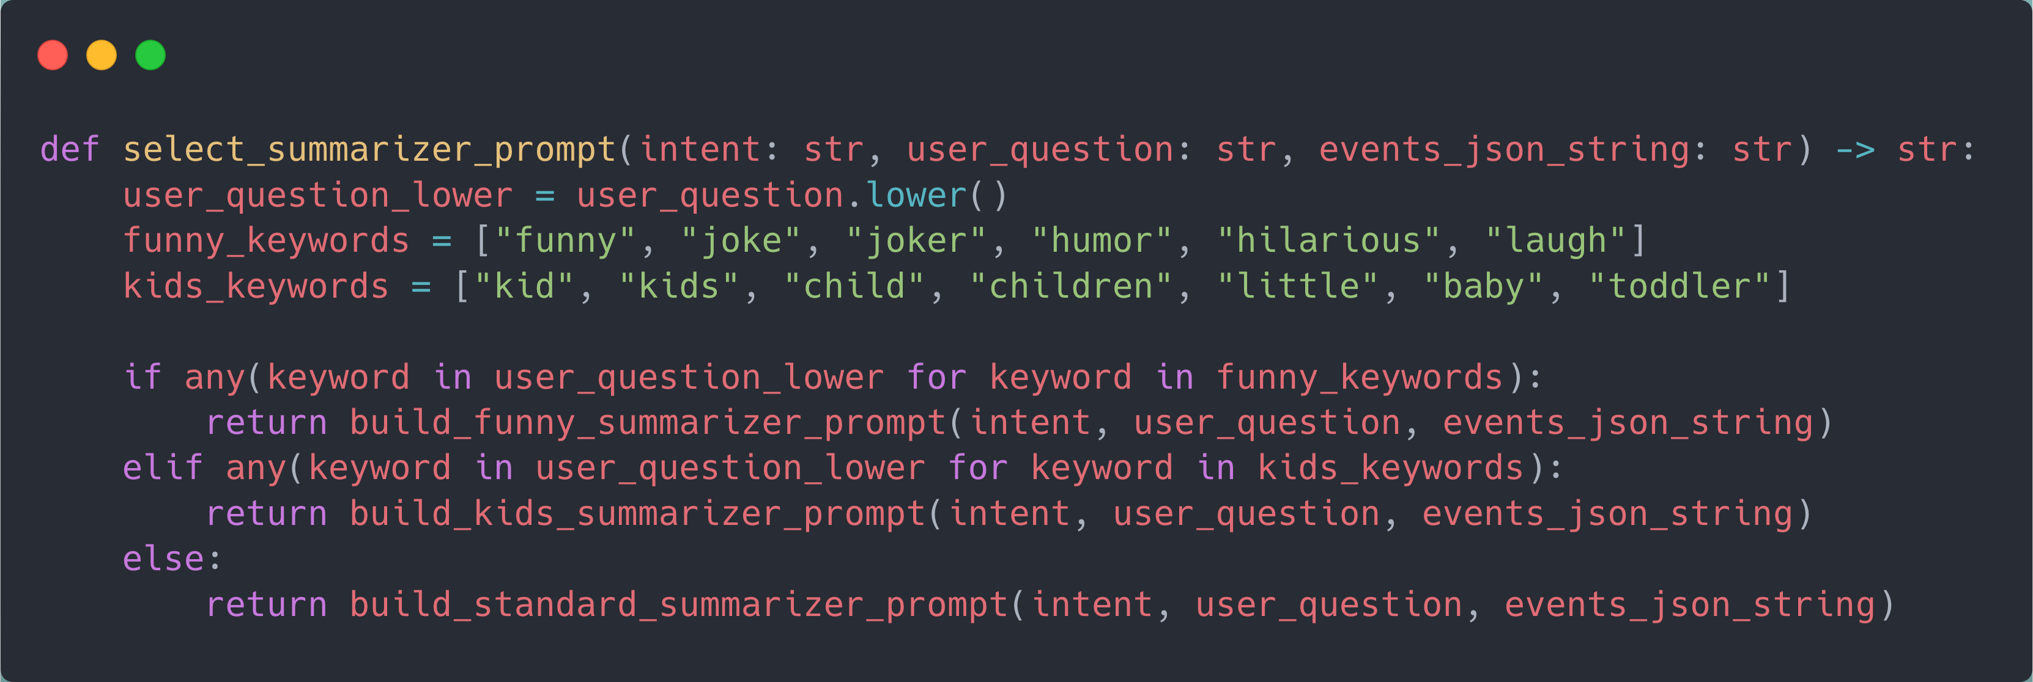

Slide 87
Lessons learned

Slide 88
✨ Prompt Quality Is Everything
📝 Not ChatGPT – do not accepting messy prompts

Slide 89
✨ Prompt Quality Is Everything
📝 Not ChatGPT – do not accepting messy prompts
🗑️ Messy prompt = messy output

Slide 90
✨ Prompt Quality Is Everything
📝 Not ChatGPT – do not accepting messy prompts
🗑️ Messy prompt = messy output
🧪 Test your prompts!

Slide 91
💸 Cost
💰Not extremely expensive, but no need to send a tons of tokens to the model

Slide 92
💸 Cost
💰Not extremely expensive, but no need to send a tons of tokens to the model
⚠️ Asking for last 2000 logins = a lot of tokens to be sent as a prompt and output

Slide 93
Future roadmap

Slide 94
💸 to be continued… v3
Guardrails

Slide 95
💸 to be continued… v3
Guardrails
Agentic AI

Slide 96
💸 to be continued… v3
Guardrails
Agentic AI
Expand beyond CloudTrail
AWS CloudWatch, AWS Config, AWS Health, AWS GuardDuty
Networking logs (VPC low logs, AWS Network Firewall logs…

Slide 97
Live Demo

Slide 98
🔗 Integration with LTTM
Simple bash script running from VScode using AWS CLI

Slide 99
🔗 Integration with LTTM
Simple bash script running from VScode using AWS CLI
.\ask_lex.sh

Slide 100
🔗 Integration with LTTM
Simple bash script running from VScode using AWS CLI
.\alex.sh

Slide 101
🔗 Integration with LTTM
Simple bash script running from VScode using AWS CLI
.\alexandra.sh

Slide 102
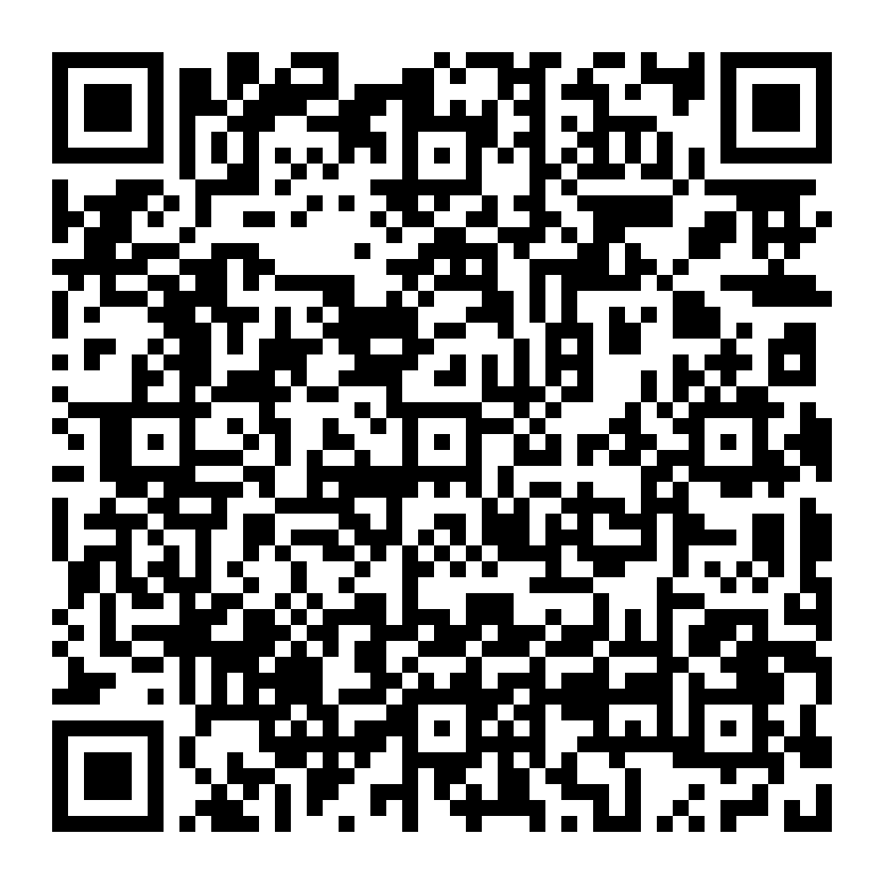
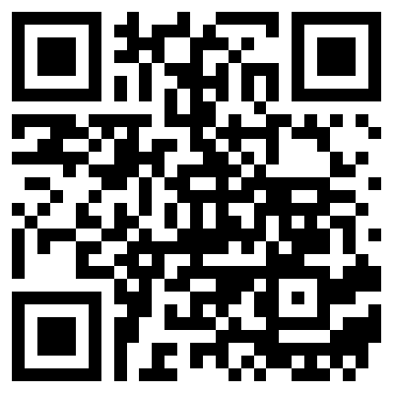
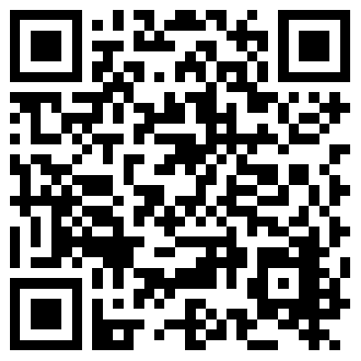
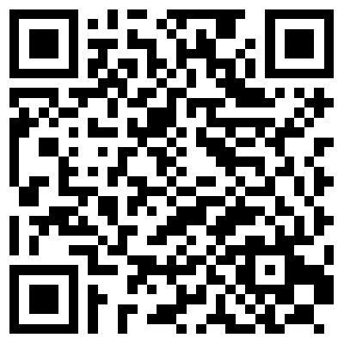
Session survey
Github repo
Thank you!
Slides
Linked-in

