Slide 1
WE ARE DEVELOPERS · SAN JOSE · 23-25 SEPTEMBER 2026
Run Your Agents in Kubernetes
Build once, deploy anywhere. But really?
Michal Salanci
Senior System Engineer @ESET

Slide 2




Michal Salanci
Senior System engineer @ESET
AWS Community Builder
Leader of AWS User Group Kosice

Slide 3
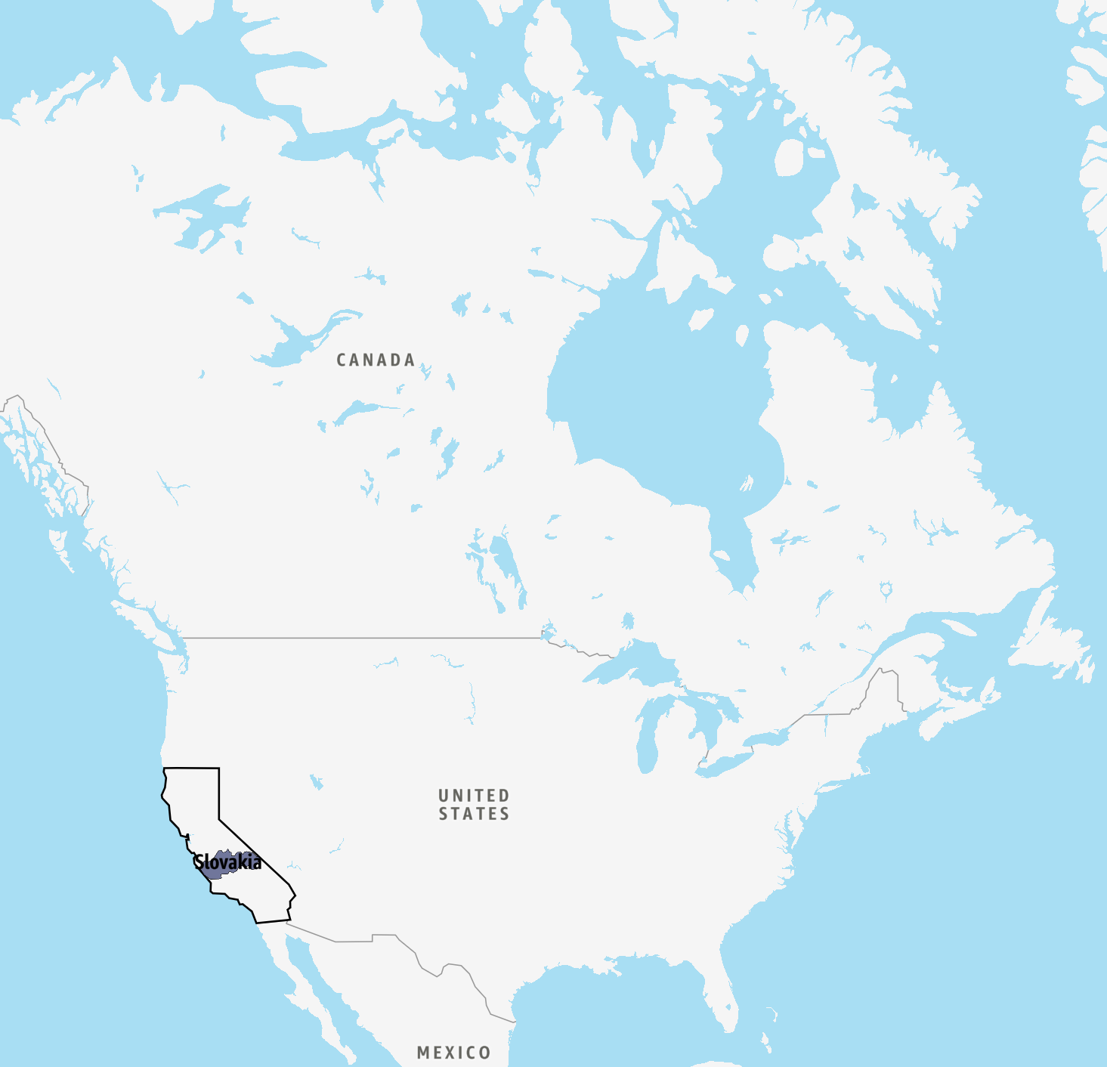
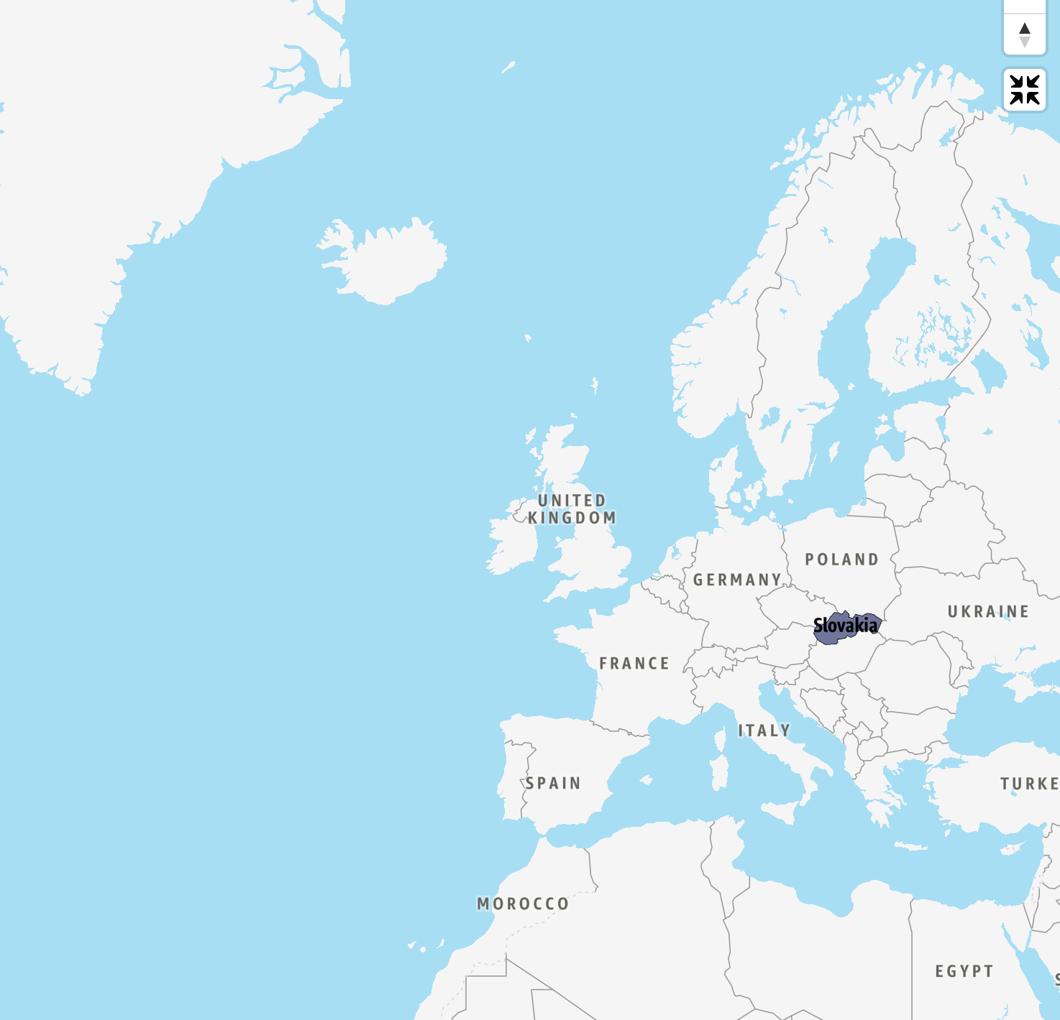
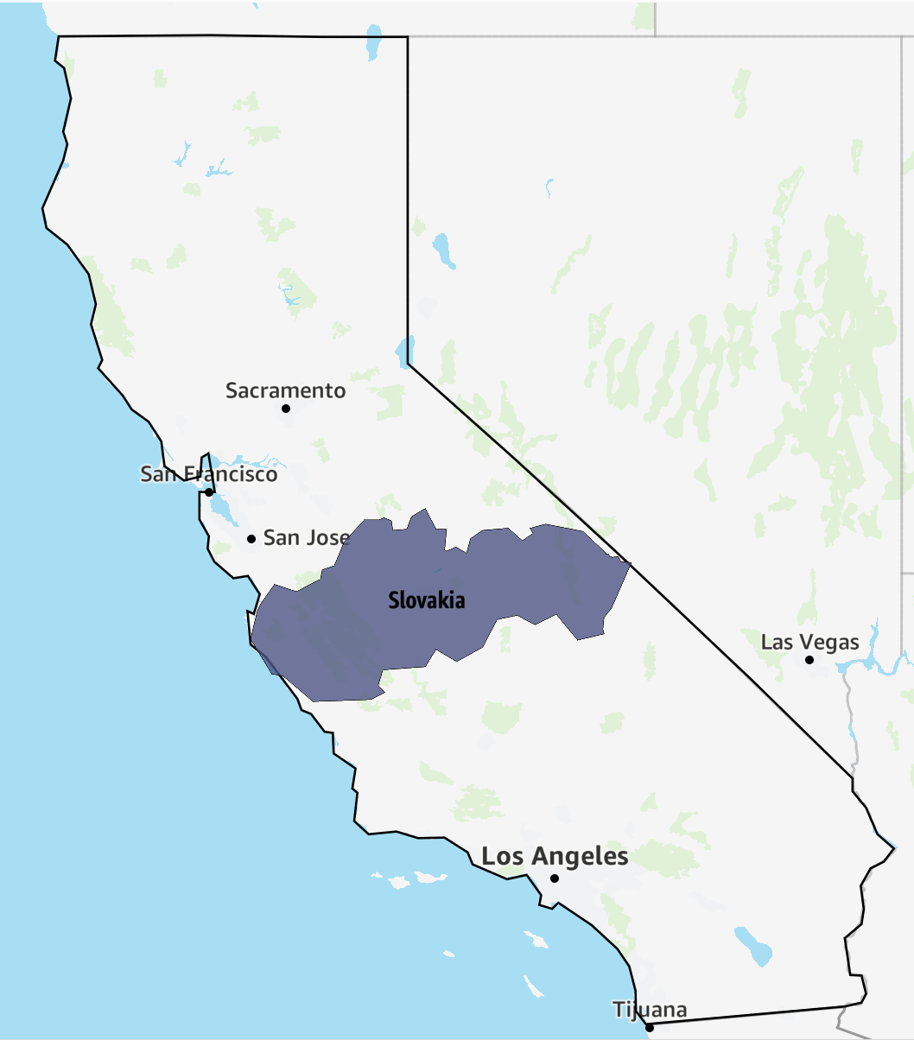
https://www.mylifeelsewhere.com/state-size-comparison

Slide 4
01
PART ONE
Build once
01 — Build once
02 — Deploy anywhere
03 — Where it breaks

Slide 5
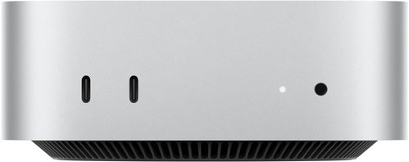
Local workstation

Slide 6
Local workstation
Amazon Bedrock

Slide 7
Local workstation
Amazon Bedrock
Amazon SageMaker AI

Slide 8
Local workstation
Amazon EC2
Amazon Bedrock
Amazon SageMaker AI

Slide 9
Local workstation
Amazon EC2
Amazon Bedrock
AWS Lambda
Amazon SageMaker AI

Slide 10
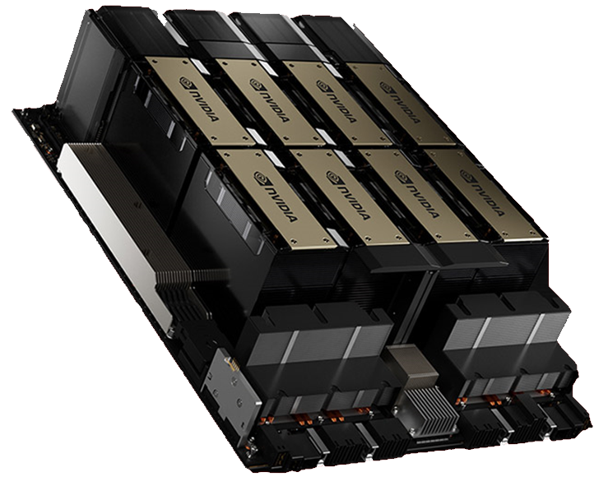
Local workstation
Amazon EC2
Amazon Bedrock
AWS Lambda
GPU server
Amazon SageMaker AI

Slide 11

Local workstation
Amazon EC2
Amazon Bedrock
AWS Lambda
GPU server
Amazon SageMaker AI

Slide 12
01
PART ONE
Build once
01 — Build once
02 — Deploy anywhere
03 — Where it breaks

Slide 13

(Bad) Auntie

Slide 14
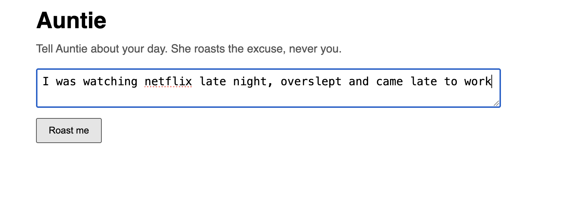

Slide 15
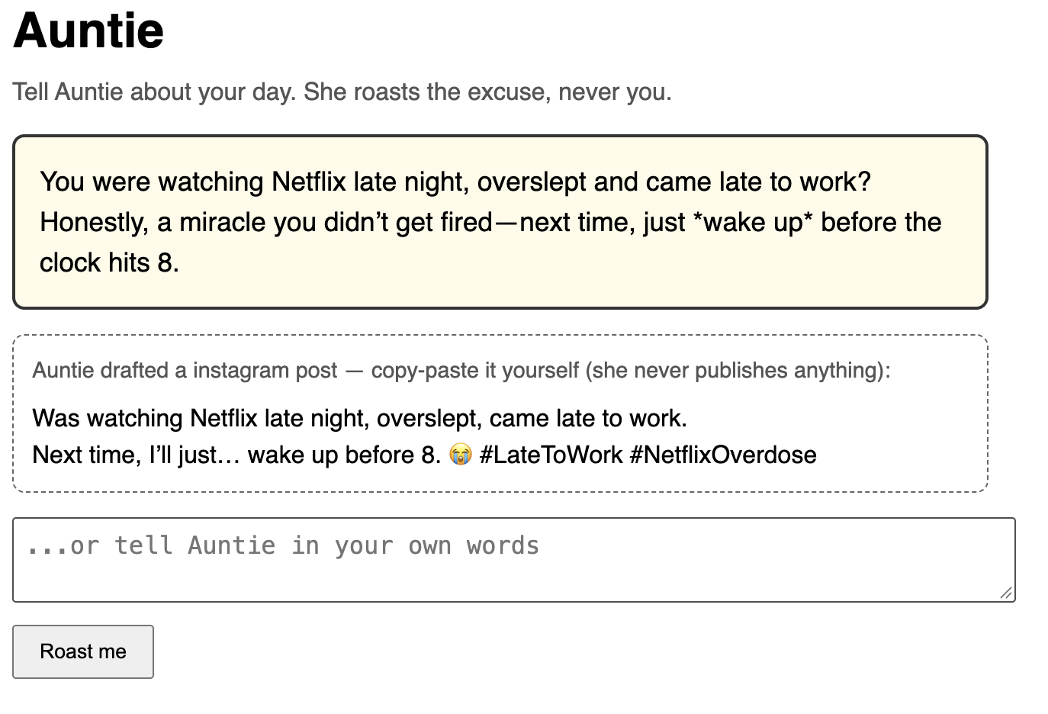

Slide 17
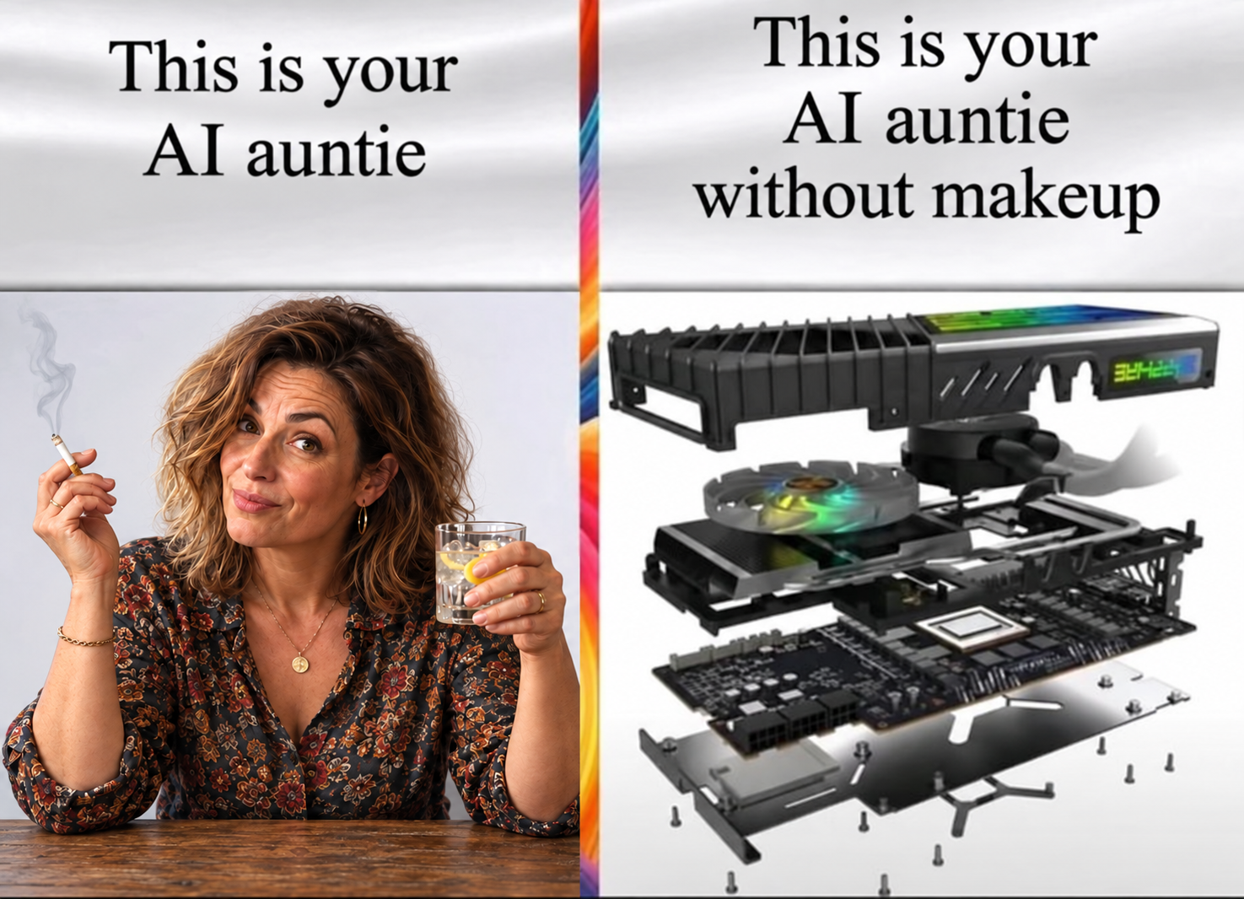

Slide 18
Prompts / Replies
Model
Ollama + Qwen3
Decision making
Agent
Validates decisions
Coordinates model calls
Memory DB
PostgreSQL
Stores past exchanges
Read history
Save exchange

Slide 19
Local kind
Prompts / Replies
Model
Ollama + Qwen3
Decision making
Browser
Agent
Validates decisions
Coordinates model calls
Memory DB
MAC SSD
PostgreSQL
Stores past exchanges
Read history
Save exchange

Slide 20
Apple MacBook Air | M4 (arm64) | 10 CPU cores | 24 GiB RAM
Local kind | 8x CPU, 16 GiB RAM, 1 GB of storage (SSD)
Prompts / Replies
Model
Ollama + Qwen3
Decision making
Agent
Validates decisions
Coordinates model calls
Memory DB
MAC SSD
PostgreSQL
Stores past exchanges
Docker Desktop VM disk
backs PostgreSQL data
Read history
Save exchange

Slide 21
Amazon ECR
Container images
Apple MacBook Air | M4 (arm64) | 10 CPU cores | 24 GiB RAM
Image pulls
Local kind | 8x CPU, 16 GiB RAM, 1 GB of storage (SSD)
Prompts / Replies
Model
Ollama + Qwen3
Decision making
Agent
Validates decisions
Coordinates model calls
Memory DB
MAC SSD
PostgreSQL
Stores past exchanges
Docker Desktop VM disk
backs PostgreSQL data
Read history
Save exchange

Slide 22
Amazon ECR
Container images
Apple MacBook Air | M4 (arm64)
Apple MacBook Air | M4 (arm64) | 10 CPU cores | 24 GiB RAM
Image pulls
Local kind | 8x CPU, 16 GiB RAM, 1 GB of storage (SSD)
Prompts / Replies
Model
Ollama + Qwen3
Decision making
Browser
complaint
Agent
Complaint in
Response out
response
Validates decisions
Coordinates model calls
Memory DB
MAC SSD
PostgreSQL
Stores past exchanges
Docker Desktop VM disk
backs PostgreSQL data
Read history
Save exchange

Slide 23
02
PART TWO
Deploy anywhere
01 — Build once
02 — Deploy anywhere
03 — Where it breaks

Slide 24
Amazon ECR
Container images
AMAZON EKS | eu-central-1
Image pulls
EC2 worker node
Model
runtime
Prompts / Replies
Ollama + Qwen3
Decision making
Browser
Complaint
Agent app
Complaint in
Response out
Response
Validates decisions
Coordinates model calls
EBS
Memory DB
Persistent volume
PostgreSQL
Stores past exchanges
Read history
Save exchange

Slide 25
03
PART THREE
Where it breaks
01 — Build once
02 — Deploy anywhere
03 — Where it breaks

Slide 26
Three pods, none of them ready
$ kubectl --context auntie-eks -n auntie get pods
NAME READY STATUS RESTARTS AGE
agent-app-7b6465c8f9-76fr9 0/1 CrashLoopBackOff 13 (18s ago) 43m
memory-db-0 0/1 Pending 0 43m
model-runtime-79d9f4579-fbrrn 0/1 Running 15 (43s ago) 42m

Slide 27
What CPU-sh do you speak bro?
My Mac spoke ARM64, the EKS node understands AMD64
Neither brought a translator

Slide 28
Agent pod investigation
$ kubectl --context auntie-eks -n auntie describe pod agent-app-7b6465c8f9-76fr9
...
State: Waiting
Reason: CrashLoopBackOff
Last State: Terminated
Reason: Error
Exit Code: 255
...
$ kubectl --context auntie-eks -n auntie logs agent-app-7b6465c8f9-76fr9
exec /usr/local/bin/python: exec format error

Slide 29
The image and the node don’t speak the same
CPU ON THE IMAGE
$ docker image inspect public.ecr.aws/c3m4o8g3/auntie-agent:0.4.10-1 --format '{{.Os}}/{{.Architecture}}'
linux/arm64

Slide 30
The image and the node disagree
CPU ON THE IMAGE
$ docker image inspect public.ecr.aws/c3m4o8g3/auntie-agent:0.4.10-1 --format '{{.Os}}/{{.Architecture}}'
linux/arm64
CPU ON THE EKS NODE
$ kubectl --context auntie-eks get node ip-10-42-1-98.eu-central-1.compute.internal -o jsonpath='{.status.nodeInfo.architecture}{"\n"}'
amd64

Slide 31
The image and the node disagree
CPU ON THE IMAGE
$ docker image inspect public.ecr.aws/c3m4o8g3/auntie-agent:0.4.10-1 --format '{{.Os}}/{{.Architecture}}'
linux/arm64
CPU ON THE EKS NODE
$ kubectl --context auntie-eks get node ip-10-42-1-98.eu-central-1.compute.internal -o jsonpath='{.status.nodeInfo.architecture}{"\n"}'
amd64
arm64 ≠ amd64

Slide 32


Slide 33
The fix: multi-platform image
$ docker buildx build --platform linux/amd64,linux/arm64 -t <image_name:image_tag>

Slide 34
The fix: multi-platform image
$ docker buildx build --platform linux/amd64,linux/arm64 -t <image_name:image_tag>
THE IMAGE THAT SHIPS
linux/amd64 + linux/arm64

Slide 35
Deployed anywhere, stored nowhere
The database asked: Give me a default StorageClass
EKS replied: Which default?

Slide 36
F7 · DEPLOYED ANYWHERE, STORED NOWHERE
public.ecr.aws/c3m4o8g3/auntie-agent:0.4.13@sha256:d4ea0fb795e3
One pod Pending, and it is the one that remembers
The database pod never became ready:
CAPTURED · EKS · NS/AUNTIE
$ kubectl --context auntie-eks -n auntie get pods
NAME READY STATUS RESTARTS AGE
agent-app-7b6465c8f9-76fr9 1/1 Running 0 110s
memory-db-0 0/1 Pending 0 109s
model-runtime-79d9f4579-fbrrnc 0/1 Running 0 109s

Slide 37
F7 · DEPLOYED ANYWHERE, STORED NOWHERE
public.ecr.aws/c3m4o8g3/auntie-agent:0.4.13@sha256:d4ea0fb795e3
One pod Pending, and it is the one that remembers
The database pod never became ready:
CAPTURED · EKS · NS/AUNTIE
$ kubectl --context auntie-eks -n auntie get pods
NAME READY STATUS RESTARTS AGE
agent-app-7b6465c8f9-76fr9 1/1 Running 0 110s
memory-db-0 0/1 Pending 0 109s
model-runtime-79d9f4579-fbrrnc 0/1 Running 0 109s
Even if it could roast (if model pod was working), it won’t remember anything

Slide 38
The claim and the cluster disagree
The claim is waiting for a storage class that does not exist:
$ kubectl --context auntie-eks -n auntie get pvc
NAME STATUS VOLUME CAPACITY ACCESS MODES STORAGECLASS VOLUMEATTRIBUTESCLASS AGE
data-memory-db-0 Pending no-such-storageclass <unset> 5m10s
kubectl --context auntie-eks -n auntie describe pvc data-memory-db-0
Events:
Type Reason Age From Message
---- ------ ---- ---- -------
Normal FailedBinding 5s (x25 over 5m57s) persistentvolume-controller no persistent volumes available for this claim
and no storage class is set
$ kubectl --context auntie-eks get storageclass
NAME PROVISIONER RECLAIMPOLICY VOLUMEBINDINGMODE ALLOWVOLUMEEXPANSION AGE
gp2 kubernetes.io/aws-ebs Delete WaitForFirstConsumer false 6m31s

Slide 39
The fix: enable default storage-class
infra/eks/cluster/ebs.tf
resource "aws_eks_addon" "ebs_csi" {
cluster_name = aws_eks_cluster.this.name
addon_name = "aws-ebs-csi-driver"
configuration_values = jsonencode({
defaultStorageClass = { enabled = true }
})
...
}

Slide 40
$ kubectl --context auntie-eks get storageclass
NAME PROVISIONER RECLAIMPOLICY VOLUMEBINDINGMODE ALLOWVOLUMEEXPANSION AGE
gp2 kubernetes.io/aws-ebs Delete WaitForFirstConsumer false 6m31s
ebs-csi-default-sc (default) ebs.csi.aws.com Delete WaitForFirstConsumer true 1m12s

Slide 41
Started anywhere, ready nowhere
The node had two cores
The model was still loading when the probe ran out of patience

Slide 42
It starts, but never finishes starting
$ kubectl --context auntie-eks -n auntie get pods
NAME READY STATUS RESTARTS AGE
agent-app-7b6465c8f9-76fr9 1/1 Running 0 110s
memory-db-0 1/1 Running 0 109s
model-runtime-79d9f4579-fbrrnc 0/1 CrashLoopBackOff 15 (3m47s ago) 47m

Slide 43
It starts, but never finishes starting
$ kubectl --context auntie-eks -n auntie get pods
NAME READY STATUS RESTARTS AGE
agent-app-7b6465c8f9-76fr9 1/1 Running 0 110s
memory-db-0 1/1 Running 0 109s
model-runtime-79d9f4579-fbrrnc 0/1 CrashLoopBackOff 15 (3m47s ago) 47m
$ kubectl --context auntie-eks -n auntie describe pod -l app=model-runtime
...
Exit Code: 143
Started: Fri, 04 Sep 2026 08:32:34 +0000
Finished: Fri, 04 Sep 2026 08:33:33 +0000
Startup: exec [/bin/sh -c /bin/ollama ps | grep -q 'qwen3:4b-instruct'] delay=0s timeout=4s period=5s #success=1 #failure=12
$ kubectl --context auntie-eks -n auntie logs deploy/model-runtime –previous
...
msg="Load failed" ... error="timed out waiting for llama-server to start"

Slide 44
infra/eks/cluster/terraform.tfvars
t3.medium
node_instance_types = ["t3.medium"]
node_count = 1
2 vCPU, 4 GiB RAM
The node was too small to get the model ready in time—slow startup became a restart loop

Slide 45
The fix: don’t be greedy, get it more resources
infra/eks/cluster/terraform.tfvars
t3.medium
# node_instance_types = ["t3.medium"]
node_instance_types = ["c6a.2xlarge"]
node_count
2 vCPU, 4 GiB RAM
c6a.2xlarge
8 vCPU, 16 GiB RAM
The node was too small to get the model ready in time—slow startup became a restart loop

Slide 46
Build once, redeploy anytime, but into wrong AZ
Come back home buddy

Slide 47
AWS Cloud
eu-central-1a
eu-central-1b
eu-central-1c
t3.medium
gp3

Slide 48
t3.medium > c6a.2xlarge
AWS Cloud
eu-central-1a
eu-central-1b
eu-central-1c
t3.medium
gp3

Slide 49
t3.medium > c6a.2xlarge
AWS Cloud
eu-central-1a
eu-central-1b
eu-central-1c
gp3

Slide 50
t3.medium > c6a.2xlarge
AWS Cloud
eu-central-1a
eu-central-1b
eu-central-1c
c6a.2xlarge
gp3

Slide 51
infra/eks/cluster/eks.tf
resource "aws_eks_node_group" "main" {
...
subnet_ids = aws_subnet.public[*].id

Slide 52
infra/eks/cluster/eks.tf
resource "aws_eks_node_group" "main" {
...
subnet_ids = aws_subnet.public[*].id
Create it into AZ1 or AZ2 or AZ3

Slide 53
The fix: create it into same AZ everytime
infra/eks/cluster/eks.tf
resource "aws_eks_node_group" "main" {
...
# subnet_ids = aws_subnet.public[*].id
subnet_ids = aws_subnet.public[0].id

Slide 54
The fix: create it into same AZ everytime
infra/eks/cluster/eks.tf
resource "aws_eks_node_group" "main" {
...
# subnet_ids = aws_subnet.public[*].id
subnet_ids = aws_subnet.public[0].id
Create it into AZ1

Slide 55
Same image, but also not same image
Same tag, different digest

Slide 56
Image A:
Tag: 0.40.2
Digest sha256:6cf3f9b4…

Slide 57
Image A:
Tag: 0.40.2
Digest sha256:6cf3f9b4…
kind
image reference auntie:0.40.2
pull policy IfNotPresent
node cache Image A

Slide 58
Image A:
Tag: 0.40.2
Digest sha256:6cf3f9b4…
Image B:
Tag: 0.40.2
Digest sha256:2f76875a…
kind
image reference auntie:0.40.2
pull policy IfNotPresent
node cache Image A

Slide 59
Image A:
Tag: 0.40.2
Digest sha256:6cf3f9b4…
Image B:
Tag: 0.40.2
Digest sha256:2f76875a…
kind
EKS
image reference auntie:0.40.2
pull policy IfNotPresent
node cache Image A
image reference auntie:0.40.2
pull policy IfNotPresent
node cache Image B

Slide 60
Image A:
Tag: 0.40.2
Digest sha256:6cf3f9b4…
Image B:
Tag: 0.40.2
Digest sha256:2f76875a…
kind
EKS
image reference auntie:0.40.2
pull policy IfNotPresent
node cache Image A
image reference auntie:0.40.2
pull policy IfNotPresent
node cache Image B
green
≈
green
WHAT THE POD ACTUALLY RAN
WHAT THE POD ACTUALLY RAN
sha256:6cf3f9b4…
≠
sha256:2f76875a…

Slide 61
The fix: proper tagging and digest using

Slide 62
The fix: proper tagging and digest using
image: public.ecr.aws/c3m4o8g3/auntie-agent:<tag>@sha256:<digest>
imagePullPolicy: IfNotPresent

Slide 63
Bigger is not always the better
Faster inference ≠ more users to roast

Slide 64
EC2 worker node
c6a.2xlarge
A faster inference (faster roast)
8 vCPU, 16 GiB RAM
Model
runtime
More cores, or faster cores, for the oneruntime.
Adding agent pods does not make one roast faster.
c6a.4xlarge
16 vCPUs, 32 GiB RAM
Ollama + Qwen3
Decision making
g6.2xlarge
8 vCPUs, 32 GiB RAM, 1 GPU of 24 GB

Slide 65
EC2 worker node
c6a.2xlarge
A faster inference (faster roast)
8 vCPU, 16 GiB RAM
Model
runtime
More cores, or faster cores, for the oneruntime.
Adding agent pods does not make one roast faster.
c6a.4xlarge
16 vCPUs, 32 GiB RAM
Ollama + Qwen3
Decision making
g6.2xlarge
8 vCPUs, 32 GiB RAM, 1 GPU of 24 GB
EC2 worker node
EC2 worker node
EC2 worker node
Increased users capacity
Model
runtime
Model
runtime
Model
runtime
More model pods or increased model slots
Ollama + Qwen3
Decision making
Ollama + Qwen3
Decision making
Ollama + Qwen3
Decision making

Slide 66
Conclusion
Not every good idea is a good idea

Slide 67

THANK YOU
www.michalsalanci.com
Michal Salanci
Senior System Engineer @ESET

