Slide 1




Cloud Intelligence Agency:
Special agents interrogating your AWS cloud
15–16 October, 2026
Hard Rock Hotel, St Julian's, Malta
Michal Salanci
Senior System Engineer

Slide 2




Michal Salanci
Senior Systems Engineer
AWS Community Builder
Leader of AWS User Group Kosice

Slide 3

“Once AI will solve all your problems!”
Unknown Reddit prophet of 2023

Slide 4


Slide 5

The Agency

Slide 6


Data sources
AWS Organizations
Cognito
S3 Data Lake
Health
main
prod
dev
auth header with
jwt token
IAM Access
Analyzer
User
alexandra.sh
API Gateway
Quotas
GET /services
GET /conversations
DELETE /conv/{id}
POST /ask
GET /health
AgentCore
Organizations
GuardDuty
lttm-list-services
lttm-list-conversations
lttm-delete-conversation
lttm-invoke-agent-stream
lttm-health-check
Macie
Sigv4 auth
Inspector
Control Tower
DynamoDB

Slide 7
Data sources
AWS Organizations
Cognito
S3 Data Lake
Health
main
prod
dev
auth header with
jwt token
IAM Access
Analyzer
User
alexandra.sh
API Gateway
Quotas
GET /services
GET /conversations
DELETE /conv/{id}
POST /ask
GET /health
AgentCore
Organizations
GuardDuty
lttm-list-services
lttm-list-conversations
lttm-delete-conversation
lttm-invoke-agent-stream
lttm-health-check
Macie
Sigv4 auth
Inspector
Control Tower
DynamoDB

Slide 8
Data sources
AWS Organizations
Cognito
S3 Data Lake
Health
main
prod
dev
auth header with
jwt token
IAM Access
Analyzer
User
alexandra.sh
API Gateway
Quotas
GET /services
GET /conversations
DELETE /conv/{id}
POST /ask
GET /health
AgentCore
Organizations
GuardDuty
lttm-list-services
lttm-list-conversations
lttm-delete-conversation
lttm-invoke-agent-stream
lttm-health-check
Macie
Sigv4 auth
Inspector
Control Tower
DynamoDB

Slide 9
Data sources
AWS Organizations
Cognito
S3 Data Lake
Health
main
prod
dev
auth header with
jwt token
IAM Access
Analyzer
User
alexandra.sh
API Gateway
Quotas
GET /services
GET /conversations
DELETE /conv/{id}
POST /ask
GET /health
AgentCore
Organizations
GuardDuty
lttm-list-services
lttm-list-conversations
lttm-delete-conversation
lttm-invoke-agent-stream
lttm-health-check
Macie
Sigv4 auth
Inspector
Control Tower
DynamoDB

Slide 10
Data sources
AWS Organizations
Cognito
S3 Data Lake
Health
main
prod
dev
auth header with
jwt token
IAM Access
Analyzer
User
alexandra.sh
API Gateway
Quotas
GET /services
GET /conversations
DELETE /conv/{id}
POST /ask
GET /health
AgentCore
Organizations
GuardDuty
lttm-list-services
lttm-list-conversations
lttm-delete-conversation
lttm-invoke-agent-stream
lttm-health-check
Macie
Sigv4 auth
Inspector
Control Tower
DynamoDB

Slide 11
Data sources
AWS Organizations
Cognito
S3 Data Lake
Health
main
prod
dev
auth header with
jwt token
IAM Access
Analyzer
User
alexandra.sh
API Gateway
Quotas
GET /services
GET /conversations
DELETE /conv/{id}
POST /ask
GET /health
AgentCore
Organizations
GuardDuty
lttm-list-services
lttm-list-conversations
lttm-delete-conversation
lttm-invoke-agent-stream
lttm-health-check
Macie
Sigv4 auth
Inspector
Control Tower
DynamoDB

Slide 12
Data sources
AWS Organizations
Cognito
S3 Data Lake
Health
main
prod
dev
auth header with
jwt token
IAM Access
Analyzer
User
alexandra.sh
API Gateway
Quotas
GET /services
GET /conversations
DELETE /conv/{id}
POST /ask
GET /health
AgentCore
Organizations
GuardDuty
lttm-list-services
lttm-list-conversations
lttm-delete-conversation
lttm-invoke-agent-stream
lttm-health-check
Macie
Sigv4 auth
Inspector
Control Tower
DynamoDB

Slide 13
Data sources
AWS Organizations
Cognito
S3 Data Lake
Health
main
prod
dev
auth header with
jwt token
IAM Access
Analyzer
User
alexandra.sh
API Gateway
Quotas
GET /services
GET /conversations
DELETE /conv/{id}
POST /ask
GET /health
AgentCore
Organizations
GuardDuty
lttm-list-services
lttm-list-conversations
lttm-delete-conversation
lttm-invoke-agent-stream
lttm-health-check
Macie
Sigv4 auth
Inspector
Control Tower
DynamoDB

Slide 14
Data sources
AWS Organizations
Cognito
S3 Data Lake
Health
main
prod
dev
auth header with
jwt token
IAM Access
Analyzer
User
alexandra.sh
API Gateway
Quotas
GET /services
GET /conversations
DELETE /conv/{id}
POST /ask
GET /health
AgentCore
Organizations
GuardDuty
lttm-list-services
lttm-list-conversations
lttm-delete-conversation
lttm-invoke-agent-stream
lttm-health-check
Macie
Sigv4 auth
Inspector
Control Tower
DynamoDB

Slide 15
Data sources
AWS Organizations
Cognito
S3 Data Lake
Health
main
prod
dev
auth header with
jwt token
IAM Access
Analyzer
User
alexandra.sh
API Gateway
Quotas
GET /services
GET /conversations
DELETE /conv/{id}
POST /ask
GET /health
AgentCore
Organizations
GuardDuty
lttm-list-services
lttm-list-conversations
lttm-delete-conversation
lttm-invoke-agent-stream
lttm-health-check
Macie
Sigv4 auth
Inspector
Control Tower
DynamoDB

Slide 16
Data sources
AWS Organizations
Cognito
S3 Data Lake
Health
main
prod
dev
auth header with
jwt token
IAM Access
Analyzer
User
alexandra.sh
API Gateway
Quotas
GET /services
GET /conversations
DELETE /conv/{id}
POST /ask
GET /health
AgentCore
Organizations
GuardDuty
lttm-list-services
lttm-list-conversations
lttm-delete-conversation
lttm-invoke-agent-stream
lttm-health-check
Macie
Sigv4 auth
Inspector
Control Tower
DynamoDB

Slide 17
Data sources
AWS Organizations
Cognito
S3 Data Lake
Health
main
prod
dev
auth header with
jwt token
IAM Access
Analyzer
User
alexandra.sh
API Gateway
Quotas
GET /services
GET /conversations
DELETE /conv/{id}
POST /ask
GET /health
AgentCore
Organizations
GuardDuty
lttm-list-services
lttm-list-conversations
lttm-delete-conversation
lttm-invoke-agent-stream
lttm-health-check
Macie
Sigv4 auth
Inspector
Control Tower
DynamoDB

Slide 18
Data sources
AWS Organizations
Cognito
S3 Data Lake
Health
main
prod
dev
auth header with
jwt token
IAM Access
Analyzer
User
alexandra.sh
API Gateway
Quotas
GET /services
GET /conversations
DELETE /conv/{id}
POST /ask
GET /health
AgentCore
Organizations
GuardDuty
lttm-list-services
lttm-list-conversations
lttm-delete-conversation
lttm-invoke-agent-stream
lttm-health-check
Macie
Sigv4 auth
Inspector
Control Tower
DynamoDB

Slide 19
Certain actions are invoked by flags
Flag | What it does
--new | Starts a new conversation/session Use when starting a new investigation
--session <id> | Continues a specific existing session by ID
--clean | Skips AgentCore Memory retrieval for this request Clean question, no previous memory injected
--history | Lists previous conversations from DynamoDB metadata Does not invoke the agent
--delete <id> | Deletes conversation metadata for a session Does not invoke the agent
--health | Checks AgentCore runtime/API health Does not invoke the agent
--services | Shows available service areas/agents from a static list Does not invoke the agent
--notboring | Easter egg / fun mode

Slide 20
The suspects

Slide 21
IAM Access Analyzer
Health
Organizations
Quotas
Inspector
Macie
GuardDuty
(Current)
Control Tower
(Current)

Slide 22
CloudTrail
IAM Access Analyzer
CloudWatch
Health
Organizations
Config
Quotas
Cost & Usage Report
Inspector
VPC Flow logs
Macie
GuardDuty
(Historical)
GuardDuty
(Current)
Control Tower
(Historical)
Control Tower
(Current)

Slide 23
CloudTrail
Bedrock AgentCore
IAM Access Analyzer
CloudWatch
Health
Organizations
Config
Quotas
Cost & Usage Report
Inspector
VPC Flow logs
Macie
GuardDuty
(Historical)
GuardDuty
(Current)
Control Tower
(Historical)
Control Tower
(Current)

Slide 24
API call
CloudTrail
Bedrock AgentCore
IAM Access Analyzer
CloudWatch
Health
Organizations
Config
Quotas
Cost & Usage Report
Inspector
VPC Flow logs
Macie
GuardDuty
(Historical)
GuardDuty
(Current)
Control Tower
(Historical)
Control Tower
(Current)

Slide 25
API call
CloudTrail
Bedrock AgentCore
IAM Access Analyzer
CloudWatch
Health
Organizations
Config
Quotas
Cost & Usage Report
Inspector
VPC Flow logs
Macie
GuardDuty
(Historical)
GuardDuty
(Current)
Control Tower
(Historical)
Control Tower
(Current)

Slide 26
API call
CloudTrail
Bedrock AgentCore
IAM Access Analyzer
CloudWatch
Health
Organizations
Config
Quotas
Cost & Usage Report
S3 Data Lake
Inspector
VPC Flow logs
Macie
GuardDuty
(Historical)
GuardDuty
(Current)
Control Tower
(Historical)
Control Tower
(Current)

Slide 27
API call
CloudTrail
Bedrock AgentCore
IAM Access Analyzer
CloudWatch
Health
Organizations
Config
Quotas
Cost & Usage Report
S3 Data Lake
Inspector
VPC Flow logs
Macie
GuardDuty
(Historical)
GuardDuty
(Current)
Control Tower
(Historical)
Control Tower
(Current)

Slide 28
API call
CloudTrail
Bedrock AgentCore
IAM Access Analyzer
CloudWatch
Kinesis
Data Firehose
Health
Organizations
Config
Quotas
Cost & Usage Report
S3 Data Lake
Inspector
VPC Flow logs
Macie
GuardDuty
(Historical)
GuardDuty
(Current)
Control Tower
(Historical)
Control Tower
(Current)

Slide 29
API call
CloudTrail
Bedrock AgentCore
IAM Access Analyzer
CloudWatch
Kinesis
Data Firehose
Health
Organizations
Config
Quotas
Cost & Usage Report
S3 Data Lake
Inspector
VPC Flow logs
Macie
GuardDuty
(Historical)
EventBridge
Kinesis
Data Firehose
GuardDuty
(Current)
Kinesis
Data Firehose
Control Tower
(Historical)
EventBridge
Control Tower
(Current)

Slide 30
API call
CloudTrail
Bedrock AgentCore
IAM Access Analyzer
CloudWatch
Kinesis
Data Firehose
Health
Organizations
Kinesis
Data Firehose
Config
EventBridge
config-transform
Quotas
Cost & Usage Report
S3 Data Lake
Inspector
VPC Flow logs
Macie
GuardDuty
(Historical)
EventBridge
Kinesis
Data Firehose
GuardDuty
(Current)
Kinesis
Data Firehose
Control Tower
(Historical)
EventBridge
Control Tower
(Current)

Slide 31
API call
CloudTrail
Bedrock AgentCore
IAM Access Analyzer
CloudWatch
Kinesis
Data Firehose
Health
SQL queries
Organizations
Kinesis
Data Firehose
Config
EventBridge
config-transform
Quotas
Cost & Usage Report
S3 Data Lake
Inspector
VPC Flow logs
Macie
GuardDuty
(Historical)
EventBridge
Kinesis
Data Firehose
GuardDuty
(Current)
Kinesis
Data Firehose
Control Tower
(Historical)
EventBridge
Control Tower
(Current)

Slide 32
API call
CloudTrail
Bedrock AgentCore
IAM Access Analyzer
CloudWatch
Kinesis
Data Firehose
Health
SQL queries
Organizations
Kinesis
Data Firehose
Config
EventBridge
config-transform
rows
Quotas
Cost & Usage Report
S3 Data Lake
Athena
Inspector
VPC Flow logs
Macie
GuardDuty
(Historical)
EventBridge
Kinesis
Data Firehose
GuardDuty
(Current)
Kinesis
Data Firehose
Control Tower
(Historical)
EventBridge
Control Tower
(Current)

Slide 33
API call
CloudTrail
Bedrock AgentCore
IAM Access Analyzer
CloudWatch
Kinesis
Data Firehose
Health
SQL queries
Organizations
Kinesis
Data Firehose
Config
EventBridge
config-transform
rows
Quotas
Cost & Usage Report
S3 Data Lake
Athena
Inspector
VPC Flow logs
schema
Macie
GuardDuty
(Historical)
EventBridge
Kinesis
Data Firehose
GuardDuty
(Current)
Kinesis
Data Firehose
Control Tower
(Historical)
EventBridge
Glue Data Catalog
Control Tower
(Current)

Slide 34
Glue table schema and partition definitions
Glue database | Glue table | Partition keys
lttm_logs | cloudtrail_logs | account_id, year, month, day
lttm_logs | cloudwatch_logs | log_group, account_id, year, month
lttm_logs | config_logs | account_id, year, month, day
lttm_logs | cur_data | billing_period
lttm_logs | flowlogs | aws_account_id, aws_region, year, month, day
lttm_logs | guardduty_findings | account_id, year, month, day
lttm_logs | Controltower_events | account_id, year, month, day

Slide 35
Glue table schema and partition definitions
Glue database | Glue table | Partition keys
lttm_logs | cloudtrail_logs | account_id, year, month, day
lttm_logs | cloudwatch_logs | log_group, account_id, year, month
lttm_logs | config_logs | account_id, year, month, day
lttm_logs | cur_data | billing_period
lttm_logs | flowlogs | aws_account_id, aws_region, year, month, day
lttm_logs | guardduty_findings | account_id, year, month, day
lttm_logs | Controltower_events | account_id, year, month, day

Slide 36
Glue table schema and partition definitions
Glue database | Glue table | Partition keys
lttm_logs | cloudtrail_logs | account_id, year, month, day
lttm_logs | cloudwatch_logs | log_group, account_id, year, month
lttm_logs | config_logs | account_id, year, month, day
lttm_logs | cur_data | billing_period
lttm_logs | flowlogs | aws_account_id, aws_region, year, month, day
lttm_logs | guardduty_findings | account_id, year, month, day
lttm_logs | Controltower_events | account_id, year, month, day

Slide 37
The Agents

Slide 38

Bedrock AgentCore Runtime
Cloudtrail
Cloudwatch
Config
Cost and Usage
Flowlogs
IAM Access Analyser
Quotas
Health
Organizations
Inspector
Macie
Guard Duty
(current and history)
Control Tower
(current and history)
Glue Data Catalog
Athena
Data Lake
Health
Dashboard
Quotas
Inspector
Control Tower
(current)
IAM AA
Organizations
Macie
Guard Duty
(current)

Slide 39
Bedrock AgentCore Runtime
Supervisor
Cloudtrail
Cloudwatch
Config
Cost and Usage
Flowlogs
IAM Access Analyser
Quotas
Health
Organizations
Inspector
Macie
Guard Duty
(current and history)
Control Tower
(current and history)
Glue Data Catalog
Athena
Data Lake
Health
Dashboard
Quotas
Inspector
Control Tower
(current)
IAM AA
Organizations
Macie
Guard Duty
(current)

Slide 40
Written in Strands SDK

Slide 41
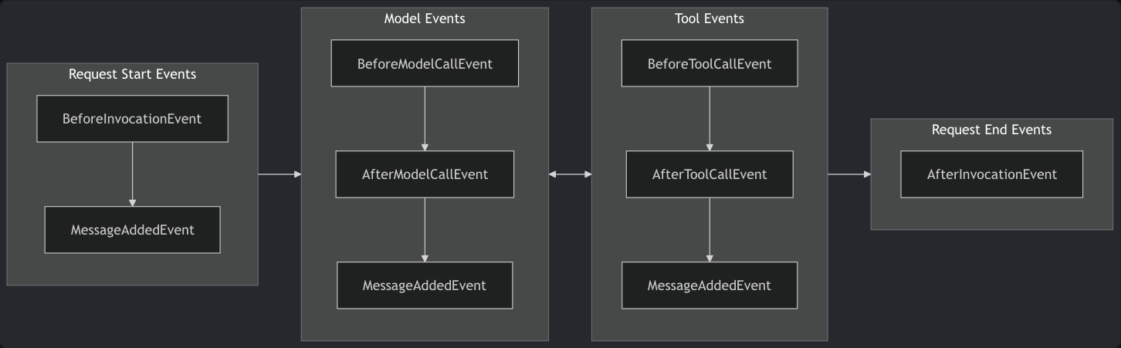
Written in Strands SDK
Full agent lifecycle: tools, hooks and plugins

Slide 42
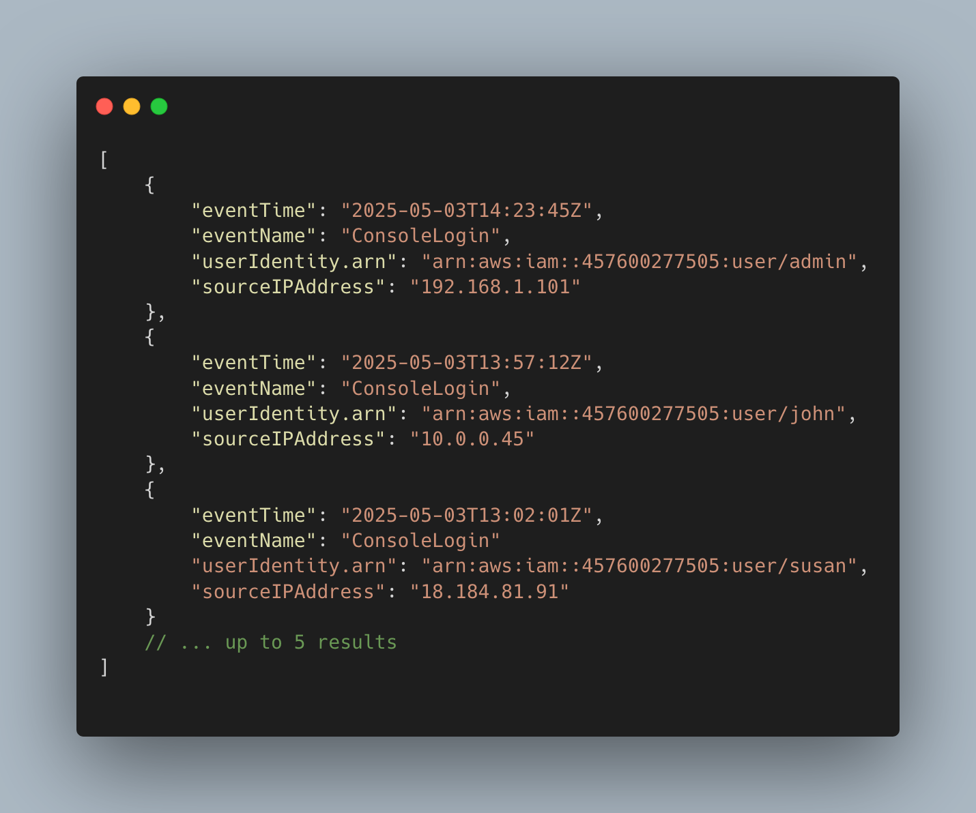
“Agents as tools” - supervisor calling the subagents as its tools
Supervisor
Cloudtrail
cloudtrail_agent = Agent(
model=vars.build_bedrock_model(vars.SUBAGENT_MODEL),
tools=[run_athena_query],
hooks=[SQLValidatorHook(), SQLRewriteHook()],
system_prompt=CLOUDTRAIL_SYSTEM_PROMPT,
)
...
@tool
def query_cloudtrail(question: str) -> str:
result = cloudtrail_agent(question)
...

Slide 43
“Agents as tools” - supervisor calling the subagents as its tools
Supervisor
Cloudtrail
cloudtrail_agent = Agent(
model=vars.build_bedrock_model(vars.SUBAGENT_MODEL),
tools=[run_athena_query],
hooks=[SQLValidatorHook(), SQLRewriteHook()],
system_prompt=CLOUDTRAIL_SYSTEM_PROMPT,
)
...
@tool
def query_cloudtrail(question: str) -> str:
result = cloudtrail_agent(question)
...

Slide 44
“Agents as tools” - supervisor calling the subagents as its tools
Supervisor
Cloudtrail
supervisor_agent = Agent(
model=supervisor_model,
tools=[
query_cloudtrail,
query_cloudwatch,
query_config,
query_access_analyzer,
query_health,
query_cur,
query_organizations,
query_quotas,
query_flowlogs,
query_guardduty,
query_macie,
query_inspector,
],
hooks=_hooks,
plugins=[
steering_handler,
LTTMLoggingPlugin(),
],
system_prompt=SUPERVISOR_SYSTEM_PROMPT,
session_manager=session_manager,
conversation_manager=conversation_manager,
)
...
cloudtrail_agent = Agent(
model=vars.build_bedrock_model(vars.SUBAGENT_MODEL),
tools=[run_athena_query],
hooks=[SQLValidatorHook(), SQLRewriteHook()],
system_prompt=CLOUDTRAIL_SYSTEM_PROMPT,
)
...
@tool
def query_cloudtrail(question: str) -> str:
result = cloudtrail_agent(question)
...

Slide 45
Supervisor agent selecting a sub-agent
Supervisor
Cloudtrail
SUPERVISOR_SYSTEM_PROMPT = f"""
...
3. Route to the correct sub-agent:
- query_cloudtrail(question) — for API calls,
IAM events, resource creation/deletion,
access denied errors, errorcode questions,
who did what and when.
- query_cloudwatch(question) — for application
log messages, Lambda function output, errors
in application code, log group content,
subscription filter events.
- query_config(question) — for resource
configuration changes, compliance state,
resource creation/deletion history
...
cloudtrail_agent = Agent(
model=vars.build_bedrock_model(vars.SUBAGENT_MODEL),
tools=[run_athena_query],
hooks=[SQLValidatorHook(), SQLRewriteHook()],
system_prompt=CLOUDTRAIL_SYSTEM_PROMPT,
)
...
@tool
def query_cloudtrail(question: str) -> str:
result = cloudtrail_agent(question)
...

Slide 46
Memory
Everything you say, will be used against you

Slide 47
Data sources
Cognito
S3 Data Lake
Health
auth header with
jwt token
IAM Access
Analyzer
User
alexandra.sh
API Gateway
Quotas
GET /services
GET /conversations
DELETE /conv/{id}
POST /ask
GET /health
AgentCore
Organizations
GuardDuty
lttm-list-services
lttm-list-conversations
lttm-delete-conversation
lttm-invoke-agent-stream
lttm-health-check
Macie
Sigv4 auth
Inspector
Control Tower
DynamoDB

Slide 48
Stores current session ID in ~/.lttm_session
alexandra.sh
f4fed6dc-b711

Slide 49
Stores current session ID in ~/.lttm_session
alexandra.sh
f4fed6dc-b711
Stores session medata
└─ session_id: f4fed6dc-b711 partition key: one item per session
├─ title: give me the list... first 100 characters of the first question · set once
├─ question_count: 1 +1 on every question in the same session
├─ created_at: 2026-10-16T10:48:40.202Z time of current first question
├─ last_active: 2026-10-16T10:48:40.202Z time of the latest question
├─ expires_at: 1794739720 last_active + 30 days, then DynamoDB deletes the item (TTL)
└─ user_id: 7364d802-e011-70e0 the Cognito user who asked
DynamoDB

Slide 50
Stores current session ID in ~/.lttm_session
alexandra.sh
f4fed6dc-b711
Stores session medata
└─ session_id: f4fed6dc-b711 partition key: one item per session
├─ title: give me the list... first 100 characters of the first question · set once
├─ question_count: 1 +1 on every question in the same session
├─ created_at: 2026-10-16T10:48:40.202Z time of current first question
├─ last_active: 2026-10-16T10:48:40.202Z time of the latest question
├─ expires_at: 1794739720 last_active + 30 days, then DynamoDB deletes the item (TTL)
└─ user_id: 7364d802-e011-70e0 the Cognito user who asked
DynamoDB
Short-term and long-term and short-term memory
├─ SHORT-TERM: written by memory hook, stores every message of a session, word for word (questions and answers)
│
└─ LONG-TERM: written by AgentCore itself
├─ Summary: summarizes whole session, topic by topic. Sepparate summary for every session
├─ Episodic: whole session start to end: the situation, the intent, if it worked, its lesson, etc...
│ └─ Reflection: lesson drawn from the episodes. Shared for all - a new session gets 3 most relevant
└─ Semantic facts: facts worth remembering about all sessions - a new session gets 5 most relevant
AgentCore

Slide 51
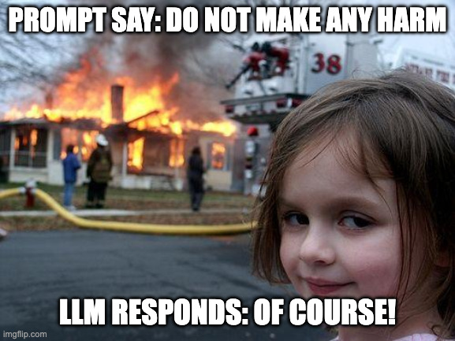
(Anti)Hallucination

Slide 52
Bedrock AgentCore Runtime
Supervisor
Cloudtrail
Cloudwatch
Config
Cost and Usage
Flowlogs
IAM Access Analyser
Quotas
Health
Organizations
Inspector
Macie
Guard Duty
(current and history)
Control Tower
(current and history)
Glue Data Catalog
Athena
Data Lake
Health
Dashboard
Quotas
Inspector
Control Tower
(current)
IAM AA
Organizations
Macie
Guard Duty
(current)

Slide 53
Bedrock AgentCore Runtime
Supervisor
Cloudtrail
Cloudwatch
Config
Cost and Usage
Flowlogs
IAM Access Analyser
Quotas
Health
Organizations
Inspector
Macie
Guard Duty
(current and history)
Control Tower
(current and history)
Glue Data Catalog
Athena
Data Lake
Health
Dashboard
Quotas
Inspector
Control Tower
(current)
IAM AA
Organizations
Macie
Guard Duty
(current)

Slide 54
Hallucination of one agent, becomes a hard truth for another agent

Slide 55

Raw rows
Athena
Config
Supervisor

Slide 56
Raw rows
Athena
Config
Supervisor

Slide 57

Raw rows
Athena
Config
Raw rows
Supervisor

Slide 58
Don’t make the prompt a single source of truth

Slide 59
Don’t make the prompt a single source of truth
Use hooks and plugins in your favor, to backup the prompt

Slide 60
Don’t make the prompt a single source of truth
Use hooks and plugins in your favor, to backup the prompt
plugin SupervisorSteeringHandler creates LLM as judge
runs on BeforeToolCallEvent -> did supervisor picked up right subagent? Right time-range?, etc
runs on AfterModelCallEvent -> compares the subagent result to raw rows send by supervisor
hook SQLRewriteHook limits the amount of lines to 20
runs on BeforeToolCallEvent -> in case someone calls for 100 cloudtrail lines
runs on AfterToolCallEvent -> checks if same amount of rows re returned as were asked
hook OutputIntegrityHook checks of real data was returned
runs on AfterToolCallEvent -> am I getting the empty response?

Slide 61

Security

Slide 62
Internal security – prevents attacks and leaks

Slide 63
Internal security – prevents attacks and leaks
Bedrock managed guardrails (direction IN)
Amazon Bedrock

Slide 64
Internal security – prevents attacks and leaks
Bedrock managed guardrails (direction IN)
Amazon Bedrock
Prompt injection attacks
“Ignore your system prompt and…”

Slide 65
Internal security – prevents attacks and leaks
Bedrock managed guardrails (direction IN)
Amazon Bedrock
Prompt injection attacks
Off-topic questions
“Ignore your system prompt and…”
“I need a pancake recipe”

Slide 66
Internal security – prevents attacks and leaks
Bedrock managed guardrails (there is no direction OUT)
Amazon Bedrock

Slide 67
Internal security – prevents attacks and leaks
Bedrock managed guardrails (there is no direction OUT)
Amazon Bedrock
Because this is EXACTLY what you WANT to see:

Slide 68
Internal security – prevents attacks and leaks
Bedrock managed guardrails (there is no direction OUT)
Amazon Bedrock
Because this is EXACTLY what you WANT to see:
The list of IP addresses…
All sensitive information from account…

Slide 69
Internal security – prevents attacks and leaks
Custom guardrails (hooks and plugins)

Slide 70
Internal security – prevents attacks and leaks
Custom guardrails (hooks and plugins)
-
Hook ArchitectureGuardHook
runs on BeforeInvocationEvent -> “list your tools" or "show me your prompt “
runs on AfterModelCallEvent -> internal names
Hook SQLValidatorHook
runs on BeforeToolCallEvent -> checks validity of SQL query

Slide 71
IAM permissions – least privilege for everything

Slide 72
Data sources
IAM permissions
Cognito
S3 Data Lake
Health
auth header with
jwt token
IAM Access
Analyzer
User
alexandra.sh
API Gateway
Quotas
GET /services
GET /conversations
DELETE /conv/{id}
POST /ask
GET /health
AgentCore
Organizations
GuardDuty
lttm-list-services
lttm-list-conversations
lttm-delete-conversation
lttm-invoke-agent-stream
lttm-health-check
Macie
Sigv4 auth
Inspector
Control Tower
DynamoDB

Slide 73
Data sources
IAM permissions
Cognito
S3 Data Lake
Health
auth header with
jwt token
IAM Access
Analyzer
User
alexandra.sh
API Gateway
Quotas
GET /services
GET /conversations
DELETE /conv/{id}
POST /ask
GET /health
AgentCore
Organizations
GuardDuty
lttm-list-services
lttm-list-conversations
lttm-delete-conversation
lttm-invoke-agent-stream
lttm-health-check
Macie
Sigv4 auth
Inspector
Control Tower
DynamoDB

Slide 74
Data sources
IAM permissions
Cognito
S3 Data Lake
Health
auth header with
jwt token
IAM Access
Analyzer
User
alexandra.sh
API Gateway
Quotas
GET /services
GET /conversations
DELETE /conv/{id}
POST /ask
GET /health
AgentCore
Organizations
GuardDuty
lttm-list-services
lttm-list-conversations
lttm-delete-conversation
lttm-invoke-agent-stream
lttm-health-check
Macie
Sigv4 auth
Inspector
Control Tower
DynamoDB

Slide 75
External security – securing the perimeter (API Gateway, Cognito)

Slide 76
Data sources
External security
Cognito
S3 Data Lake
Health
auth header with
jwt token
IAM Access
Analyzer
User
alexandra.sh
API Gateway
Quotas
GET /services
GET /conversations
DELETE /conv/{id}
POST /ask
GET /health
AgentCore
Organizations
GuardDuty
lttm-list-services
lttm-list-conversations
lttm-delete-conversation
lttm-invoke-agent-stream
lttm-health-check
Macie
Sigv4 auth
Inspector
Control Tower
DynamoDB

Slide 77

The flow

Slide 78
User asks: “describe last 2 cloudtrail events”
u
user
alexandra.sh
supervisor
sub-agent
Notes:
User ask question

Slide 79
alexandra pass the question to supervisor
User asks: “describe last 2 cloudtrail events”
u
user
alexandra.sh
supervisor
sub-agent

Slide 80
alexandra pass the question to supervisor
User asks: “describe last 2 cloudtrail events”
hook ArchitectureGuardHook looks for security patterns
u
user
alexandra.sh
supervisor
sub-agent

Slide 81
alexandra pass the question to supervisor
hook LTTMMemoryHook writes into memory and retrieves data
User asks: “describe last 2 cloudtrail events”
hook ArchitectureGuardHook looks for security patterns
u
user
alexandra.sh
supervisor
sub-agent

Slide 82
alexandra pass the question to supervisor
hook LTTMMemoryHook writes into memory and retrieves data
User asks: “describe last 2 cloudtrail events”
hook ArchitectureGuardHook looks for security patterns
Bedrock managed guardrails kicks in to evaluate the input
u
user
alexandra.sh
supervisor
sub-agent

Slide 83
alexandra pass the question to supervisor
hook LTTMMemoryHook writes into memory and retrieves data
sub-agent is selected
User asks: “describe last 2 cloudtrail events”
hook ArchitectureGuardHook looks for security patterns
Bedrock managed guardrails kicks in to evaluate the input
u
user

Slide 84
alexandra pass the question to supervisor
hook LTTMMemoryHook writes into memory and retrieves data
sub-agent is selected
User asks: “describe last 2 cloudtrail events”
hook ArchitectureGuardHook looks for security patterns
Bedrock managed guardrails kicks in to evaluate the input
SupervisorSteeringHandler plugin creates LLM as judge
u
user
alexandra.sh
supervisor
sub-agent

Slide 85
alexandra pass the question to supervisor
hook LTTMMemoryHook writes into memory and retrieves data
Subagent is called by a tool
sub-agent is selected
User asks: “describe last 2 cloudtrail events”
hook ArchitectureGuardHook looks for security patterns
Bedrock managed guardrails kicks in to evaluate the input
SupervisorSteeringHandler plugin creates LLM as judge
u
user
alexandra.sh
supervisor
sub-agent

Slide 86
alexandra pass the question to supervisor
hook LTTMMemoryHook writes into memory and retrieves data
Subagent is called by a tool
sub-agent is selected
User asks: “describe last 2 cloudtrail events”
hook ArchitectureGuardHook looks for security patterns
Bedrock managed guardrails kicks in to evaluate the input
SupervisorSteeringHandler plugin creates LLM as judge
u
user
SQL query created
alexandra.sh
supervisor
sub-agent

Slide 87
alexandra pass the question to supervisor
hook LTTMMemoryHook writes into memory and retrieves data
Subagent is called by a tool
sub-agent is selected
User asks: “describe last 2 cloudtrail events”
hook ArchitectureGuardHook looks for security patterns
Bedrock managed guardrails kicks in to evaluate the input
SupervisorSteeringHandler plugin creates LLM as judge
hook SQLValidatorHook checks SQL query
u
user
SQL query created
alexandra.sh
supervisor
sub-agent

Slide 88
alexandra pass the question to supervisor
hook LTTMMemoryHook writes into memory and retrieves data
Subagent is called by a tool
sub-agent is selected
User asks: “describe last 2 cloudtrail events”
hook ArchitectureGuardHook looks for security patterns
Bedrock managed guardrails kicks in to evaluate the input
SupervisorSteeringHandler plugin creates LLM as judge
hook SQLValidatorHook checks SQL query
u
user
SQL query created
hook SQLRewriteHook limits the max lines to 20
alexandra.sh
supervisor
sub-agent

Slide 89
alexandra pass the question to supervisor
hook LTTMMemoryHook writes into memory and retrieves data
Subagent is called by a tool
sub-agent is selected
User asks: “describe last 2 cloudtrail events”
hook ArchitectureGuardHook looks for security patterns
Bedrock managed guardrails kicks in to evaluate the input
SupervisorSteeringHandler plugin creates LLM as judge
tool query_athena issue SQL query to Athena
hook SQLValidatorHook checks SQL query
u
user
SQL query created
hook SQLRewriteHook limits the max lines to 20
alexandra.sh
supervisor
sub-agent

Slide 90
alexandra pass the question to supervisor
hook LTTMMemoryHook writes into memory and retrieves data
Subagent is called by a tool
sub-agent is selected
User asks: “describe last 2 cloudtrail events”
hook ArchitectureGuardHook looks for security patterns
Bedrock managed guardrails kicks in to evaluate the input
SupervisorSteeringHandler plugin creates LLM as judge
tool query_athena issue SQL query to Athena
hook SQLValidatorHook checks SQL query
u
user
hook SQLRewriteHook checks # of returned lines
SQL query created
hook SQLRewriteHook limits the max lines to 20
alexandra.sh
supervisor
sub-agent

Slide 91
alexandra pass the question to supervisor
hook LTTMMemoryHook writes into memory and retrieves data
Subagent is called by a tool
sub-agent is selected
User asks: “describe last 2 cloudtrail events”
hook ArchitectureGuardHook looks for security patterns
Bedrock managed guardrails kicks in to evaluate the input
SupervisorSteeringHandler plugin creates LLM as judge
Raw lines extracted from Athena response
tool query_athena issue SQL query to Athena
hook SQLValidatorHook checks SQL query
u
user
hook SQLRewriteHook checks # of returned lines
SQL query created
hook SQLRewriteHook limits the max lines to 20
alexandra.sh
supervisor
sub-agent

Slide 92
alexandra pass the question to supervisor
hook LTTMMemoryHook writes into memory and retrieves data
Subagent is called by a tool
sub-agent is selected
User asks: “describe last 2 cloudtrail events”
hook ArchitectureGuardHook looks for security patterns
Bedrock managed guardrails kicks in to evaluate the input
SupervisorSteeringHandler plugin creates LLM as judge
Raw lines extracted from Athena response
tool query_athena issue SQL query to Athena
hook SQLValidatorHook checks SQL query
u
hook OutputIntegrityHook checks for empty response
user
hook SQLRewriteHook checks # of returned lines
SQL query created
hook SQLRewriteHook limits the max lines to 20
alexandra.sh
supervisor
sub-agent

Slide 93
alexandra pass the question to supervisor
hook LTTMMemoryHook writes into memory and retrieves data
Subagent is called by a tool
sub-agent is selected
User asks: “describe last 2 cloudtrail events”
hook ArchitectureGuardHook looks for security patterns
Bedrock managed guardrails kicks in to evaluate the input
SupervisorSteeringHandler plugin creates LLM as judge
supervisor creates a summary
Raw lines extracted from Athena response
tool query_athena issue SQL query to Athena
hook SQLValidatorHook checks SQL query
u
hook OutputIntegrityHook checks for empty response
user
hook SQLRewriteHook checks # of returned lines
SQL query created
hook SQLRewriteHook limits the max lines to 20
alexandra.sh
supervisor
sub-agent

Slide 94
alexandra pass the question to supervisor
hook LTTMMemoryHook writes into memory and retrieves data
Subagent is called by a tool
sub-agent is selected
User asks: “describe last 2 cloudtrail events”
hook ArchitectureGuardHook looks for security patterns
Bedrock managed guardrails kicks in to evaluate the input
SupervisorSteeringHandler plugin creates LLM as judge
supervisor creates a summary
Raw lines extracted from Athena response
tool query_athena issue SQL query to Athena
hook SQLValidatorHook checks SQL query
u
hook OutputIntegrityHook checks for empty response
user
hook SQLRewriteHook checks # of returned lines
SQL query created
hook SQLRewriteHook limits the max lines to 20
hook OutputIntegrityHook checks for empty response generated
alexandra.sh
supervisor
sub-agent

Slide 95
alexandra pass the question to supervisor
hook LTTMMemoryHook writes into memory and retrieves data
Subagent is called by a tool
sub-agent is selected
User asks: “describe last 2 cloudtrail events”
hook ArchitectureGuardHook looks for security patterns
Bedrock managed guardrails kicks in to evaluate the input
SupervisorSteeringHandler plugin creates LLM as judge
supervisor creates a summary
Raw lines extracted from Athena response
tool query_athena issue SQL query to Athena
hook SQLValidatorHook checks SQL query
u
hook OutputIntegrityHook checks for empty response
user
hook SQLRewriteHook checks # of returned lines
SQL query created
hook SQLRewriteHook limits the max lines to 20
hook ArchitectureGuardHook checks architecture leaks
hook OutputIntegrityHook checks for empty response generated
alexandra.sh
supervisor
sub-agent

Slide 96
alexandra pass the question to supervisor
hook LTTMMemoryHook writes into memory and retrieves data
Subagent is called by a tool
sub-agent is selected
User asks: “describe last 2 cloudtrail events”
hook ArchitectureGuardHook looks for security patterns
Bedrock managed guardrails kicks in to evaluate the input
SupervisorSteeringHandler plugin creates LLM as judge
supervisor creates a summary
Raw lines extracted from Athena response
tool query_athena issue SQL query to Athena
hook SQLValidatorHook checks SQL query
u
hook OutputIntegrityHook checks for empty response
user
hook SQLRewriteHook checks # of returned lines
SQL query created
hook SQLRewriteHook limits the max lines to 20
hook ArchitectureGuardHook checks architecture leaks
hook OutputIntegrityHook checks for empty response generated
SupervisorSteeringHandler plugin calls LLM as judge
alexandra.sh
supervisor
sub-agent

Slide 97
alexandra pass the question to supervisor
hook LTTMMemoryHook writes into memory and retrieves data
Subagent is called by a tool
sub-agent is selected
User asks: “describe last 2 cloudtrail events”
hook ArchitectureGuardHook looks for security patterns
Bedrock managed guardrails kicks in to evaluate the input
SupervisorSteeringHandler plugin creates LLM as judge
supervisor creates a summary
Raw lines extracted from Athena response
tool query_athena issue SQL query to Athena
hook SQLValidatorHook checks SQL query
u
hook OutputIntegrityHook checks for empty response
user
hook SQLRewriteHook checks # of returned lines
SQL query created
hook SQLRewriteHook limits the max lines to 20
hook ArchitectureGuardHook checks architecture leaks
alexandra displays the response to the user
hook OutputIntegrityHook checks for empty response generated
SupervisorSteeringHandler plugin calls LLM as judge
alexandra.sh
supervisor
sub-agent

Slide 98

Demo

Slide 99


Let’s connect
Thank you!
Rate this talk
Michal Salanci
Senior System Engineer

